Slide 1
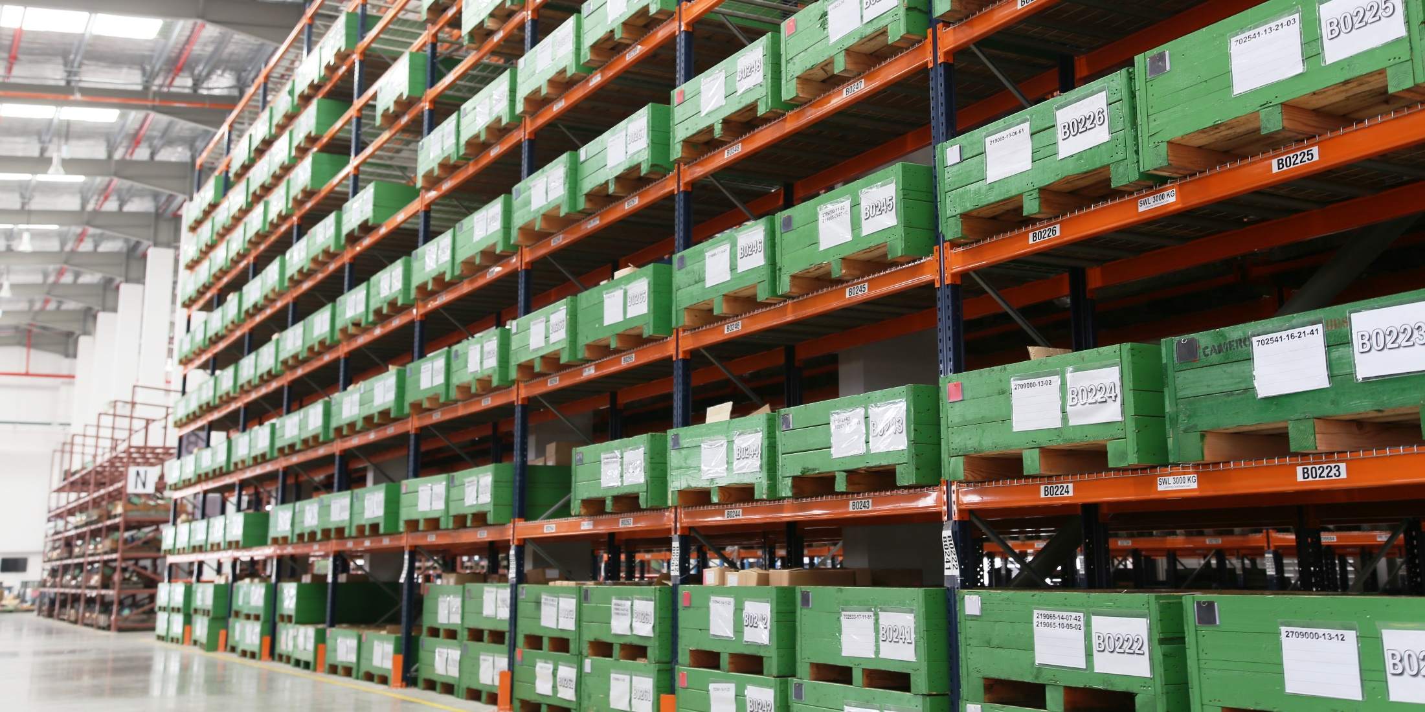
Training slides on Workplace Housekeeping
This set of slides may be used to complement your company’s in-house Workplace Safety & Health (WSH) training for workers.
Workplace housekeeping concerns doing the necessary to make workplaces tidy, clean, organised and safe. With good housekeeping, companies may look forward to increased productivity, improved WSH performance and enhanced corporate image.
All rights reserved, Oct 2016. The information provided in this training slides is accurate at time of publication. All examples shared in this training slides are meant for learning purposes only. The learning points for each example are not exhaustive and should not be taken to encapsulate all the responsibilities and obligations of the user of this training slides under the law. The Workplace Safety and Health Council does not accept any liability or responsibility for any modifications made to this set of training slides.
Notes:
All rights reserved, October 2016. The information provided in this training slides is accurate at time of publication. All examples shared in this training slides are meant for learning purposes only. The learning points for each example are not exhaustive and should not be taken to encapsulate all the responsibilities and obligations of the user of this training slides under the law. The Workplace Safety and Health Council does not accept any liability or responsibility for any modifications made to this set of training slides.

Slide 2
Your company logo here
Workplace Housekeeping
Date
Notes:
Trainer Notes:
Insert your company logo at the top right corner.
Insert the date for version tracking.

Slide 3
Content
Workplace Safety and Health (WSH) Policy
Employee Roles and Responsibilities
Introduction to Workplace Housekeeping
The 5S Approach
Good Housekeeping and WSH
Good Housekeeping Examples
Housekeeping Inspection Checklist
Housekeeping Plan
Notes:
Trainer Notes:
This set of slides (as is) is expected to require a minimum of 60 minutes to complete.
Customise the slides according to your needs and adjust the time required as appropriate.
- select topics that are relevant to your company operations and delete all that are irrelevant
- insert additional topics and/ or company specific examples as required
The workplace housekeeping strategies/ ideas featured are based on common practices employed across industries.
If your company has requirements stricter than those featured in this set of slides, adjust the slides to include your company requirements.

Slide 4
1. WSH Policy
Insert your company’s
WSH Policy here
Notes:
Trainer notes:
Insert your company’s WSH Policy here.
You may wish to explain your WSH Policy to help staff better understand the rationale for the policy and what it covers.

Slide 5
2. Employee Roles and Responsibilities
Report to your supervisor if you are feeling unwell
Follow safe work procedures and instructions
Report any unsafe work condition or practice to your supervisor
…
…
…
…
…
Insert your company’s
WSH rules and regulations here
Notes:
Trainer Notes:
Add on your company’s WSH rules and regulations.

Slide 6
3. Workplace Housekeeping
[Define] Housekeeping
“The routine tasks that must be carried out in order
for a system to function or to function efficiently.”
[Define] Workplace Housekeeping
“Activities undertaken to create or maintain a
tidy, clean, orderly and safe working environment.”
Source: WSH Guidelines on Workplace Housekeeping
Notes:
Trainer Notes:
Housekeeping is relevant in all workplaces – whether at the office, factory, shipyard, construction site, storage facility, hospital, laboratory, retail shop or industrial kitchen.
Housekeeping is not just about the cleanliness of a workplace. It is also about keeping workplaces in order.
Workplace housekeeping may be defined as the routine tasks that must be carried out to create or maintain a tidy, clean, orderly and safe working environment.

Slide 7
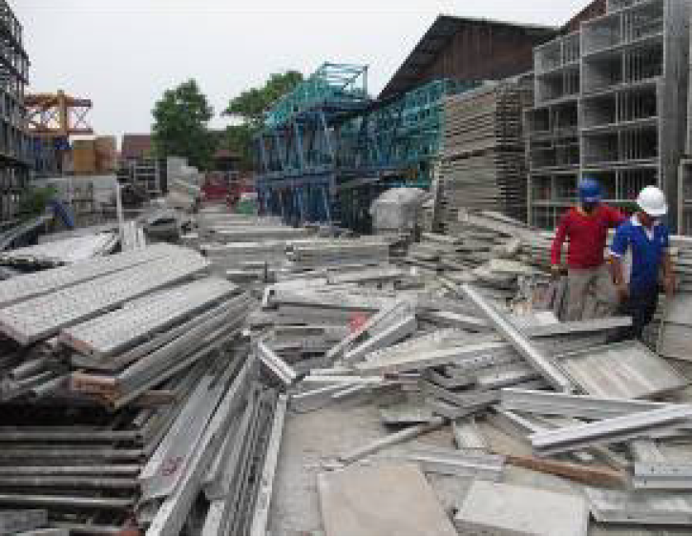
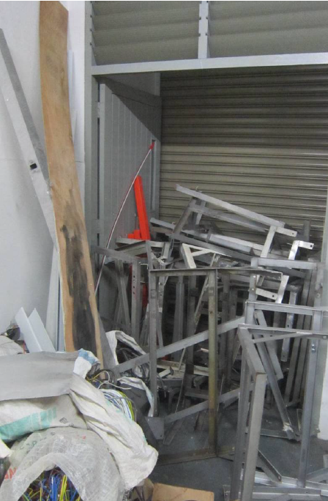
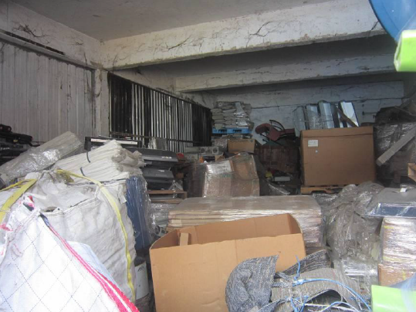
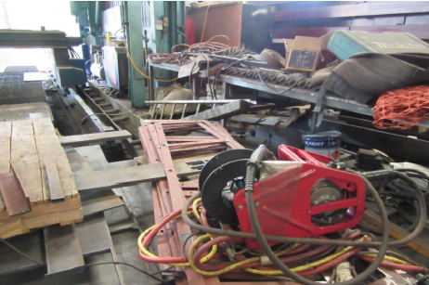
Poor Housekeeping
Industry Examples
Outdoor storage
Source: Ministry of Manpower
Corridor
Storeroom
Workshop
Notes:
Trainer Notes:
These are scenes encountered by MOM Officers during inspections.
Poor housekeeping is often a contributing factor to many workplace accidents.

Slide 8



Good Housekeeping
Tidy
Clean
Orderly
Safe
Notes:
Trainer Notes:
The Library is an excellent example of good workplace housekeeping as its environment is tidy, clean and safe not only for staff but also for public users.
Everything is organized and the exact location of library resources can be pinpointed using the Library Search Catalogue (available both online and via mobile app).

Slide 9

Housekeeping Benefits
Prevent STF
Good for Business
Elimination of hazards
Hygienic working conditions
Improved staff morale & wellbeing
Increased productivity
Improved quality control
Better WSH performance
Effective use of space
Better inventory control
Enhanced company image
Commitment to WSH
Limit Spills
Machine Safety
Traffic Management
Fire Prevention
Fast Evacuation
Proper Storage
Notes:
Trainer Notes:
Housekeeping is good for business. Highlight a few of the bulleted points.
Housekeeping also contributes to proper storage, fire prevention and fast evacuation.
Housekeeping will help to prevent slip, trips & falls, is part of spill control and machine safety. It is also an important aspect of workplace traffic safety mgt.
Housekeeping is essentially a way of saying NO to risks at work and putting measures in place to prevent all injuries.

Slide 10

Workplace Housekeeping
Getting Started
Download: www.wshc.sg
Notes:
Trainer Notes:
Fastest way to get started – download a free copy of the WSH Guidelines on Workplace Housekeeping at: https://www.wshc.sg/files/wshc/upload/infostop/attachments/2016/IS201606290000000406/Workplace_Housekeeping.pdf
Distribute hardcopies of the Guidelines if available.

Slide 11
4. The 5S Approach
Sort
Straighten
Shine
Standardise
Sustain
Workplace Housekeeping and Organisation
Start with these 3 steps:
Step 1: Sort
Step 2: Straighten (Set in Order)
Step 3: Shine
Productivity • Quality • WSH Improvement
Notes:
Trainer Notes:
Introduce the first 3S – Sort, Straighten (Set in Order) and Shine.
These 3S are the cornerstone (core) of any housekeeping programme.
Housekeeping is not just about cleaning, it’s about creating order (organisation) as well.

Slide 12

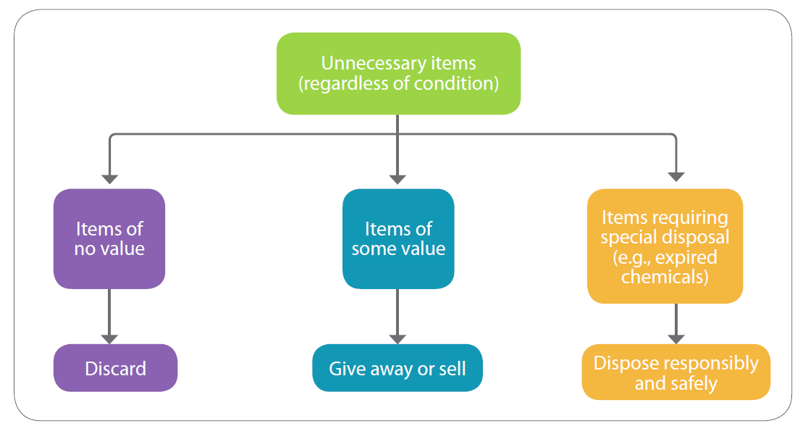
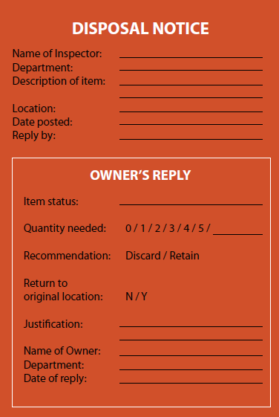
The 5S Approach
Step 1: Sort
Action: Keep only necessary items
Red Tag
Strategy
Notes:
Trainer Notes:
In Sort, the aim is to keep only the necessary items. Sorting is about knowing what to keep and what to remove or discard.
Unnecessary items may be thrown away, given away, sold or disposed responsibly.
Examples of unnecessary items at the workplace include irrelevant or obsolete objects, expired or excess inventory, outdated signs and documents, defective machines & equipment, unwanted furniture, broken tools, etc.
The Red Tag Strategy is a common method used to identify items that are potentially unnecessary.
Items that are potentially unnecessary include workplace items that are in good or working condition but not in use for an extended period.
A red tag (otherwise known as a disposal notice) is placed on item(s) to be evaluated. A red tag typically asks the following:
• Is the item necessary?
• If it is necessary, is it needed in this quantity?
• If it is necessary, does it need to be located here?
Upon receiving the owner’s recommendation, the item may be discarded, relocated or returned to its original location.

Slide 13

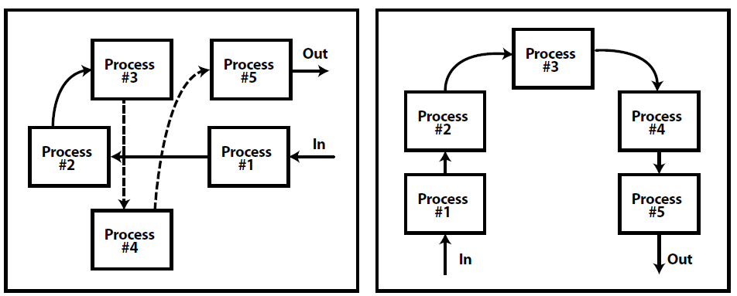
The 5S Approach
Step 2: Straighten (Set in Order)
Action: Organise for better workflow
and easy retrieval
Better workflow
Map of existing layout
New layout
(after rearrangement)
Notes:
Trainer Notes:
For Straighten, the aim is to organise for better workflow and/ or easy retrieval.
On organising for better workflow, companies may use an overview map to determine possible rearrangements to improve WSH and operational efficiency.
The rearrangement may be applied to small or large work areas, for example, a single workstation, the entire shop floor, production line, office or department.
See diagram for an example of how a simple rearrangement can make workplace operations safer and more efficient.

Slide 14
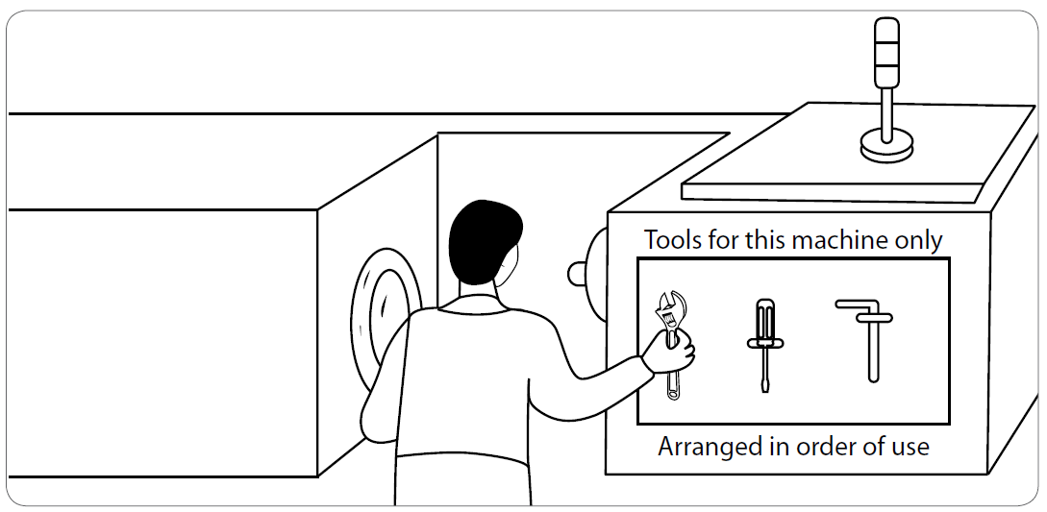
The 5S Approach
Step 2: Straighten (Set in Order)
Easy Retrieval
Tools kept close to the location of work and stored in the order of use.
Notes:
Trainer Notes:
On organising for easy retrieval, the idea is to achieve optimal storage so that things can be easily found, retrieved and returned to their original location(s).
For small objects (e.g., tools), efficiency may be improved by storing items used together and in the sequence in which they are used (see diagram). This will
eliminate or significantly reduce the time taken to carry out the work and ensure that the tools do not become misplaced (which could result in a dangerous
condition and/ or equipment breakdown if left inside a machine).

Slide 15
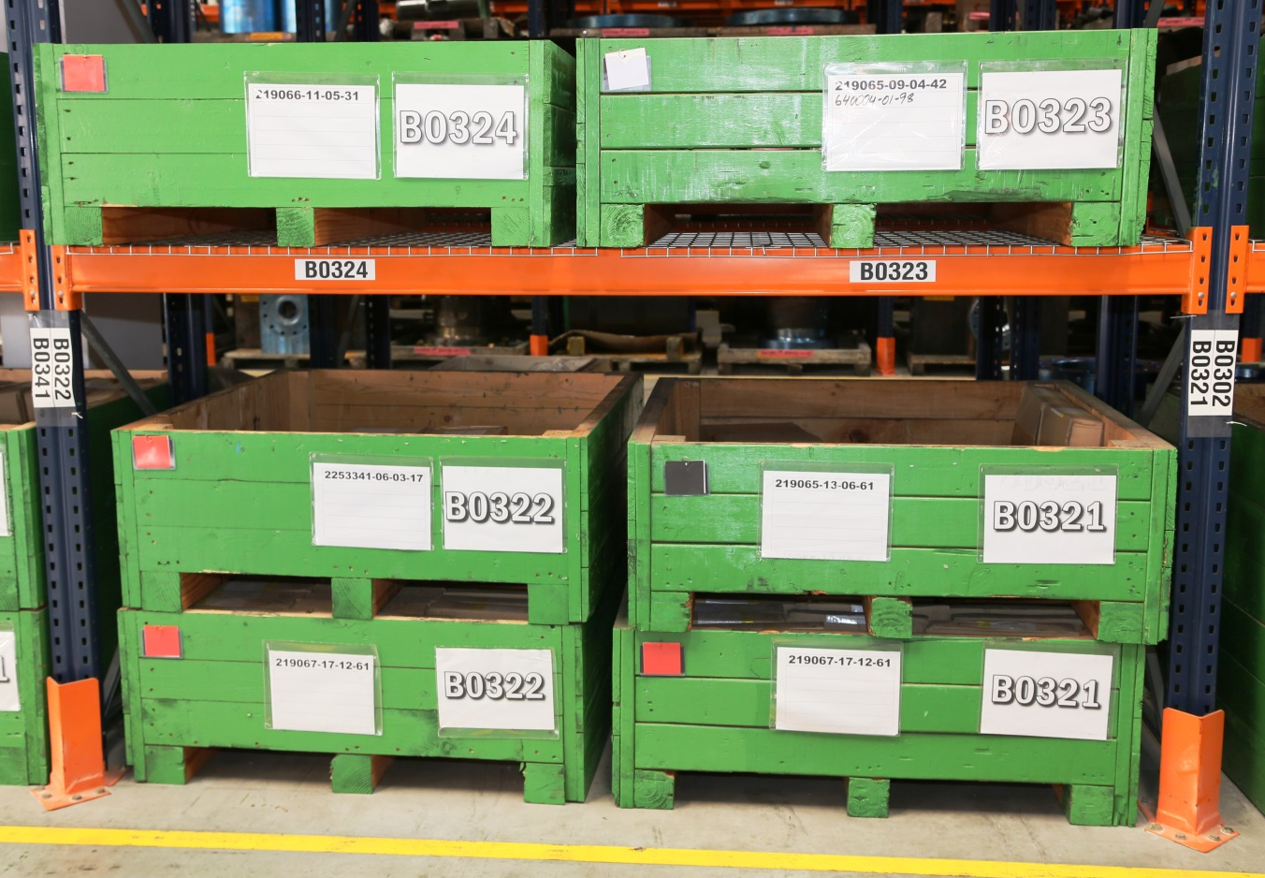
The 5S Approach
Step 2: Straighten (Set in Order)
Visual Order
Photo credit: Cameron Singapore Pte Ltd
(i) Labelling
Notes:
Trainer Notes:
Set in Order includes creating visual order by implementing a visual control management system.
Visual controls refer to any means used to:
• Provide visual instructional guidance on how a task should be carried out;
• Display operating or progress status in an easy-to-see format; and
• Make the abnormality or deviation from the desired standard easy to identify.
Visual control strategies include:-
(i) Labelling - Storage shelf labelling to facilitate quick retrieval and return.

Slide 16
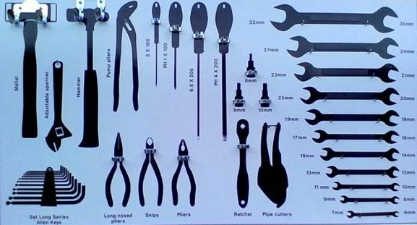
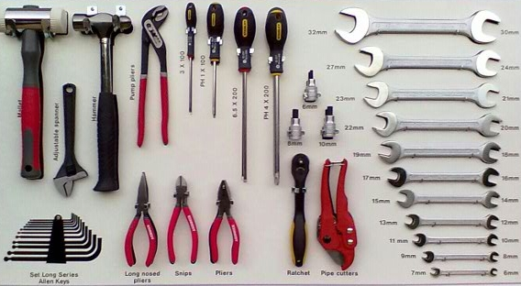
The 5S Approach
Step 2: Straighten (Set in Order)
Visual Order
(ii) Outlining
Notes:
Trainer Notes:
Visual control strategies include:-
(ii) Outlining - Outlines of tools indicate exactly where each tool is kept, the total number of tools, and which tools are in use or missing.

Slide 17
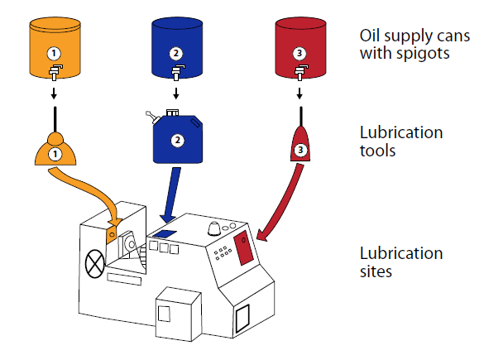
The 5S Approach
Step 2: Straighten (Set in Order)
Visual Order
(iii) Colour Coding
Notes:
Trainer Notes:
Visual control strategies include:-
(iii) Colour coding - Colours are used to ensure that the correct lubricant goes to the correct lubrication site.

Slide 18
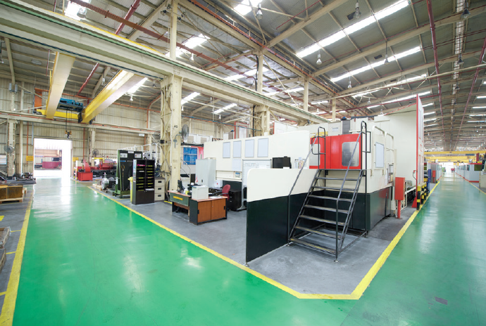
The 5S Approach
Step 2: Straighten (Set in Order)
Visual Order
Photo credit: Cameron Singapore Pte Ltd
(iv) Marking
Notes:
Trainer Notes:
Visual control strategies include:-
(iv) Marking - Floor markings (painted or taped on) to separate process or storage areas from aisles meant for human or vehicular traffic.

Slide 19
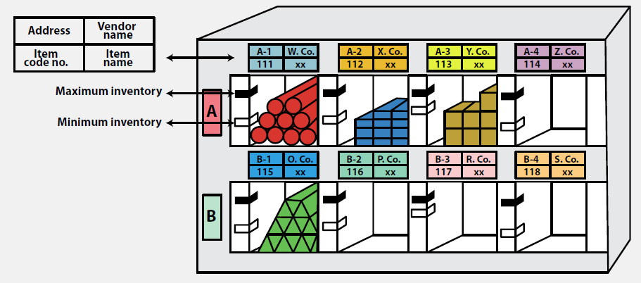
The 5S Approach
More ideas: Visual Order
Label indicators to denote item’s name, code number, location
(e.g., A-1) and maximum & minimum required quantities.
Notes:
Trainer Notes:
Use of labels to indicate item location and required quantities. This will help workers to easily identify abnormally low inventory conditions and take the
necessary action to ensure zero operational downtime and continued operational effectiveness.

Slide 20
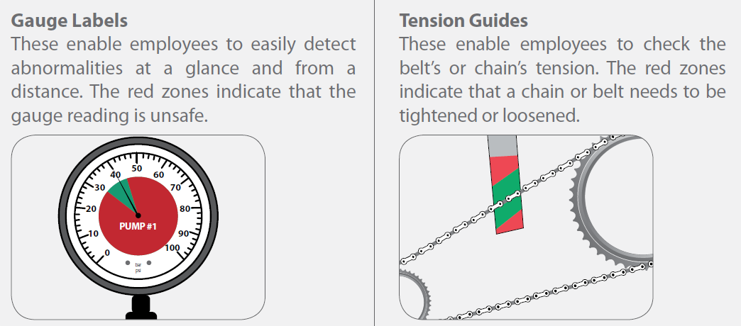
The 5S Approach
More ideas: Visual Order
Labels to indicate safe (green) and dangerous (red) operating zone.
Notes:
Trainer Notes:
Use of red-green gauge labels and tension guides to help workers identify abnormal (or unsafe) operating conditions so that the necessary action
may be taken to return the equipment to a safe operating state.

Slide 21

The 5S Approach
Step 3: Shine
Action: Keep workplace clean, tidy
and in good condition.
Covers both inspection and cleaning
What & where (5S Assignment Map)
Who & when (5S Schedule)
How (Safe Work Procedure)
Inspection: Detecting abnormalities
See • Hear • Smell • Touch
Notes:
Trainer Notes:
In Shine, the aim is to keep the workplace, clean, tidy and in good condition.
A clean workplace makes for a pleasant working environment.
Machines and equipment, if kept clean and in good working condition, will lead to fewer breakdowns, lower operational downtime and fewer late deliveries to customers;
these are prerequisites for the production of quality goods and services.
Shine covers both cleaning and inspection as an inspection is always carried out before cleaning an area or a machine.
Tools for Shine include 5S Assignment Map (what & where), 5S Schedule (who & when) and SWP (how – cleaning tools, procedure, standard).
Note that inspection is not just a visual activity. In fact, almost all of one’s senses may be used to identify abnormalities during an inspection.
See: Examine the machine closely and look for defects (e.g., missing parts, leaks, evidence of wear and tear, deformation or colour change).
Hear: Listen for strange sounds while the machine is operating.
Smell: Use one’s nose to detect burning smells (e.g., due to burning rubber) or other unusual odours (e.g., due to a leak).
Touch: Touch the machine (only if it is safe to do so) to detect excessive vibration or heat and feel for parts that are loose or wobbly.

Slide 22
The 5S Approach
Sort
Straighten
Shine
Standardise
Sustain
Workplace Housekeeping and Organisation
Complete the last 2 steps for
company-wide implementation:
Step 4: Standardise
Step 5: Sustain
Refer to WSH Guidelines on Workplace Housekeeping
for more information.
Notes:
Trainer Notes:
Following Sort, Straighten and Shine, the two remaining steps are Standardise and Sustain.
Standardisation is about creating standards to make Sort, Straighten and Shine a habit.
Strategies include setting up a duty chart, developing SOPs, and establishing the operating standard to be met.
Sustain is about maintaining the standard and implementing initiatives to sustain a 5S programme.
Strategies include implementing a 5S audit system and employee engagement initiatives (e.g., 5S training, newsletters, seminars, dept tours, projects, competitions, rewards, etc).
Refer to WSH Guidelines on Workplace Housekeeping for more information.

Slide 23

Recap
Good workplace housekeeping can eliminate hazards and keep your company organised, productive and safe.
Sort
Set in Order
Shine
Standardise
Sustain
Outlining
Colour
coding
Labelling
Step 1: Sort
Step 2: Straighten
Step 3: Shine
Marking
Visual Order
Tidy • Clean • Orderly • Safe
Notes:
Trainer Notes:
A quick recap of the 5S approach to workplace housekeeping and organisation.
The first 3S (Sort, Straighten, Shine) are the cornerstone (core) of any housekeeping programme.
Straighten involves organising for better workflow and/ or easy retrieval.
Straighten also includes the creation of visual order through labelling, outlining, colour coding and marking.
Good housekeeping will render any workplace tidy, clean, organised and safe.

Slide 24
5. Good Housekeeping and WSH
Housekeeping aspects that can improve WSH include:-
Employee Workspace
Office
chairs
Cabinet drawers
Employee Facilities
Eating
area
Washroom
Floors
Good condition
Clean
Walls
Obstructions (contrasting colours)
Light
colours
Electrical cords
Contaminant removal
Anti-slip
Guarding
(contrasting colours)
Notes:
Trainer Notes:
Employee Workspace
office chairs to be pushed under a desk or counter when not in use
desk and cabinet drawers to be kept closed when not in use
place office equipment such that electrical cords (and extension cables)
do not cut across corridors or common walkways. If this is not
possible, lay them in such a way to avoid becoming tripping hazards
(e.g. by taping them securely to the floor).
Employee Facilities
no eating or drinking in work areas where contaminants are present
washrooms should be cleaned at least once per work shift; soap, paper towels, toilet paper should be provided and, if needed, disinfectants (e.g., in hospitals & clinics)
In particular, special effort must be taken to keep floors of washrooms dry to prevent injuries due to slips and falls.
provide dedicated contaminant removal facilities (e.g. washing area, shower rooms, changing rooms) for employees handling hazardous materials.
Floors
repair or replace any uneven, torn, worn out or damaged flooring or carpets; deploy barriers & warning signs around the unsafe condition until it is repaired or replaced
clean floors regularly and immediately if liquids (including water) or other materials (e.g., oil, powder) are spilled
use anti-slip flooring in work areas that tend to be wet or greasy (e.g., industrial kitchens & washing bays)
Walls
light colours (e.g., white or beige) reflect light making rooms airy, bright and more conducive to work in
use contrasting colours (e.g., red, green, orange, yellow) to mark obstructions such as pillars and low-hanging overhead support beams
contrasting colours may also be used to highlight railings, physical guards and other safety equipment (but should never be used as a substitute for physical guarding)

Slide 25
Good Housekeeping and WSH
Housekeeping aspects that can improve WSH include:-
Aisles & Stairways
Lighting
Take out of service if worn out
Clean every few months
Replace dim lights
Spoilt lights to be repaired
Storage
Storage area demarcation
Pedestrian and forklift access
Anti-slip stairway strips
Keep free from obstruction
Blind
corners
Proper labelling
Tools
Return to designated location
Visual controls
Notes:
Trainer Notes:
Aisles & Stairways
keep aisles & stairways clear at all times; do not use aisles & stairways for storage (not even for temporary storage)
install warning signs and mirrors in blind corners of aisles to improve line of sight
install anti-slip strips along the edge of each stairway step + ensure that all handrails are firmly fixed & stable
Lighting
clean light fixtures regularly and replace lights that are dim so that illumination levels can be maintained
any lights or light fixtures that are not working should be replaced or repaired immediately
Storage
mark floors with coloured tape or paint to indicate storage areas
segregate storage areas from aisles meant for pedestrian or vehicle traffic (e.g., forklifts)
store flammable, corrosive, toxic and other hazardous materials in approved containers in designated areas that are appropriate for the different hazards that they pose
Properly label such containers according to the Globally Harmonised System (GHS) of Classification and Labelling of Chemicals.
Tools
always return tools to their designated location; a misplaced tool not only results in time wasted searching for it, it could also result in a dangerous condition and/ or equipment breakdown if it was left inside a machine
provide suitable fixtures and marked locations on tool boards to allow visual control and encourage neat and orderly arrangement
insert into the SWP that tools are to be inspected prior to each use; any tool found damaged or worn out must be taken out of service

Slide 26
Good Housekeeping and WSH
Housekeeping aspects that can improve WSH include:-
Maintenance
Dust
Regular collection
Vacuum or wet mop
Dust enclosure
Local exhaust ventilation
Spills
Check for leaks and spills
Spill kit
Lock-out
Tag-out procedure
Facility inspection
Preventive maintenance
Secondary containment
Waste
Label for segregation
Optimum bin location
Notes:
Trainer Notes:
Maintenance
include in the housekeeping checklist the need to regularly inspect the condition of company premises (including windows, doors, floors, stairs, sanitary facilities, etc).
Any item found broken, damaged or inoperable should be repaired or replaced as quickly as possible.
put in place a preventive maintenance programme for the inspection, maintenance, upkeep and repair of tools, equipment and machines
insert in the SWP the requirement for energy lock-out tagout (LOTO) to be carried out prior to equipment or machine servicing and maintenance
Dust
vacuum or wet mop dusty floors (do not sweep); dampening a dusty floor prior to mopping will reduce the amount of airborne dust an employee might inhale
limit dust spread by installing dust enclosures on every machine that generates dust
carry out work under local exhaust ventilation (LEV) so that any dust generated can be captured at source
Spills
check storage areas for spills and storage containers for leaks during daily housekeeping inspections
obtain a spill kit and use proper absorbent materials & cleaning agents when cleaning a spill; safely dispose all contaminated cleaning materials
use secondary containment (e.g. a drip tray or by locating a storage cluster within a dike) as a strategy to prevent and control spills
Waste
clearly label all waste receptacles to facilitate easy segregation e.g. general waste, recyclable waste, hazardous waste
locate waste receptacles near work areas where the waste is being generated to encourage proper waste disposal
arrange for regular bulk waste collection (by the general waste collector, recycling company and/ or toxic waste collector) to prevent the accumulation of waste on company premises

Slide 27

6. Good Housekeeping Examples
Industry
Construction
Marine
Manufacturing
Logistics & Transport
Healthcare
Hospitality
Photo credit: Cogent Holdings Ltd
Notes:
Trainer Notes:
Next, we have good housekeeping examples from various industry sectors – so that we can
(i) see how housekeeping is practiced in different settings, and
(ii) brainstorm for more housekeeping ideas that we can apply to our respective work areas.

Slide 28
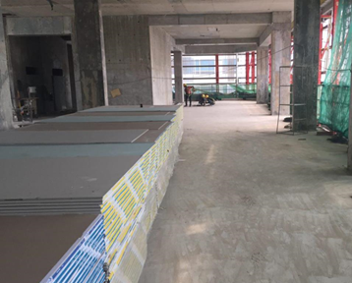
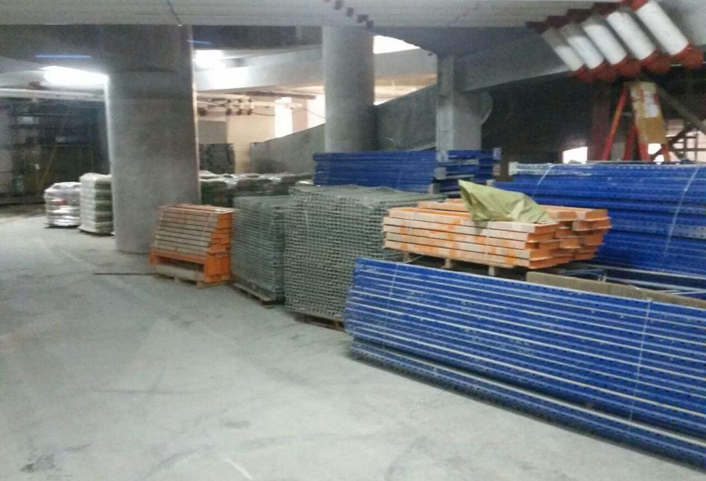
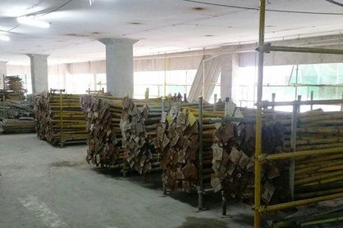
Good Housekeeping
Construction
Tidy and organised storage
Photo credit: Woh Hup Pte Ltd
Storage of reusable items (by part size)
for quick redeployment
Notes:
Trainer Notes:
Recall:-
Workplace Housekeeping: “Activities undertaken to create or maintain a tidy, clean, orderly and safe working environment.”
Refer audience to above construction sector examples:
pathway unobstructed; sufficient space for pedestrian and forklift access
construction materials organised for easy & quick retrieval/ redeployment

Slide 29
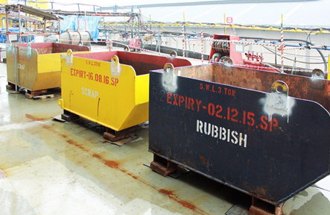



Good Housekeeping
Marine (on board vessel)
Photo credit: Sempcorp Marine Ltd
Storage area demarcation
Waste segregation
Segregation of electrical, gas and water hoses
Demarcated walkway
Notes:
Trainer Notes:
“Tidy, clean, orderly & safe.”
Refer audience to above marine industry examples:
storage area demarcation
waste segregation; labelling
demarcated walkway
segregation of hoses; by colour

Slide 30
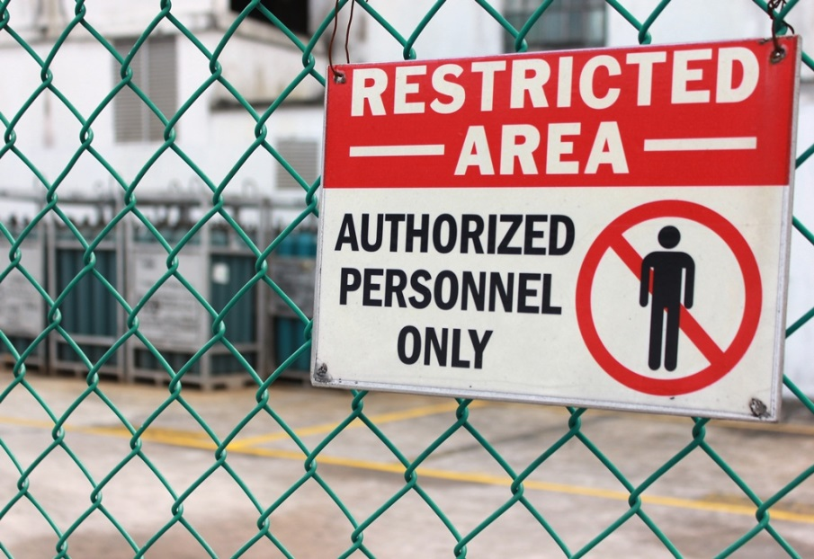
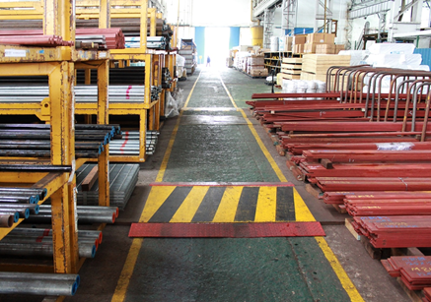
Good Housekeeping
Marine (shipyard)
Isolation of gas storage area with fence and prohibition sign
Photo credit: Sempcorp Marine Ltd
Passageway in storage area
Notes:
Trainer Notes:
“Tidy, clean, orderly & safe.”
Refer audience to above marine industry examples:
fencing to prevent unauthorized entry
demarcated walkway free from obstruction

Slide 31
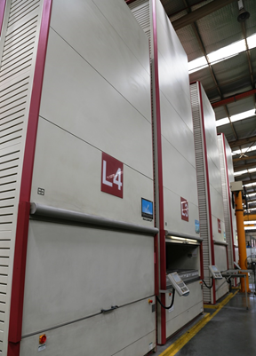
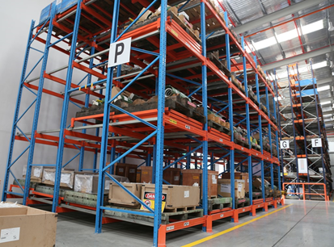
Good Housekeeping
Manufacturing (Metalworking)
Photo credit: Cameron Singapore Pte Ltd
Horizontal push-back sliding racks
Vertical carousel storage system
Notes:
Trainer Notes:
“Tidy, clean, orderly & safe.”
Refer audience to above metalworking industry examples:
use of advanced storage solutions for space optimization and efficient retrieval:
Horizontal push-back sliding racks for large items retrieved based on Last In First Out (LIFO)
Vertical carousel storage system for small items retrieved via computer access

Slide 32
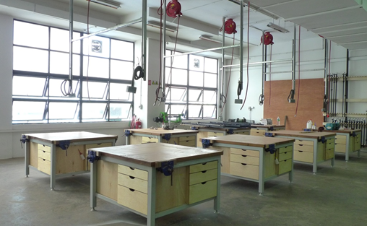
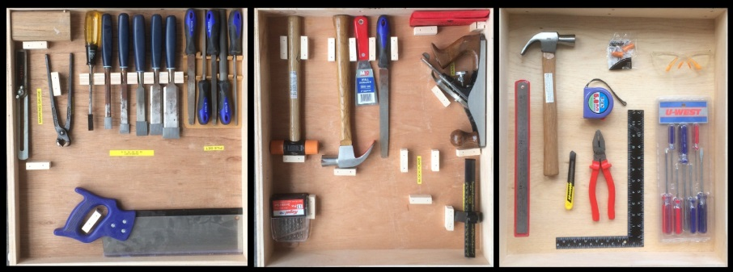
Good Housekeeping
Manufacturing (Woodworking)
Photo credit:
Singapore Furniture Industry Council (SFIC) Institute Pte Ltd
Workshop
layout
Drawer layout
Notes:
Trainer Notes:
“Tidy, clean, orderly & safe.”
Refer audience to above woodworking industry examples:
sufficient space between work benches
floors kept free from wood dust at all times
energy sources available from above (electrical power socket- fixed, pneumatic air hose reel - retractable)
designated location for each tool in the tool drawers (fast retrieval, visual control - ensure no tool is missing)

Slide 33
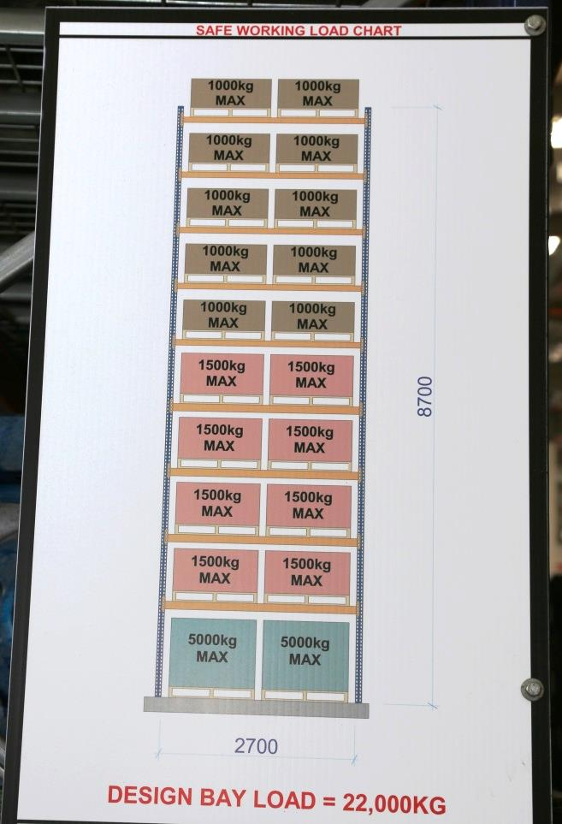
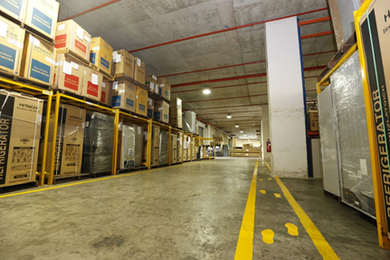
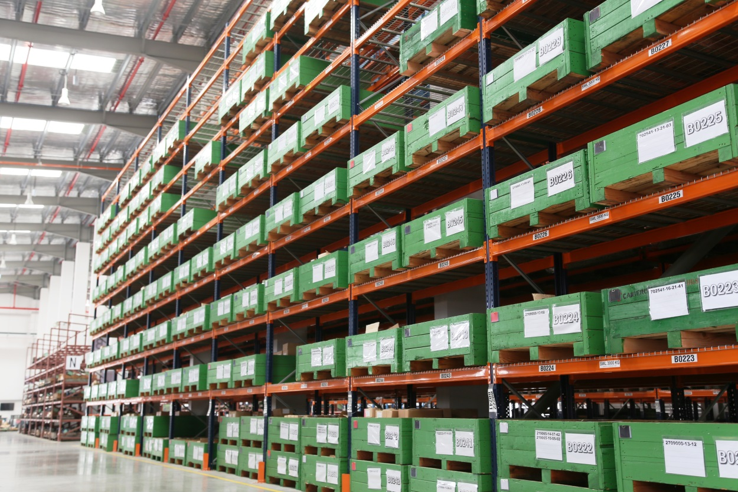
Good Housekeeping
Logistics & Transport (warehouse)
Photo credit: Bok Seng Logistics Pte Ltd
Photo credit: Cameron Singapore Pte Ltd
Demarcated walkway
Engineered racking
Notes:
Trainer Notes:
“Tidy, clean, orderly & safe.”
Refer audience to above warehousing examples:
demarcated walkway to separate pedestrian from forklift access
use of engineered storage racks (10 tiers) with safe working load chart

Slide 34
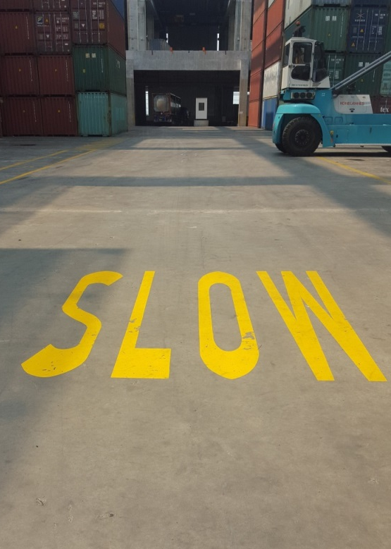

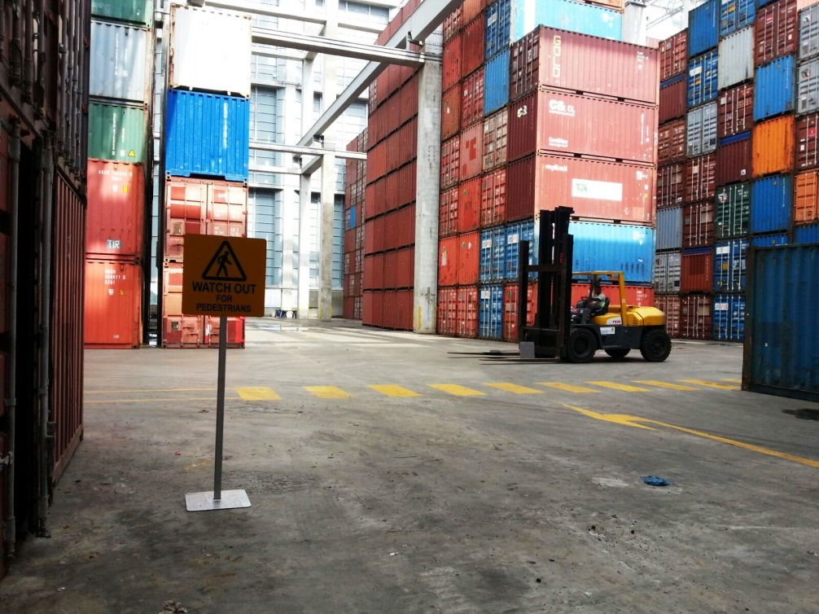
Good Housekeeping
Logistics & Transport (container depot)
Photo credit: Cogent Holdings Ltd
Neatly stacked containers
Pedestrian crossing,
warning sign for drivers.
Notes:
Trainer Notes:
“Tidy, clean, orderly & safe.”
Refer audience to above container depot examples:
containers stacked up neatly in designated locations
demarcated walkway to separate pedestrian from vehicle access
floor markings & warning signs to regulate traffic flow within work area

Slide 35
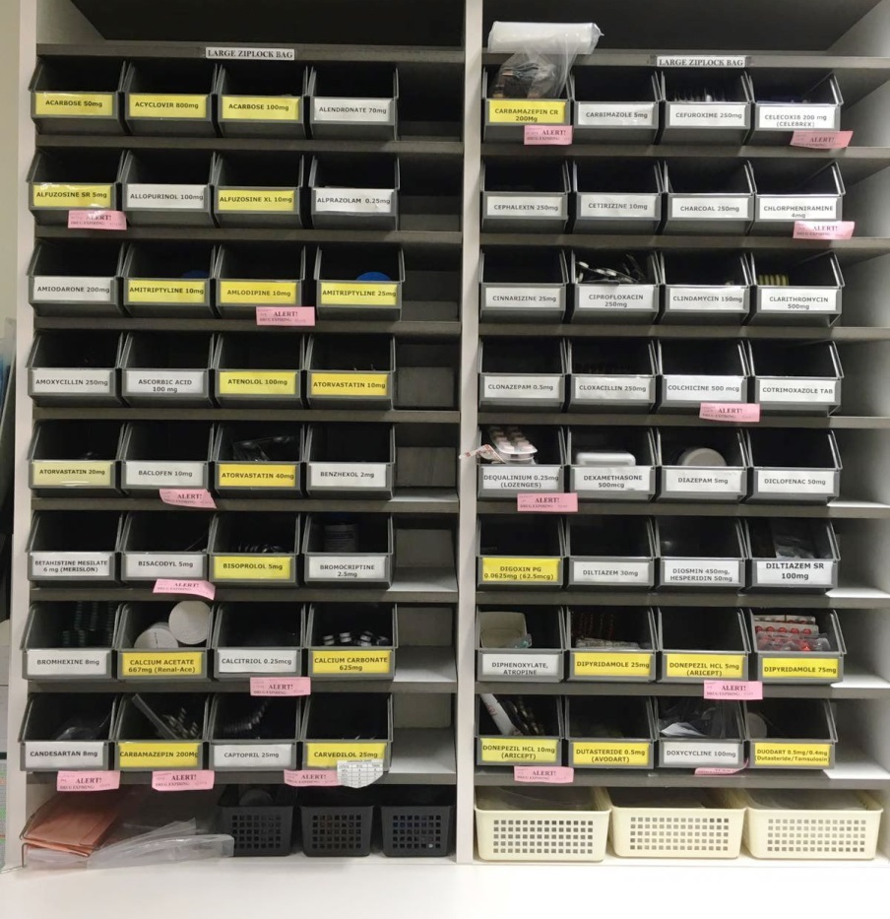
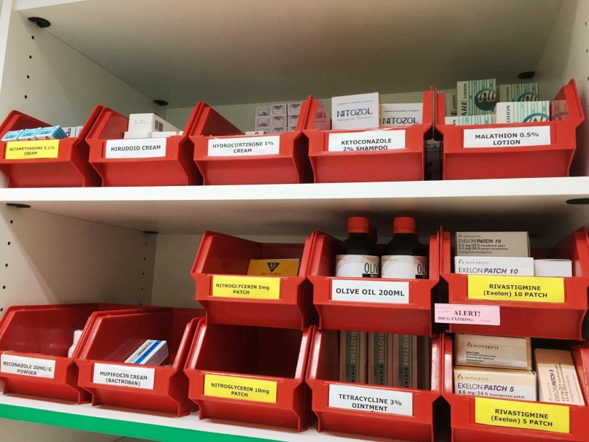
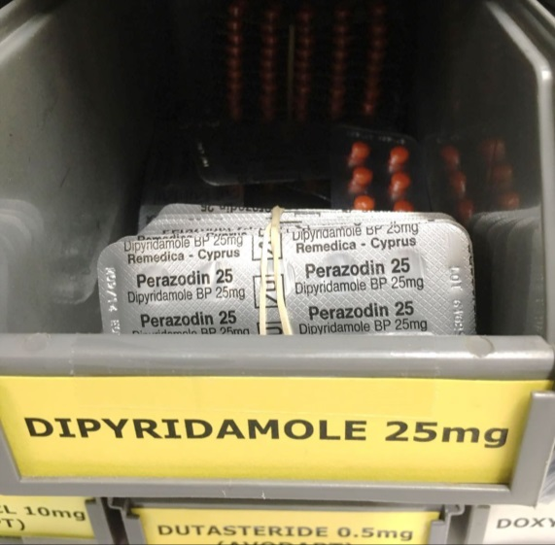
Good Housekeeping
Healthcare (Hospital Pharmacy)
Red bins for external preparations like creams, lotions & patches.
Yellow labels indicate “Different strengths available”
Grey bins for oral medication
Notes:
Trainer Notes:
“Tidy, clean, orderly & safe.”
Refer audience to above hospital pharmacy example:
use of coloured labels + coloured bins (think visual controls) for easy identification and reduction in dispensing error

Slide 36
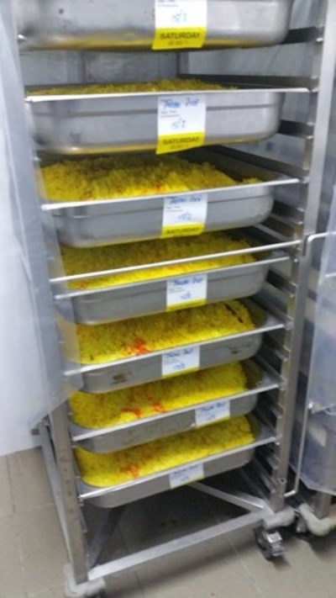
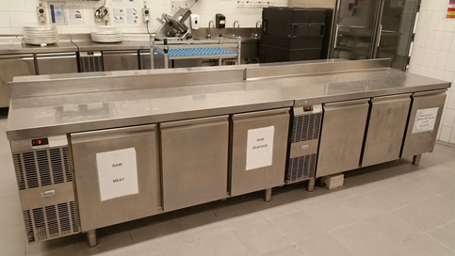
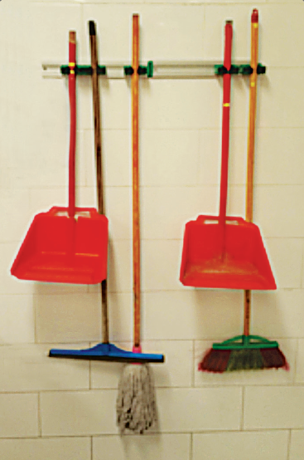
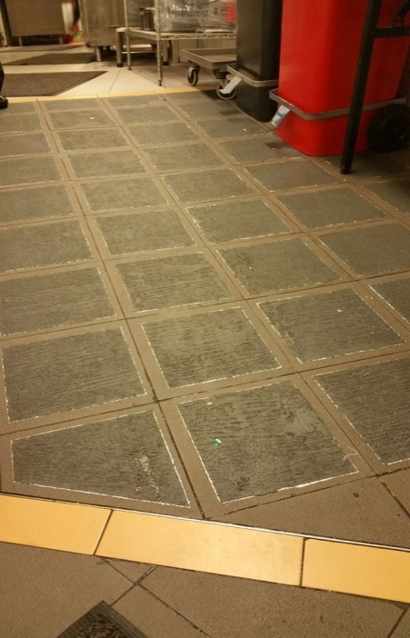
Good Housekeeping
Hospitality (Hotels)
Separate compartments for raw meat and raw seafood
Photo credit: Resorts World Sentosa Pte Ltd
Labelled food trays stating production date & time
Neatly organised cleaning tools
Anti-slip coating on kitchen floor
Notes:
Trainer Notes:
“Tidy, clean, orderly & safe.”
Refer audience to above hotel example:
different compartments (segregation) of meat & fish (prevent cross contamination)
anti-slip flooring in wet and greasy areas
labelled food trays indicating production date & time + consume by time
cleaning tools organized neatly and kept off the floor (better use of kitchen space and eliminate tripping hazard)

Slide 37
Good Housekeeping
Your company name here
Example 1 (Dept. A)
Insert example of good housekeeping
in your company here
Notes:
Trainer Notes:
Explain the aspect(s) of good housekeeping in the in-house example provided.

Slide 38
Good Housekeeping
Your company name here
Example 2 (Dept. B)
Insert example of good housekeeping
in your company here
Notes:
Trainer Notes:
Explain the aspect(s) of good housekeeping in the in-house example provided.

Slide 39
Good Housekeeping
Your company name here
Example 3 (Dept. C)
Insert example of good housekeeping
in your company here
Notes:
Trainer Notes:
Explain the aspect(s) of good housekeeping in the in-house example provided.

Slide 40
7. Housekeeping Inspection Checklist
[Recall]
Housekeeping
“The routine tasks that must be carried out in order for a system to function or to function efficiently.”
Source:
WSH Guidelines on Workplace Housekeeping
Notes:
Trainer Notes:
Above checklist lists some key housekeeping aspects that have an impact on WSH.
The checklist is non-exhaustive and advise audience to customise it to include housekeeping aspects applicable to specific work sites.
Housekeeping checklist to be used routinely (e.g. once every 1 to 2 weeks).

Slide 41
8. Housekeeping Plan
Insert your company’s housekeeping plan here
Notes:
Trainer Notes:
Share your company’s overall housekeeping plan by department or work area.
If specifics are required:-
Define the housekeeping task (what), procedure (how), frequency (when), work location (where) and assign the responsible person or team (who) as appropriate.
The housekeeping plan serves to inspire action after this training.
Create more slides to cover your housekeeping plan as necessary.

Slide 42
Thank you
Your email address
Notes:
Insert your email address (and/ or contact number) so that your trainees can easily contact you should they have follow-up questions.

