Slide 1
5 WSH tips for WORKING SAFELY IN WOODWORKING
Making Workplaces Safer
Adopt safe work practices

Slide 2
AMPUTATIONS
Every year, more than 100 workers suffer from amputations.
Source: WSH National Statistics Report 2012 - 2019
Notes:
Accidents involving machinery can lead to serious injuries.
Every year, more than 100 workers suffer from amputations while working with machines.
Do your risk assessment before starting work.
Workplace amputations typically involve arms, hands or fingers. Life will not be the same again once you lose a hand or finger.

Slide 3
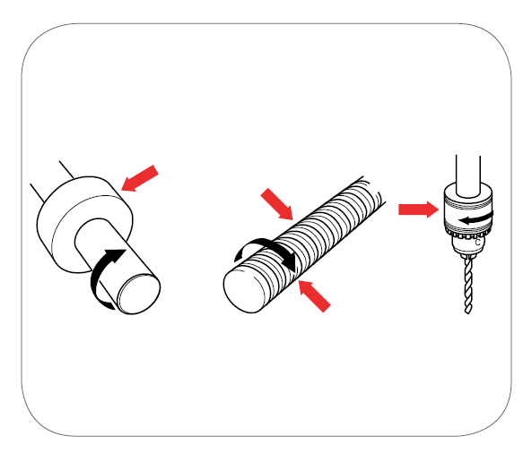
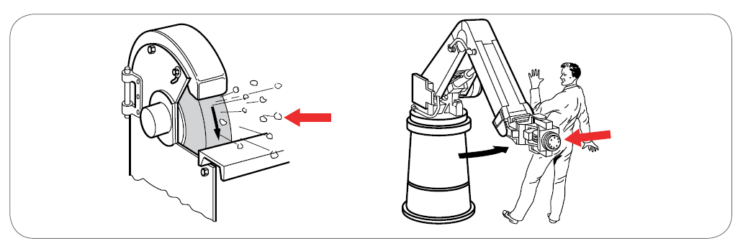
KEY CAUSES OF AMPUTATIONS
Machines with Moving Parts (see examples below)
Single rotating surface
Impact hazard
Cutting hazard
Source: WSH Guidelines on Safe Use of Machinery
Notes:
Many machines have moving parts. Machine parts may move in a linear, reciprocating, rotary, or oscillating motion, individually or in combination.
In many cases, the action of these moving parts can exert sufficient force to cause injury to workers operating the machine.

Slide 4
WSH Tip 1
Make sure all moving parts are guarded
Notes:
Before using a machine, it is good practice to check that moving/sharp parts are guarded as much as possible.
If the machine guard is broken or damaged in any way, do not use the machine.

Slide 5
WSH Tip 2
Use push block to push the workpiece through the saw
Notes:
For a machine with sharp cutting edge that cannot be fully guarded (e.g. a table saw machine), use a tool (e.g. a push block) to keep your hands away from the cutting edge.

Slide 6
WSH Tip 3
Lock-out and tag-out before
repair and maintenance
Notes:
Lockout and Tagout (LOTO) refers to a procedure where a lock (or locking device) is used to secure an energy isolation device (e.g. a switch or valve) at a safe state (e.g. switch OFF) or position (valve CLOSED). Tags are then put in place to alert others that a repair or maintenance activity is going on, as well as the name(s) of person(s) at work, and that no one is to operate the machine.
The energy isolation device basically isolates the worker from a hazardous energy source (e.g. electrical energy, mechanical energy, hydraulic energy, pneumatic energy). LOTO will help prevent the machine from being inadvertently activated or energised while the work activity is in progress.

Slide 7
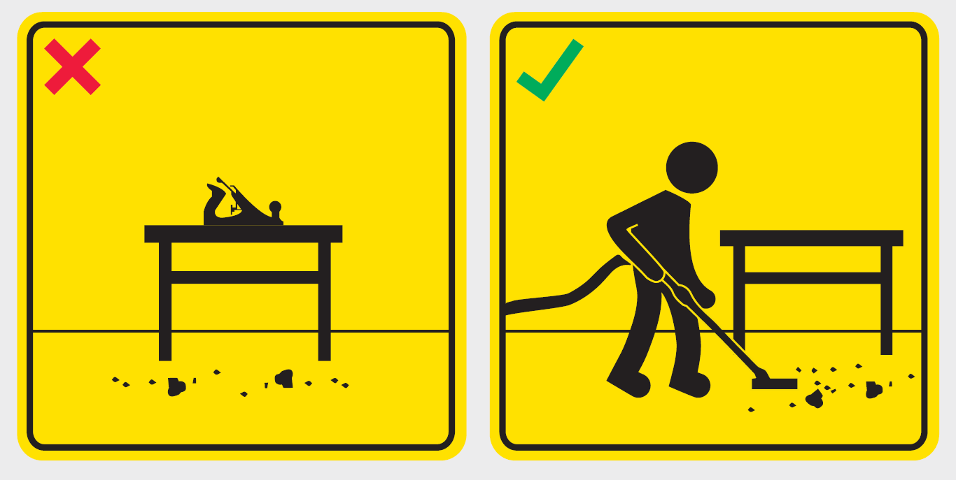
WSH Tip 4
Return all tools and keep areas
free of sawdust
Notes:
Good workplace housekeeping not only increases your productivity, but it also helps to create a safer workplace. Sawdust is combustible dust and can create a slipping hazard. By keeping your work area free of sawdust, you can minimise both the risk of slips and falls as well as the possibility of a dust fire. It is safer to use a vacuum for collecting sawdust as manual sweeping often creates a dust cloud which you might breathe in (respiratory hazard).

Slide 8
WSH Tip 5
Use the right personal protective equipment
Notes:
Workers may be exposed to falling or flying objects, sawdust or chemical vapours when working with a woodworking machine.
The right PPE for working with machines may include: protective clothing such as overalls, covered non-slip shoes, and protective items such as safety eyewear, hearing protection and use of respirators.
PPE offers protection from workplace hazards only if it is in good condition, properly selected for the work activity and correctly-fitted to the user.

Slide 9
LOOK. THINK. DO.
“I Can Prevent Hand Injuries.”
View video on WSH Council’s YouTube Channel
Notes:
In woodworking, the use of the right tools (a push block) may be used to keep your hands safe while using a table saw machine.

Slide 10
WOODWORKING ACCIDENTS
CAN BE PREVENTED
Download at www.wshc.sg/resources
Available at www.singaporestandardseshop.sg/

