Slide 1
5 WSH tips for WORKING SAFELY WITH MACHINES
Making Workplaces Safer
Adopt safe work practices

Slide 2
AMPUTATIONS
Every year, more than 100 workers suffer from amputations.
Source: WSH National Statistics Report 2012 - 2019
Notes:
Moving machine parts can cause death or serious injuries such as crushed limbs and amputations.
Every year, 2 workers die and 1,000 workers are injured while working with machines.
Do your risk assessment before starting work.
Workplace amputations typically involve arms, hands or fingers. Life will not be the same again once you lose an arm, hand or finger.

Slide 3
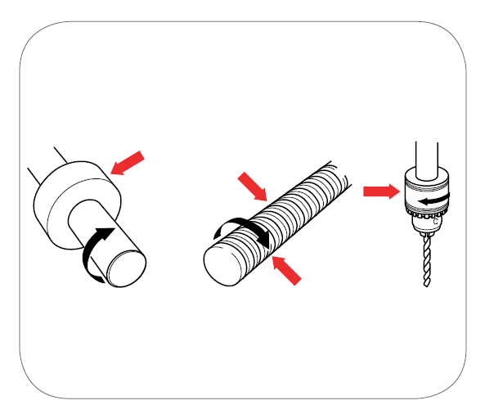
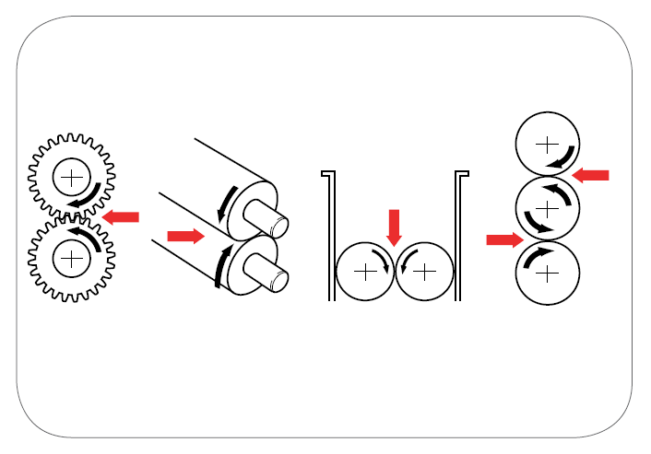
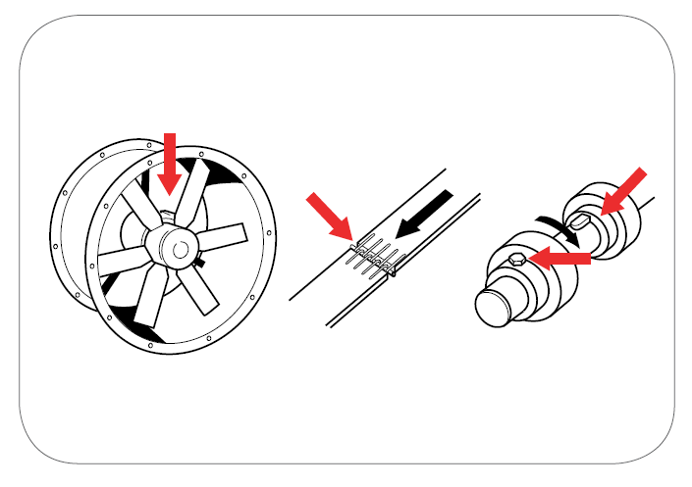
KEY CAUSES OF AMPUTATIONS
Machines with Moving Parts (see examples below)
Single rotating surface
Rotating and tangentially moving surface
Counter rotating parts
Gaps and projections
Source: WSH Guidelines on Safe Use of Machinery
Notes:
Many machines have moving parts. Machine parts may move in a linear, reciprocating, rotary, or oscillating motion, individually or in combination.
In many cases, the action of these moving parts can exert sufficient force to cause injury to workers operating the machine.

Slide 4
WSH Tip 1
Operate the machine only if you are trained and competent
Notes:
Only operate machines that you have been trained to operate.
If you are not familiar with the machine, it is best not to switch ON the machine.

Slide 5
WSH Tip 2
Make sure all moving parts are guarded
Notes:
Before using a machine, it is good practice to check that all moving parts are guarded and that there are no exposed moving parts.
If the machine guard is broken or damaged in any way, do not use the machine.

Slide 6
WSH Tip 3
Stop the machine if it is not
working properly
Notes:
You can tell if a machine is not working properly if you see its parts moving abnormally, spot a major leak, hear strange sounds, smell something burning (or anything unusual) and/or feel that the machine is not vibrating as it normally does.

Slide 7
WSH Tip 4
Lock-out and tag-out before
repair and maintenance
Notes:
Lockout and Tagout (LOTO) refers to a procedure where a lock (or locking device) is used to secure an energy isolation device (e.g. a switch or valve) at a safe state (e.g. switch OFF) or position (valve CLOSED). Tags are then put in place to alert others that a repair or maintenance activity is going on, as well as the name(s) of person(s) at work, and that no one is to operate the machine.
The energy isolation device basically isolates the worker from a hazardous energy source (e.g. electrical energy, mechanical energy, hydraulic energy, pneumatic energy). LOTO will help prevent the machine from being inadvertently activated or energised while the work activity is in progress.
Multiple lockout may be achieved using a hasp which typically allows up to 6 locks to be simultaneously applied to a energy isolation device.

Slide 8
WSH Tip 5
Use the right personal protective equipment
Notes:
Workers may be exposed to falling or flying objects, splashing fluids, or harmful dusts, fumes, mists, vapours, or gases when working with a machine.
The right PPE for working with machines may include: protective clothing such as overalls, covered non-slip shoes, heat-resistant gloves, and protective items such as safety eyewear, hearing protection and use of respirators.
PPE offers protection from workplace hazards only if it is in good condition, properly selected for the work activity and correctly-fitted to the user.

Slide 9
LOOK. THINK. DO.
“I Can Prevent Hand Injuries.”
View video on WSH Council’s YouTube Channel
Notes:
If machine guarding cannot be used, the use of the right tools (a push plate in the above bandsaw machine example) may be used to keep your hands safe.

Slide 10
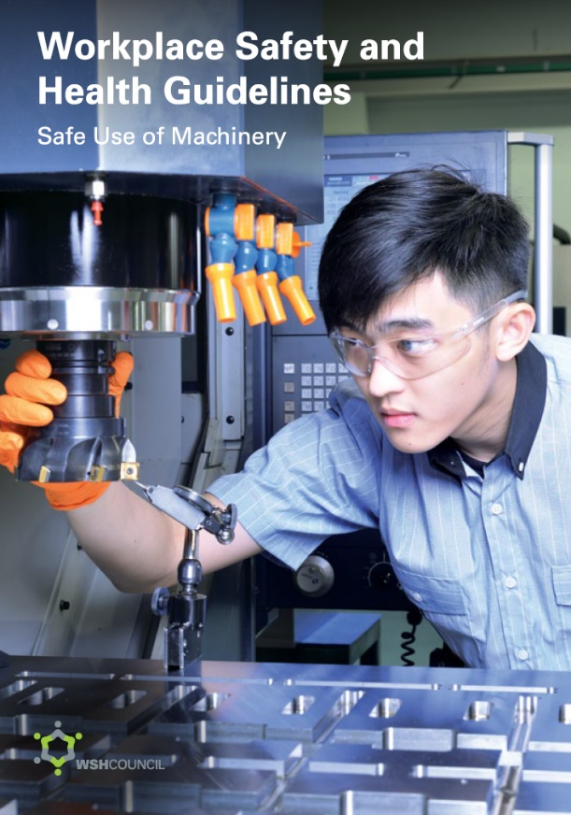
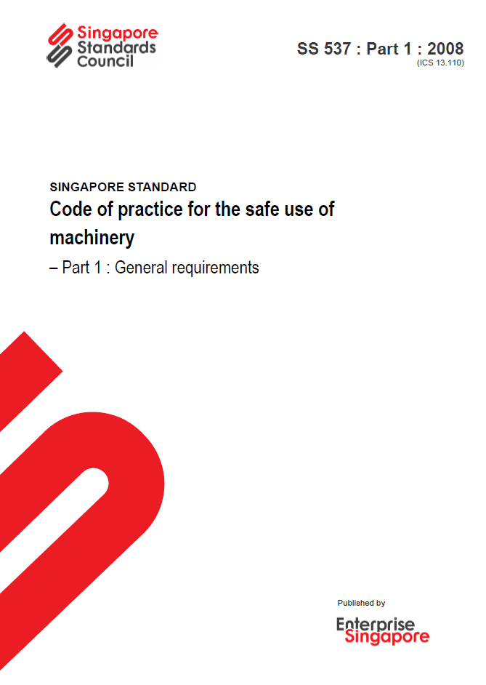
MACHINERY ACCIDENTS
CAN BE PREVENTED
Download at www.wshc.sg/machinesafety
Available at www.singaporestandardseshop.sg/

