Slide 1
5 WSH tips for WORKING SAFELY IN FOOD MANUFACTURING
Making Workplaces Safer
Adopt safe work practices

Slide 2
PREVENT WORKPLACE INJURIES
Every year, more than 400 workers are injured in the
food manufacturing industry.
 | 2017 | 2018 | 2019
Fatalities | 2 | 1 | 0
Major Injuries | 32 | 29 | 24
Minor Injuries | 432 | 497 | 535
Source: WSH National Statistics Report 2017 - 2019
Top incident types in the food manufacturing industry are:
Slips, Trips and Falls (STFs)
Struck by Moving Object (SBMO)
Caught In/Between Objects (CIBO)
Cut/ Stabbed by Object (CSBO)
Typically due to
working with machines
Notes:
Unsafe work practices and poor housekeeping in food manufacturing can cause slips, trips and falls and serious injuries that can result in amputations. Every year, more than 400 workers are injured in the food manufacturing industry.
Do your risk assessment before starting work.
Major injuries include crush injuries and arm/ hand/finger amputations.

Slide 3
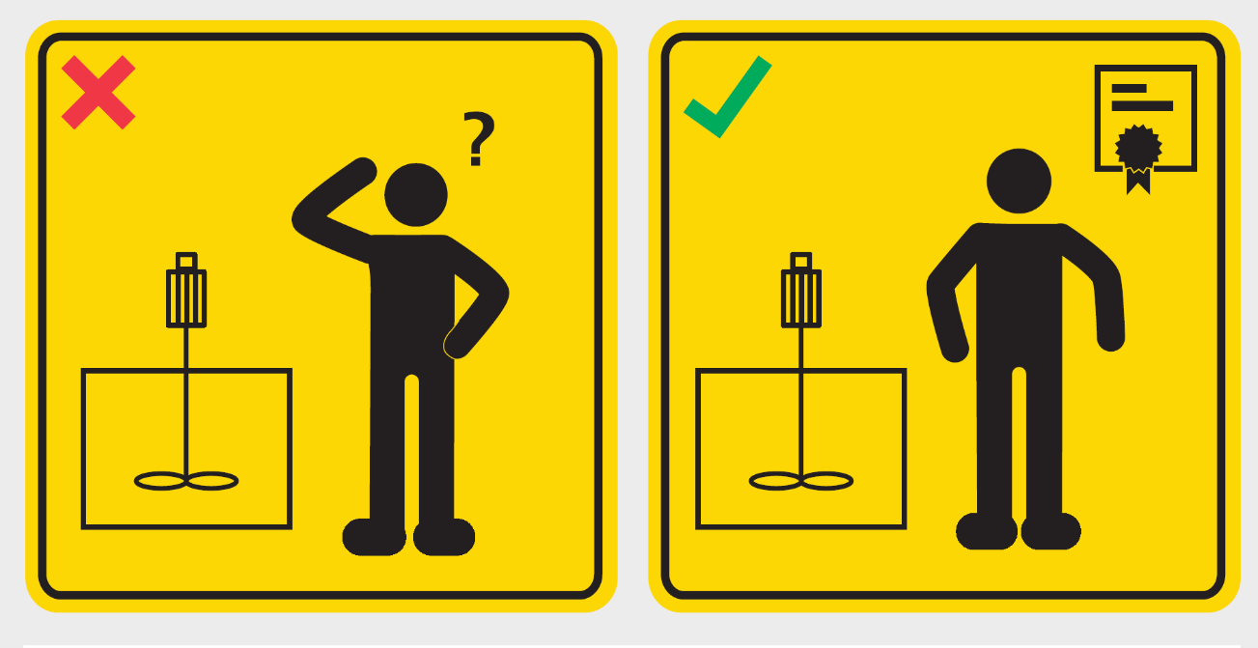
WSH Tip 1
Have adequate training before
operating a machine
Notes:
Only operate machines you have been trained to operate.
If you are not familiar with the machine, it is best not to switch ON the machine.

Slide 4
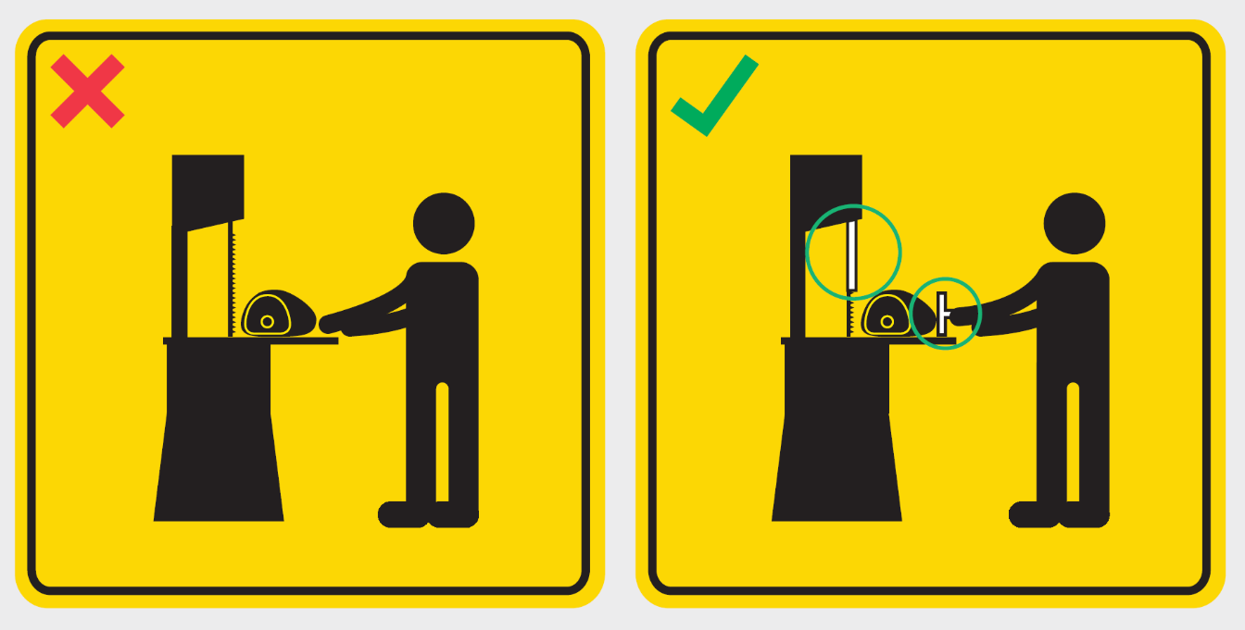
WSH Tip 2
Ensure safeguards are in place.
Use a tool to keep your hands safe.
Notes:
Before using a machine, it is good practice to check that moving/sharp parts are guarded wherever possible.
If the machine guard is broken or damaged in any way, do not use the machine.
For a machine with sharp cutting edge that cannot be fully guarded (e.g. a bandsaw machine, use a tool (e.g. a push plate) to keep your hands away from the cutting edge.

Slide 5
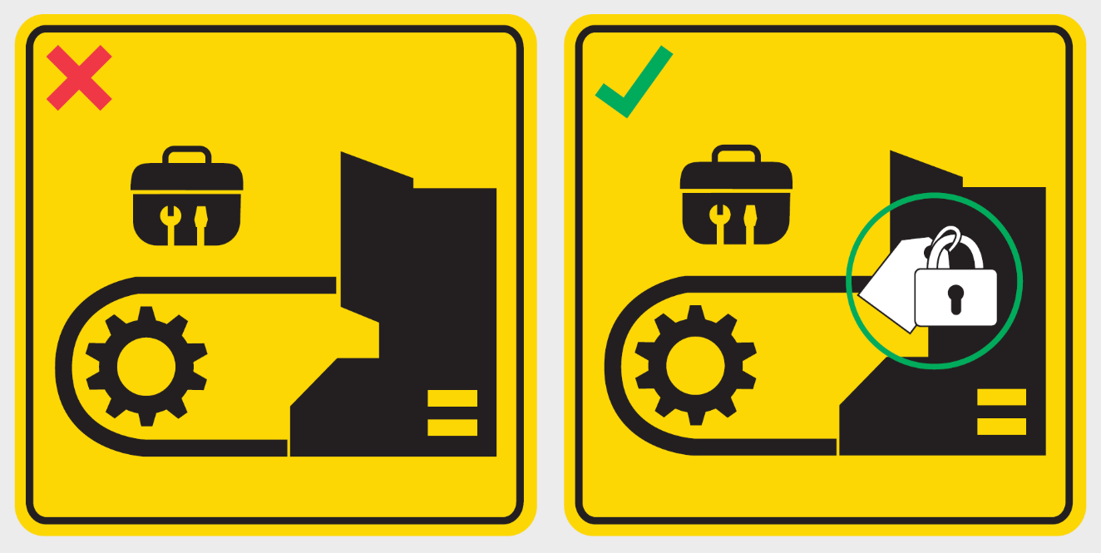
WSH Tip 3
Lock-out and tag-out before
cleaning, repair and maintenance
Notes:
Lockout and Tagout (LOTO) refers to a procedure where a lock (or locking device) is used to secure an energy isolation device (e.g. a switch or valve) at a safe state (e.g. switch OFF) or position (valve CLOSED). Tags are then put in place to alert others that a repair or maintenance activity is going on, as well as the name(s) of person(s) at work, and that no one is to operate the machine.
The energy isolation device basically isolates the worker from a hazardous energy source (e.g. electrical energy, mechanical energy, hydraulic energy, pneumatic energy). LOTO will help prevent the machine from being inadvertently activated or energised while the work activity is in progress.
Multiple lockout may be achieved using a hasp which typically allows up to 6 locks to be simultaneously applied to a energy isolation device.

Slide 6
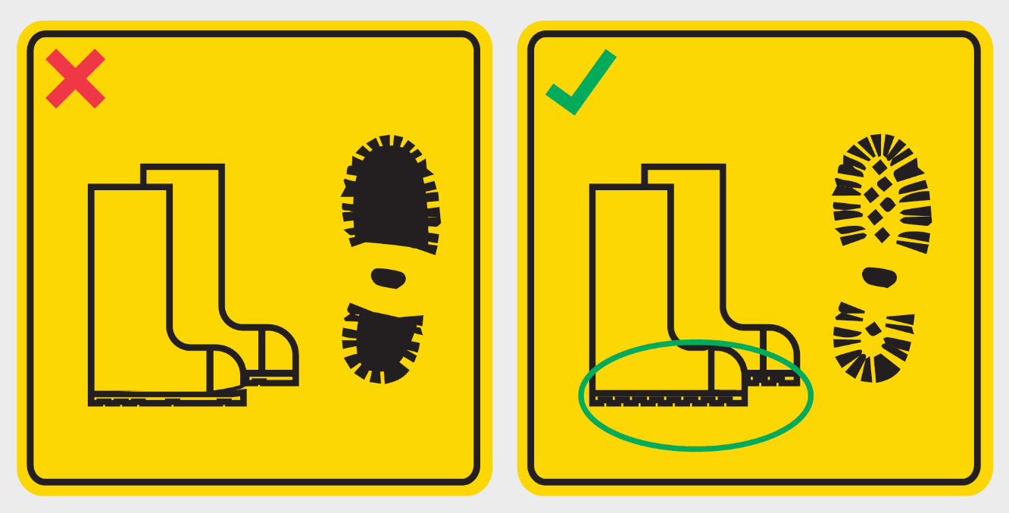
WSH Tip 4
Use non-slip footwear and replace
when it is worn out
Notes:
Floors may be slippery in a food manufacturing process area - possibly due to spills, condensation or oil accumulation.
For your safety, always put on non-slip footwear before entering a food manufacturing process area.

Slide 7
WSH Tip 5
Practise good housekeeping and
clean up spills immediately
Notes:
It is good practice to clean up a spill immediately after one occurs.
This will protect you and your colleagues from a slip and fall incident.

Slide 8
LOOK. THINK. DO. “I Can Prevent Hand Injuries”
View video on WSH Council’s YouTube Channel
Notes:
If machine guarding cannot be used, the use of the right tools (a push plate in the above bandsaw machine example) may be used to keep your hands safe.

Slide 9
LOOK. THINK. DO. “I Can Prevent Falls: Slippery Floor”
View video on WSH Council’s YouTube Channel
Notes:
By cleaning up spills immediately after they occur, you can do your part to prevent slips and falls at your workplace.

Slide 10
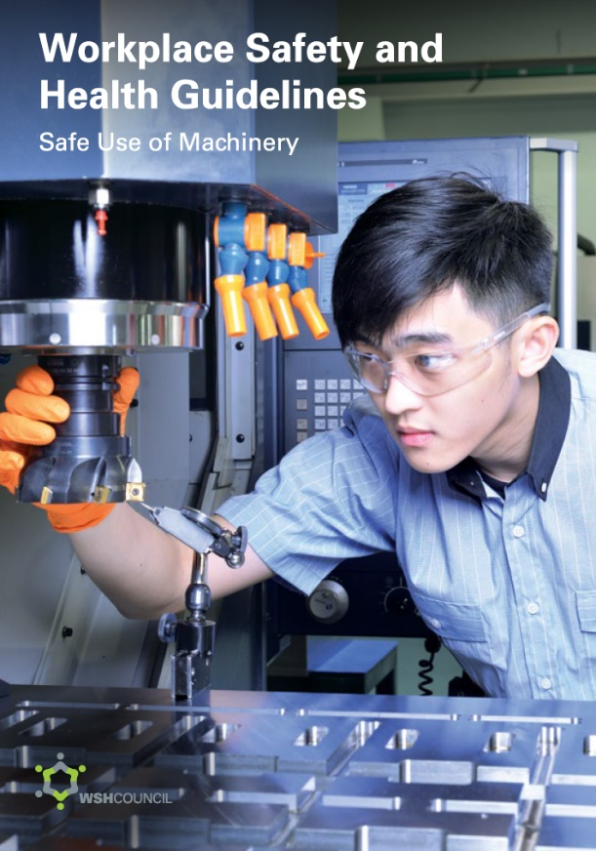
ACCIDENTS CAN BE PREVENTED
Download at http://www.wshc.sg/machinesafety

