Slide 1

WSH Training slides for Woodworking
All rights reserved, 2019. The information provided in this training slides is accurate at time of publication. All examples shared in this training slides are meant for learning purposes only. The learning points for each example are not exhaustive and should not be taken to encapsulate all the responsibilities and obligations of the user of this training slides under the law. The Workplace Safety and Health Council does not accept any liability or responsibility for any modifications made to this set of training slides.
Notes:
These slides may be used to complement your in-house Workplace Safety & Health (WSH) training programme.
Common hazards types are cited, which you can customise by selecting those relevant to your specific workplace.
Safe practices provide guidance on what your workers can do to reduce the risks associated with their daily work activities.
Sample accident case studies are included together with the lessons learnt.
You are encouraged to insert your company’s own case study examples (if any) which your staff can better relate to.
This will help enhance the effectiveness of your WSH training session.

Slide 2
Contents
1. Workplace Safety and Health Act
  Duties of Stakeholder groups (incl. employer and employee)
2. Workplace Safety and Health
(WSH Policy)
3. Risk Management
4. Common hazards in the woodworking industry
  Mechanical hazards
  Electrical hazards
  Health hazards
  Fires and explosions
  Slips, trips and falls
  Fall from heights
5. Personal Protective Equipment
6. Workplace safety signs
7. Accident case studies
2
Notes:
Further reading for trainers:
You may find the following WSH Guidelines relevant to some topics presented in this set of slides.
They are available on the WSH Council website. (www.wshc.sg)
Risk Management Code of Practice
Safe use of machineries
Safe Use of Power Presses and Press brakes
Hearing Conservation Programme

Slide 3
1. WSH Act – Duties of Stakeholders
YOU
3

Slide 4
1. Duties of Employees
DOS
DON’TS
Attend training (manufacturer/external) on the safe operating of machineries
Use Personal Protective Equipment (PPE) at the workplace
Put yourself or others in danger through unsafe behavior
Refer to company work manual / safe work procedures if unsure of work processes. If in doubt, stop work and consult supervisor
Modify PPE, devices or equipment provided. You could be fined up to S$1,000 if you carry out such modification
Follow company WSH policies and instructions
Report to supervisor for unsafe work condition / acts / hazards etc.
4
Notes:
Notes to trainer:
The examples given are non exhaustible. You are encouraged to add on to the list and contextualize to suit your company needs.

Slide 5
1. Duties of Employers
Conduct R.A to identify hazards and implement effective risk control measures
Make sure the work environment is safe
Develop and implement systems for dealing with emergencies
Ensure workers are provided with sufficient instruction, training and supervision so that they can work safely
Make sure adequate safety measures are taken for any machinery, equipment, plant, article or process used at the workplace
5

Slide 6
2. Workplace Safety and Health (WSH) Policy
A clear and concise policy statement will reflect a company’s commitment and support towards managing safety and health matters.
The statement should be signed by the business owner, managing director or CEO equivalent, to demonstrate senior management’s commitment.
A good policy will consist of:
  • Commitment to adhere to relevant legal requirements,
  • Duties and responsibilities to ensure safety and health at work; and
  • Commitment to continuously improve WSH performance.
SAMPLE
6
Notes:
Notes for the trainer:
Please insert an image of your company’s WSH Policy.

Slide 7
3. Risk Management
The main components of RM are:
  • Preparation
  • Risk Assessment (RA)
  • Implementation (includes specific communication of the hazards identified and their controls)
  • Record-keeping
RA is one component of RM. The three main parts of RA are:
Hazard Identification
Risk
Evaluation
Risk
Control
7
Notes:
Notes for the trainer:
You need not have to deep-dive into the topic. This slide intends to provide an introduction to Risk Management.

Slide 8
3. Risk Management Process
RM and RA Teams
Risk Management Process
8

Slide 9
3. Risk assessment form template
Important RA information
RA members
Clearance
Hazard Identification
Risk Evaluation
Risk Control
Risk Assessment
9
Notes:
Notes to trainer:
You can use this RA from to explain Risk assessment concepts and attach your company actual RA form to go through in detail

Slide 10
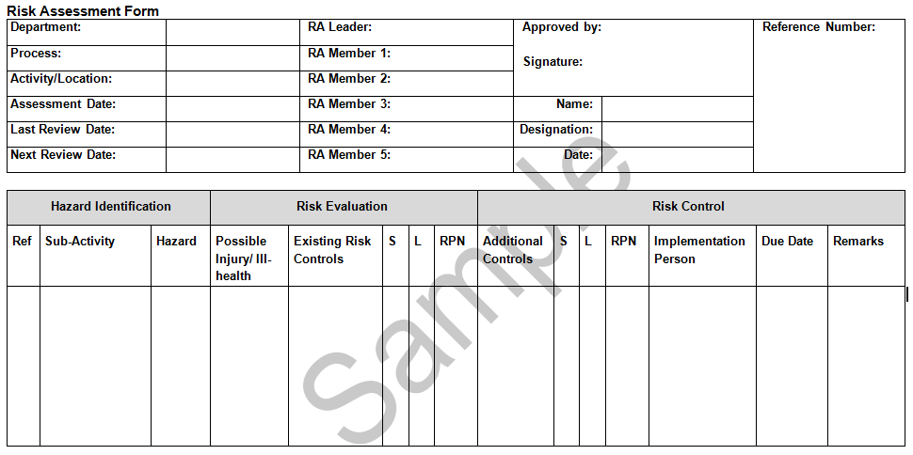
3. Risk Management
I. Hazard Identification
  A. What is a Hazard?
    Any source or any situation with the potential to cause bodily injury or ill-health.
10

Slide 11
3. Risk Management
II. Risk Evaluation
  B. What is a Risk?
    The likelihood that a hazard will cause a specific bodily injury to any person.
11

Slide 12
3. Risk Management
III. Risk Control
  C. What is Additional Risk Control?
    Steps to eliminate, reduce or confine the risk to an acceptable level.
12

Slide 13
3. Risk Management
Sample of your company’s Risk Assessment form
13
Notes:
Notes for the trainer:
Please provide a sample of your company’s Risk Assessment form.

Slide 14
Hierarchy of Control
Substitution
This involves substituting a process or a product with a less hazardous process or product to mitigate the risk, for example, using water-based paint instead of solvent-based paint.
The control of hazards and reduction of risks can be accomplished by following the WSH Hierarchy of Control (see table). These control measures are not usually mutually exclusive. Generally, it may be more effective to use multiple control measures, for example, engineering controls work better with administrative controls like training and SWPs.
Elimination
Elimination of risk refers to the total removal of the worker’s exposure to the hazards, effectively making all the identified possible accidents, incidents and ill health impossible. For example, using robots to replace humans to eliminate the danger of working in confined space.
Engineering Controls
Engineering controls are physical means that serve the workforce by reducing the likelihood of occurrence or severity of consequence in the event of the mishap. These include structural changes to the work environment or work processes, erecting a barrier to interrupt the accident transmission path between the worker and the hazard (for example, machine guards, confined space ventilation).
Administrative Controls
These eliminate or reduce exposure to a hazard by adherence to procedures or instructions. Documentation should emphasise all the steps to be taken and the controls to be used in carrying out the activity safely. For example, Permit-to-work systems, scheduling of incompatible works, SWPs.
Personal Protective Equipment
This should be used only as a last resort, after all other control measures have been considered, or as a short term contingency during emergency/ maintenance/ repair, or as an additional protective measure against residual risks. The success of this control depends critically on the protective equipment being chosen correctly, fitted correctly, worn at all times and maintained properly.
Table 1: WSH Hierarchy of Control
14
Notes:
Notes to trainer:
You are encourage to use this slide as an introduction to the HOC and its concept. Important to just highlight the key points.

Slide 15
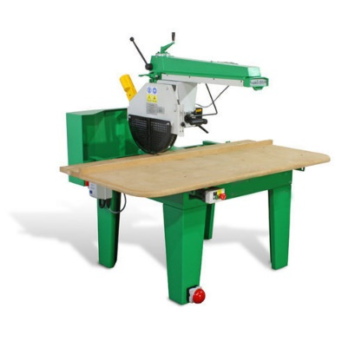
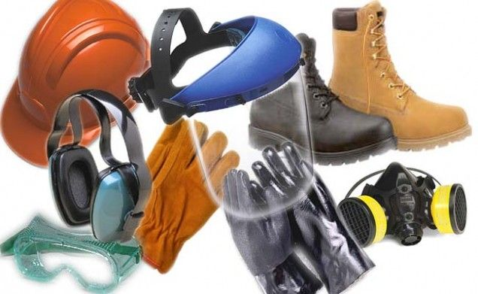
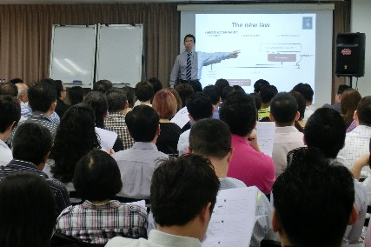
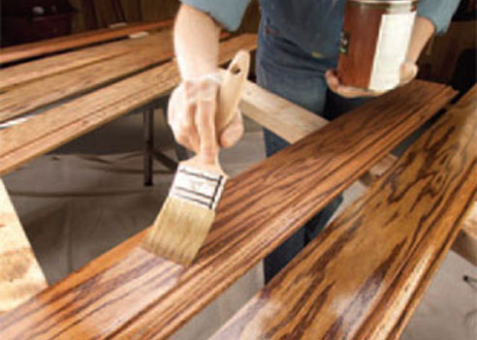

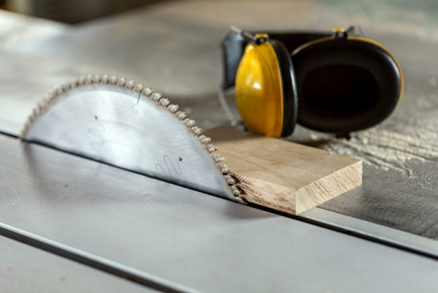
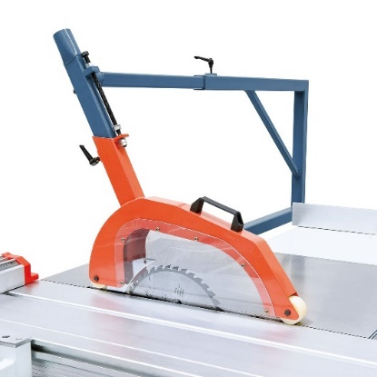
Hierarchy of Control
Before
After
PPE
Elimination
Admin Control
Wear Personal Protective Equipment (PPE)
Training, Safe Work Procedure (SWPs)
Cross cut saw machine
Using technology to replace human interface with job
Before
After
Before
After
Substitution
Engrg Control
Conventional unhealthy (i.e toxic) wood finish
Environmentally safe, non-toxic and natural products
Unguarded saw blade
Installation of safety guard for rotary blade
15
Notes:
Notes to trainer:
The examples highlighted here are woodworking related. You are free to add/ contextualise other examples to suit your organizational needs.

Slide 16
4. Common hazards in the woodworking industry
Exposure to hazards on the job Mechanical hazards Electrical Hazards Noise-induced deafness | Fires and explosions Exposure to harmful chemicals Slip, trips and falls Fall from heights
Highlight / supplement the more common hazards
in your company here (optional)
16
Notes:
Notes for the trainer:
You may choose to focus on the hazards commonly found at your workplace.
Please also use this slide as a reminder to ensure that all hazards are adequately addressed in your company’s Risk Assessment (RA).
As an added option, if there are readily available records of hazards reported in your workplace,
you can choose to emphasise the more common hazards found in your workplace in the green box above.
You can find statistics on the WSH Institute website (https://www.wsh-institute.sg).

Slide 17
Safety hazards
  Mechanical hazards
    Examples of machine guarding
  Electrical hazards
  LOTO
17

Slide 18
Mechanical hazards
E.g. Entanglement caused by contact with a single rotating surface
E.g. Impact hazard
E.g. Shearing hazards
E.g. Cutting hazards: Disc brakes, Sharp edges, band saw, circular saw
E.g. Draw-in hazards between rotating and tangentially moving surfaces
18
Notes:
Notes to trainer:

Slide 19
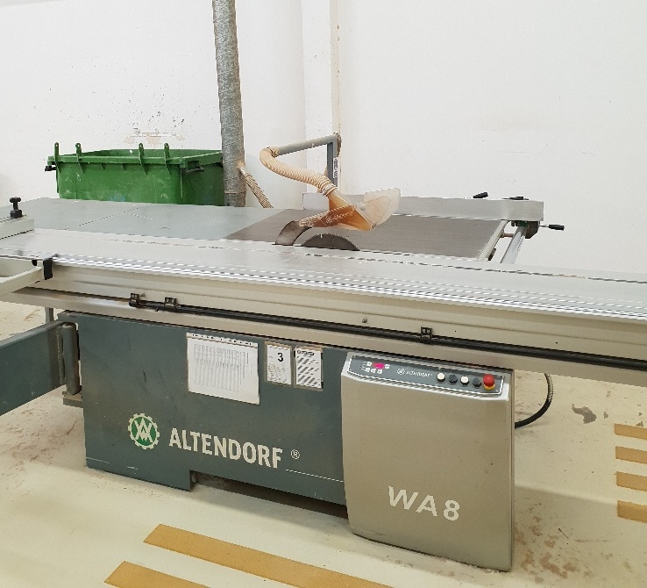
Mechanical hazards on the job
DOS
Train workers to use the machines and allow only trained and authorised workers to operate and maintain the equipment.
Inspect equipment and guards before use of equipment.
Use appropriate equipment for the job.
Provide operators of the machines with push sticks or other hand tools so that their hands are away from the point of operation when working on small pieces of stock.
Use a brush or stick to clean sawdust and scrap from a machine.
Maintain proper housekeeping.
Carry out regular preventive maintenance .
DON’TS
Never leave a machine unattended in the “on” position.
Do not wear loose clothing or dangled long hair
Never saw freehand. Always hold the stock against a gauge or fence.
19
Notes:
Notes to trainer:
This is an important slide to remind operators to be vigilant when operating woodworking machines

Slide 20
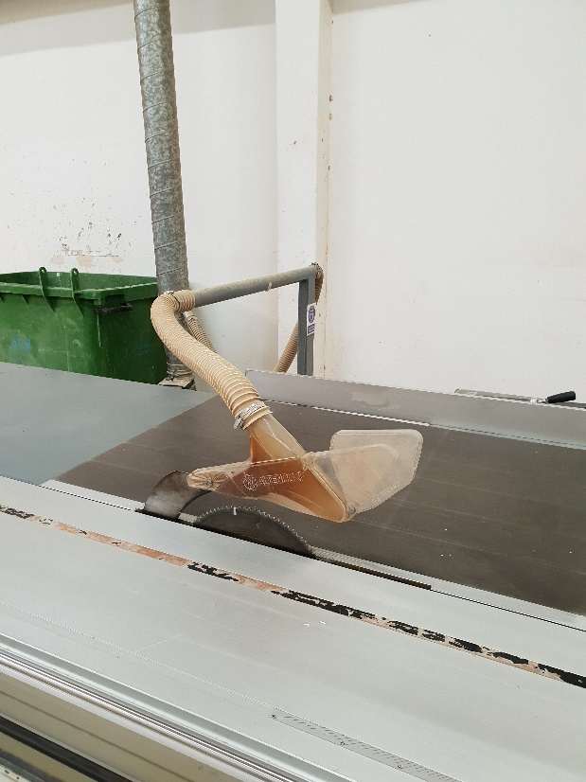
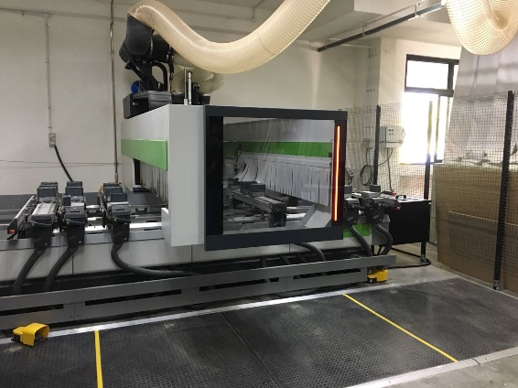
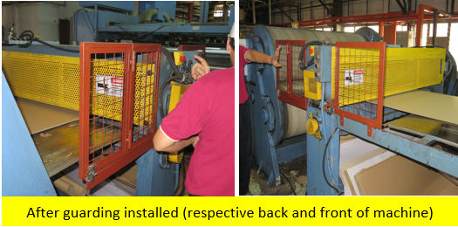
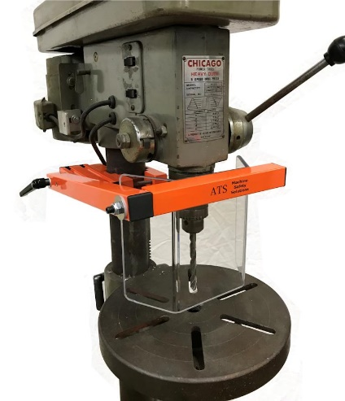
Examples of Machine guarding
E.g. Circular table saw fitted with adjustable guard
E.g. Fixed guard to prevent access to danger zone from all directions
E.g. CNC cutting machine with fixed guards
E.g. Circular table saw fitted with adjustable guard
E.g. Saw fitted with self-adjustable guard
E.g. Fixed guard to prevent access to danger zone
E.g. Drill fitted with swivel guard
20
Notes:
Notes to trainer:
You are free to include and/or contextualize any other examples relevant to your organisational needs

Slide 21
Electrical hazards
Accidents involving contact with electricity can happen when an electrical machine failed, electric circuits are overloaded (see picture) or short-circuited, or when one comes into contact with a live wire (e.g., as a result of worn out insulation).
DOS
• Use power sockets, plugs and cables registered with SPRING S’pore (ie. products with “SAFETY Mark”).
• Conduct visual inspections on electrical machines (m/c) before starting daily operation.
• Ensure that electrical m/c are properly grounded.
• Engage electrical workers who are licensed by the Energy Market Authority (EMA) to carry out electrical work.
• Establish LOTO procedures for any repair & maintenance of electrical m/c.
• Ensure that electrical m/c are protected by over-current or overload protective devices.
DON’TS
Clean electrical machines with flammable solvents.
Overload electrical power points.
Expose power cords to heat, water & oil.
Pull the cord but the electrical plug
21
Notes:
Notes to trainer:
You may download the Look. Think. Do Pictograms Pack for Use of Electrical Equipment from the WSH Council website

Slide 22
Energy Lock-out, Tag-out (LOTO)
5 steps for effective LOTO for hazardous machines (m/c):
1. Announce the shutdown
2. Shut down the machine
3. Disconnect all energy sources
4. Apply lock-out and tag-out
5. Verify the isolation and lock-out
22
Notes:
Notes to trainer:
Authorised personnel performing servicing or maintenance shall be trained to:
Recognise hazardous energy sources & understand the energy types & magnitudes,
Identify & properly operate the applicable energy-isolating devices; &
Safely apply & remove lockout devices
5 steps for effective LOTO for hazardous machines (m/c):
Announce the shutdown
Notify all affected workers that the m/c is to be shut down.
Shut down the machine
Proceed to shut down the m/c via normal procedure & ensure all moving parts have come to a complete stop
Disconnect all energy sources
Disconnect all energy sources (i.e. electrical, mechanical, pneumatic or hydraulic) supply to the m/c.
Confirm any stored energy is dissipated before starting work.
Apply lock-out and tag-out
Apply a lock-out device (e.g. a padlock) over energy-isolating device to prevent unexpected or accidental restoration of energy
Lock-out devices must be durable & strong to prevent accidental removal.
Each lock-out device should be affixed with durable tag with the identity of the person applying the lock-out.
5. Verify the isolation and lock-out
Check isolation & lock-out is in use & effective.
Test the ops controls (‘on’ and ‘off’) to confirm that m/c is unable to start up.
After the test, return ops controls to the“off” position.
Once the above steps are completed, proceed with the installation/ repair /maintenance work on the m/c.
You are encourage to use this slide as an introduction to the LOTO and its concept. Important to just highlight the key points.
For more information on energy lock-out tag out, see SS 571: 2011 Code of Practice for EnergyLockout and Tagout.

Slide 23
Energy Lock-out, Tag-out (LOTO)
6 Steps for Restoring a Machine for Operation
1. Ensure all tools have been removed from the machine (m/c),
2. Confirm all safeguards & other safety devices returned to their original locations;
3. Check the m/c’s immediate vicinity
4. Announce machine would be turned on;
5. Remove all lockout devices & re-energise m/c.
6. Notify affected workers that the m/c is ready for operations.
23
Notes:
Notes to trainer:
6 Steps for Restoring a Machine for Operation
When the repair or maintenance work for a machine (m/c) is completed, the next step is to restore it to its normal operation.
Ensure that all tools have been removed from the machine,
2. Confirm that all safeguards & other safety devices are functional & have been returned to their original locations;
Check the m/c’s immediate vicinity to ensure that its start-up will not endanger anyone;
Announce that the machine would be turned on;
Remove all lockout devices & re-energise the machine. A pre-op functionality test should be carried out before the actual op to ensure that the m/c is working properly; and
Notify affected workers that the m/c is now ready to resume normal operations.
For more information on energy lock-out tag out, see SS 571: 2011 Code of Practice for EnergyLockout and Tagout.

Slide 24
Health hazards
  Noise
    i.e. Noise Induced Deafness
  Exposure to chemicals
  Exposure to wood dust
    i.e. Respiratory Effects
17

Slide 25
Noise Hazards
Noise is often generated during machine operations and work activities.
Prolonged exposure to excessive noise can cause noise-induced hearing loss, leading to noise-induced deafness (NID).
To prevent hearing loss, a worker should not be exposed to noise levels >85 dB (A) for 8 hours a day or its equivalent.
Where the permissible exposure level is exceeded, measures must be taken to reduce the noise exposure.
25
Notes:
Notes to trainer:
For more information on protecting workers’ hearing at work, see:
• WSH (Noise) Regulations 2011; and
• WSH Guidelines on Hearing Conservation Programme.

Slide 26
Noise-induced deafness
Exposure limit (without protective gear) | dB(A) | Examples
 | 60 | conversation
 | 70
 | 75
 | 80 | alarm clock
 | 85
<4 hrs | 90 | Electric ventilation fan
<1 hr | 95 | Vacuuming the workplace
15 mins | 100 | Emergency siren
<7.5 mins | 105 | Circular saw
<2 mins | 110 | Chain saw
<1 mins | 115 | Jackhammer
 | 120
No tolerance | 140 | Power-driven nail gun
Use ear plugs
Use ear plugs and ear muffs
26
Notes:
Notes to trainer:
In general, earplugs or earmuffs are used when the noise exposure level is between 85 to 100dB(A.)
For exposure exceeding 100dB(A), earmuffs over earplugs are used together.

Slide 27
Noise-induced deafness
Frequent and prolonged exposure to loud sounds during work can cause permanent hearing loss. Hearing loss can lead to increase risks of getting into an accident.
DOS
Wear ear plugs/muffs properly
Take breaks in quiet places
Rotate noisy work with colleagues
Maintain your hearing protectors
DON’TS
Use hearing protectors that are damaged or in poor condition
27
Notes:
Notes to trainer:
Hearing protectors should be properly maintained and cleaned. Workers who are required to use hearing protectors should receive adequate training on its proper use, care and maintenance. Selecting the right type of hearing protectors and the correct usage over the period or exposure to excessive noise are critical to effective hearing protection.

Slide 28
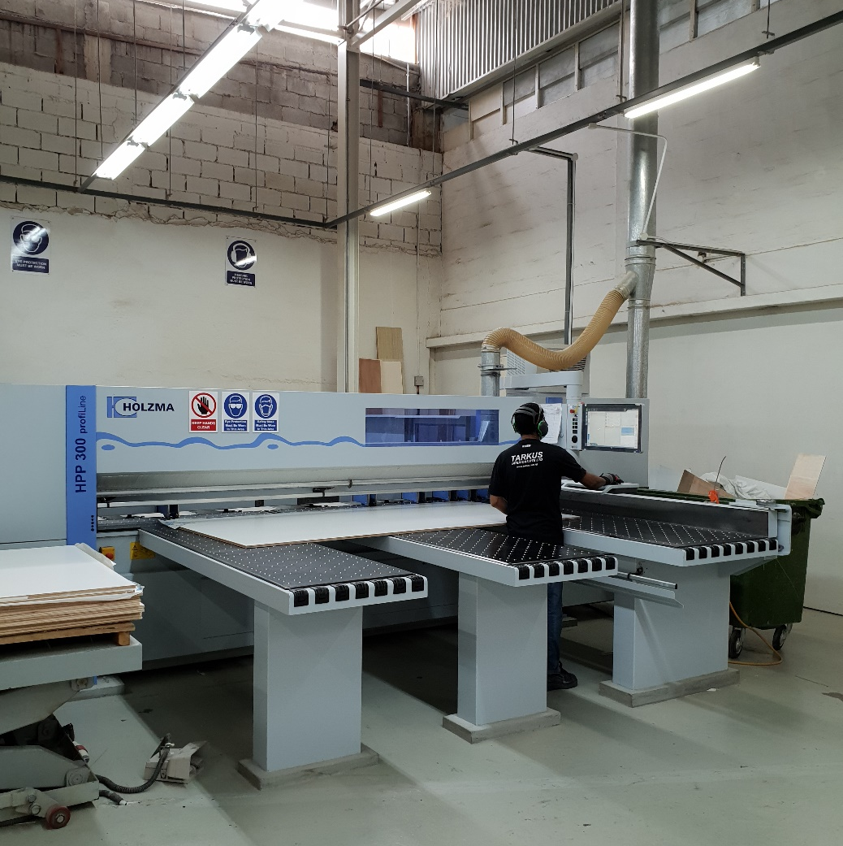
Noise Hazards (Machines)
DOS
Specify and request for low noise machines during purchase.
Replace noisy machines with less noisy ones.
Relocate noisy machines and processes to a lesser-occupied or non-occupied area of the workplace.
Locate noise sources away from hard walls or corners.
Construct suitable noise enclosures or barriers to isolate the source of noise and reduce noise emission.
Minimise the number of noisy machines running at any one time.
Provide workers with hearing protectors and ensure that they are properly used.
Worker operating a CNC cutting machine
28

Slide 29
Noise-induced deafness
Case study:
Worker was crossing a vehicle lane while looking in the another direction
A vehicle was travelling along the same lane and the driver was also looking away
Both the driver and worker failed to notice each other
Worker was suffering from noise-induced deafness
He did not hear the vehicle approaching and was run over
Overview of accident site
worker
vehicle
      Direction of travel
      Direction of sight
29
Notes:
Notes for the trainer:
This case study shows how noise-induced deafness can lead to the sufferer being more accident-prone.
The accident occurred primarily due to poor traffic management at the worksite, and poor road safety awareness.
The worker being deaf compounded the risks of the accident occurring.

Slide 30
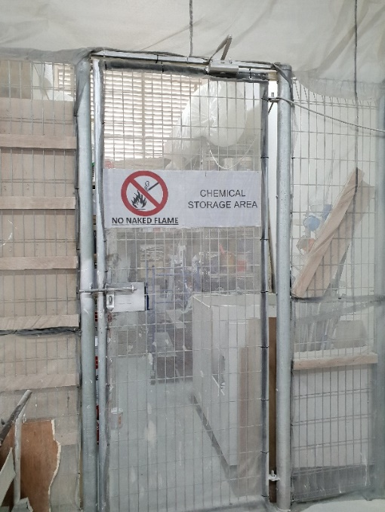
Exposure to Chemicals
The chemicals used at work can be harmful to our health. Inhaling the vapours and regular contact with these chemicals can lead to breathing and skin problems (i.e. coatings, finishings, adhesives, solvent vapours).
DOS | Read the label and understand the safety precautions (Safety data sheets) Ensure storage containers are in good condition Open windows and doors when using chemicals Switch on fans and exhaust ventilators if available Wear chemical resistant gloves Close containers tightly immediately after use
DON’TS | Use chemicals that you cannot identify Store incompatible chemicals together
30
Notes:
Notes for the trainer:
Supervisors should ensure that the employees are using the correct gloves for the job.
The gloves should be designed specifically for handling the type of chemical the staff are working with.
Common examples of chemicals used in the woodworking industry (i.e coatings, finishings, adhesives, solvents vapours).
Incompatible chemicals for proper storage from the Safety Data Sheet of the chemical.
It should be provided by the chemical supplier.
Additional resources:
You can also integrate the Activity-Based Checklist: Safe Storage of Chemicals in your work routine.
The checklist can be downloaded from the WSH Council website (www.wshc.sg)

Slide 31
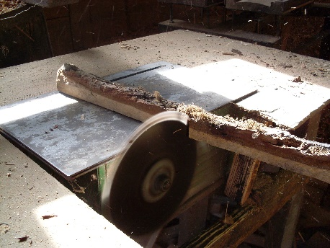
Exposure to wood dust (Health)
Exposure to wood dust can result in a variety of adverse health effects, such as dermatitis, allergic respiratory effects, mucosal and non-allergic respiratory effects, and cancer.
The respiratory effects of wood dust exposure include asthma, hypersensitivity pneumonitis, and chronic bronchitis.
Other common symptoms associated with wood dust exposure include eye irritation, nasal dryness and obstruction, prolonged colds, and frequent headaches.
LEV system
Wood dust is emitted at high velocity by moving or spinning machine components. The primary method of controlling wood dust is with local exhaust ventilation (LEV), which removes dust at or near its source.
31

Slide 32
Other hazards
  Slips, trips and falls
    i.e. Housekeeping
  Fall from heights
  Fire and explosion
17

Slide 33
Slips, Trips and Falls
Slips, Trips and Falls is a frequently occurring accident type, leading to minor injuries (sprains, bruises) as well as major injuries (fractures, head injuries).
DOS | Practice good housekeeping daily Wear anti-slip shoes if floor is usually slippery Report any damaged flooring Put up warning signs for: wet floors dry spills (i.e. saw dust) raised flooring damaged flooring
33
Notes:
Notes for the trainer:
[Housekeeping]
Housekeeping is commonly misunderstood as only cleaning up.
But it also includes tidying the workspace and walking space and keeping them free of obstructions.
Doing so not only reduces slip and trip hazards, it can also improve the fire safety and hygiene of the workplace.
Work can also be carried out more efficiently with less clutter.
[Hazard reporting]
Cracked/missing floor tiles, and uneven ground surfaces can pose tripping hazards.
These are usually identified during routine inspections around the worksite.
However, every staff can contribute by reporting tripping hazards whenever they spot them.
Creating a dedicated feedback channel can help build this culture of proactive reporting.

Slide 34


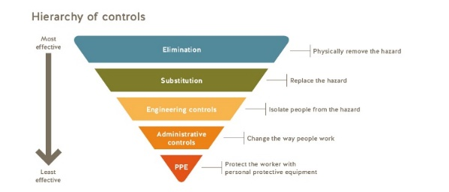
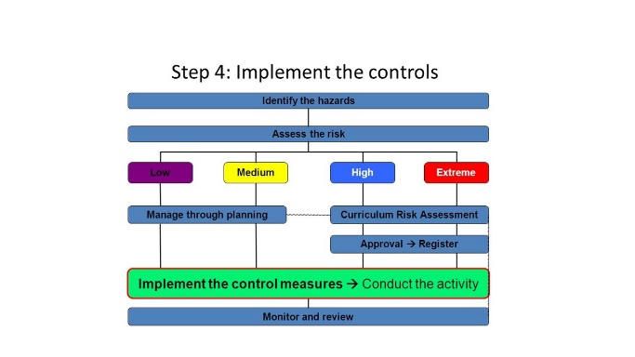
Slips, Trips and Falls
Managing STFs
  Step 1- Identify the Hazards
talk to staff
inspect the premises
review incident / injury records
Step 2- Evaluate the Risk
review work area (taking causes of STFs into account)
methods to determine floor slip resistance
Step 3 - Select Appropriate Risk Control Measures
      Elimination / Substitution / Engineering Control /
      Admin Control / Personal Protective Equipment
Step 4- Implement Control Measures
Step 5- Review Control Measures
34
Notes:
Notes for the trainer:
The trainer can re-emphasized the R concepts introduced in the earlier slides for this topic

Slide 35
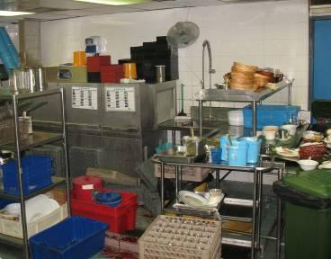
Slips, Trips and Falls
Case study:
Staff was cleaning glasses at the dish washing area in a restaurant kitchen
When lifting a tray of glasses, he slipped on the wet floor and fell
His neck was cut by broken glass and he bled to death
Dish washing area
Lesson learnt:
Wear anti-slip shoes during work
Use a trolley to transport fragile items between locations
Practice housekeeping to keep work area tidy and dry
35
Notes:
Notes for the trainer:
Balancing glassware on trays is a common practice, but it should not be allowed inside of kitchens.
The narrow walk ways and slippery floors makes it especially dangerous for carrying fragile items.
Using a trolley eliminates the need to manually carry glassware and reduces the likelihood of dropping them.
Employers should also look into the condition of the floor, especially in areas where there are high foot traffic and are constantly wet or oily.
Measures should be taken to improve traction in these areas prone to cause slips.

Slide 36
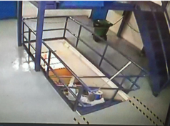
Slips, Trips and Falls
Case study:
Staff slipped and fell down a flight of stairs while sweeping
The floor was dusty due to manufacturing processes in the workplace
Safety shoes were in good condition
He sustained multiple bruises
Lesson learnt:
Place anti-slip strips on the steps of the stairs
Hold handrails for support
Stand on two steps to adopt a stable position when sweeping stairs (see picture on left)
36
Notes:
Relevant resource:
Cleaning and custodial guidelines
Notes for the trainer:
While the recommendations above are only applicable to the employees, employers should also look into the work process on how the emission of dust can be reduced.
This not only decreases the risk of slipping on dust, the frequency of cleaning can also be lower.

Slide 37
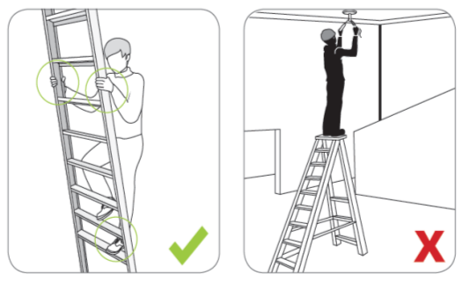
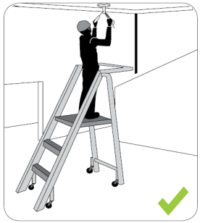
Fall from heights
Fall from heights is one of the leading accident types. Accidents and near-misses often involve the improper use of ladders.
DOS | Wear proper footwear Use the correct ladder for the job Keep 3 points of contact with the ladder at all times Set up a barrier around the ladder during work (e.g. a 2m tall ladder will need barrier at least 2m from it)
DON’TS | Use the ladder on uneven ground
37
Notes:
Notes for the trainer:
The diagram illustrates three points of contact on the ladder (indicated with circles).
The middle diagram depicts balancing on the top rung of vertical access ladders during work, which is unsafe but commonly practiced.
The right diagram shows a step platform which can provide a more stable work surface to stand on during work.
[middle diagram]
This contradicts the safe practice of maintaining three points of contact, because there are no hand supports above the top rung. Hence, there is greater risk of losing balance and falling over. A taller ladder should be used to access hard-to-reach areas instead of standing on the top rung. The top rung of the ladder may be used to place tools, as opposed to carrying the tools while climbing the ladder.
Additional resources:
Code of Practice for Working Safely at Heights

Slide 38
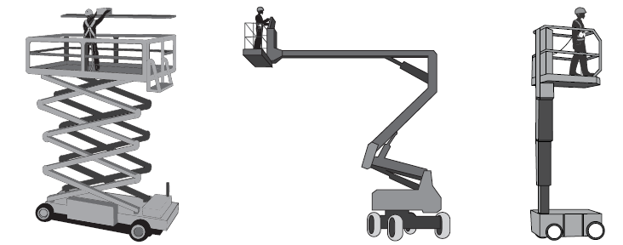
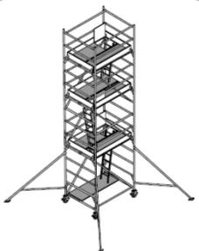
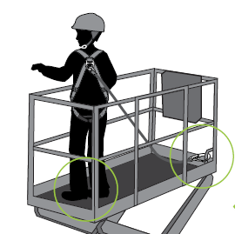
Fall from heights
A scaffold/platform is recommended to provide better access and also a more stable platform for you to work on.
DOS | Ensure the scaffold/platform has been inspected by a licensed inspector before use. Only set up on level and stable ground Fully extend outriggers to enhance stability Wear helmet, safety harness with lanyard and safety shoes
DON’TS | Overload the scaffold/platform
38
Notes:
Notes for the trainer:
[travel restrain]
Travel restraint is composed of a safety harness, lanyard and anchorage. It is common practice to put on the safety harness without attaching the lanyard to a secure anchorage. The worker is prevented from stepping out of the platform and falling. It should not be confused with a fall-arrest system, which is designed to mitigate and control the impact of a fall.
Additional resource:
Code of Practice for Working Safely at Heights

Slide 39

Fall from heights
Case study:
Staff was conducting inspections above the false ceiling of a walkway
He stepped on a weaker support that gave way
He fell through the ceiling to the ground and fractured his pelvis
3.2m
Lesson learnt:
Use a tower scaffold to access tall work areas
Do not put weight on structures unless it is designed for walking or working on
39
Notes:
Notes for the trainer:
It is not know if the support structures are designed to bear the weight of a grown man.
Furthermore, a travel restraint system or fall-arrest system would fail in this setting.
Hence it is advisable to use a mobile work platform to access and carry out the inspections.

Slide 40
Fire and explosion
Fire is the process of a fuel (such as solvents or gasoline) combining with oxygen to produce heat.
Explosions are due to the violent expansion of gases, releasing large amounts of energy rapidly. The effects of explosions are fast-moving pressure waves and shock waves, which can damage equipment, destroy buildings and shatter windows.
Note
There is no fire when any one of the three elements is eliminated or removed.
How do fire occur?
Three elements – Fuel, oxygen and an ignition source such as heat, are all needed to be present in the correct concentration for a fire to start or an explosion to occur:
  1st element - Oxygen is present naturally in the air around us.
  2nd element - Fuel keeps a fire burning.
  3rd element - Ignition source provides energy to initiate a fire.
Fire Triangle
40

Slide 41
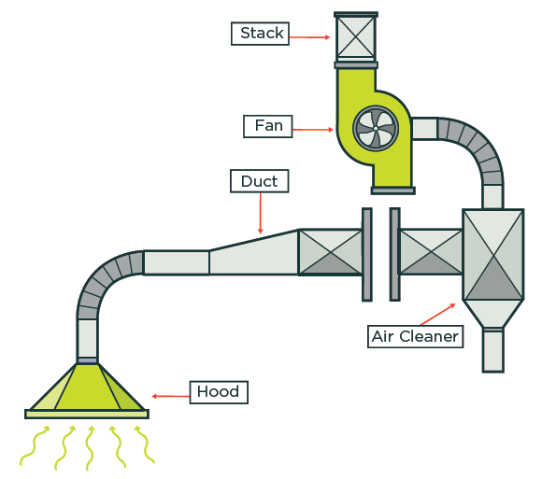
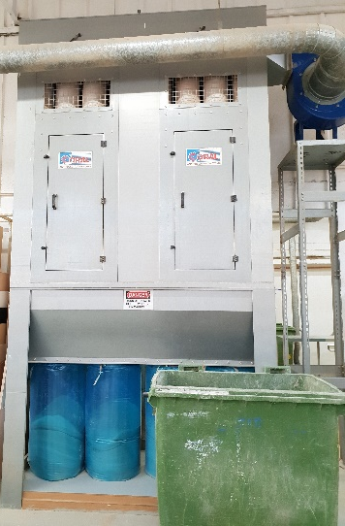

Fire and explosion
Materials such as wood, food, metal dusts can cause explosions due to the dispersion of fine combustible particles, when in sufficient quantities and concentration and under favourable conditions, such as air, heat, fuel, dispersion and confined environment.
To do:
• Establish effective dust control measures to prevent and reduce the escape of dust from processing equipment to the environment, e.g. dust collecting system.
• Establish and implement good housekeeping practices to keep work places clean and safe (i.e. regular cleaning intervals to prevent accumulation of dust).
• Design building elements and arrange equipment to reduce dust accumulation (i.e. such as smooth, easy-to-clean walls and sloped surfaces).
• Replace combustible dust with safer alternatives e.g. ready-to-use materials.
Typical Local Exhaust Ventilation (LEV) system
41

Slide 42

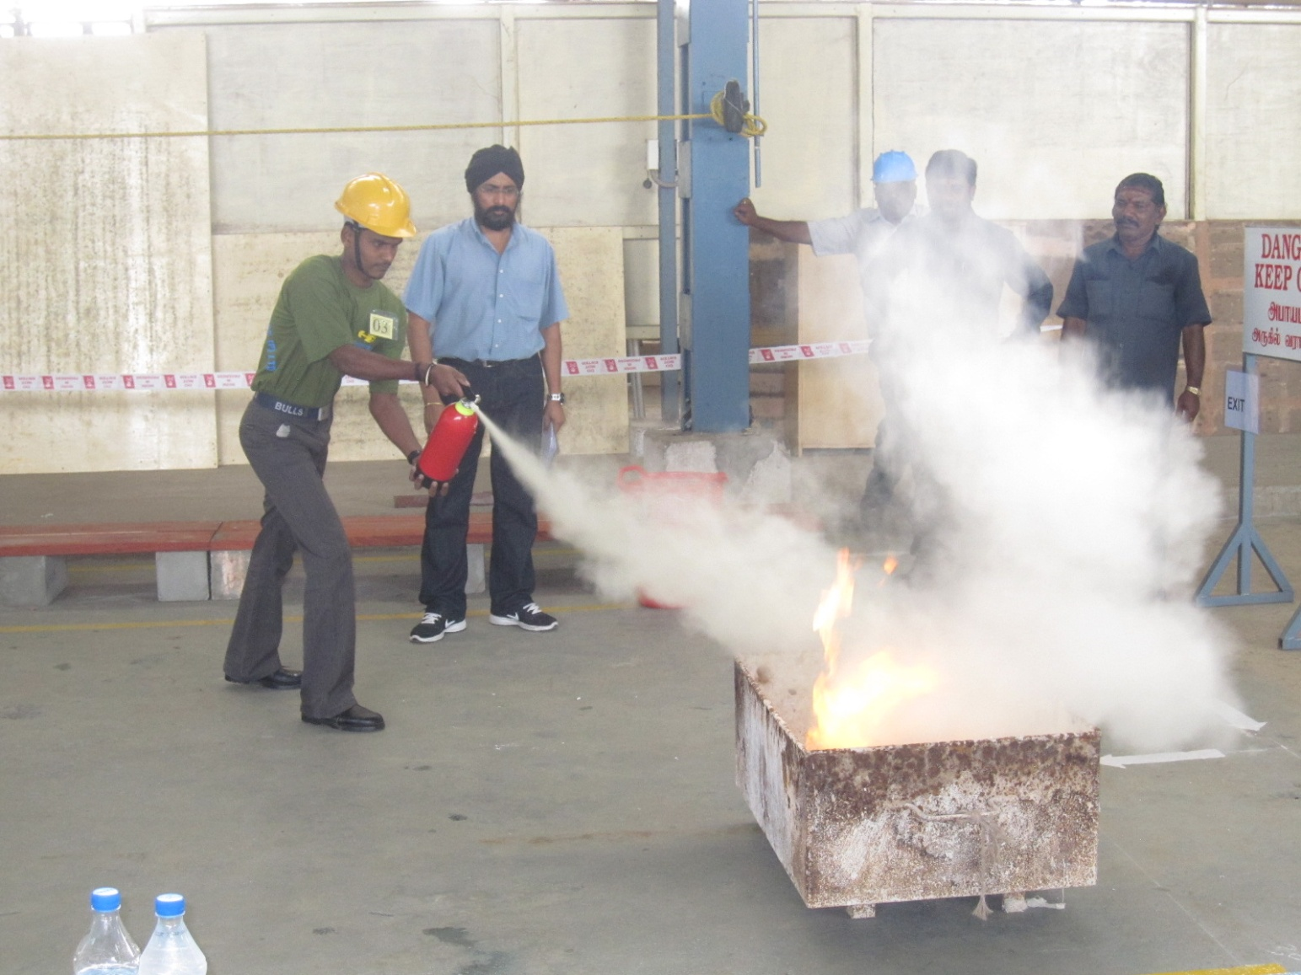
Fire and explosion
How to use a fire extinguisher… remember PASS
P – Pull the pin
A – Aim at the base of fire
S – Squeeze the Operating Handle
S – Sweep from side to side
Common types of fire extinguishers and its application for different types of fire
Note
If the fire cannot be extinguished, quickly
evacuate the workplace. The building fire alarm
system should be activated and SDCF be notified.
42

Slide 43
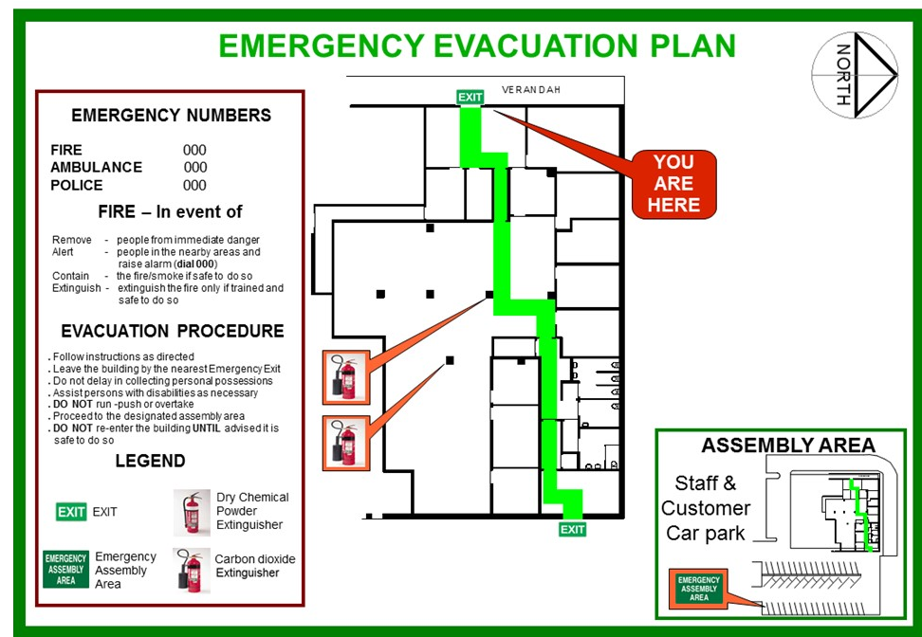
Fire and explosion
Emergency response plan (ERP)
As an employee, you must be familiar with the key emergency procedures in your workplace, such as:
  First-aid measure
  Fire extinguisher technique, and
  Evacuation plan
To- do [during an Emergency Evacuation]
  Evacuation from the workplace may be necessary when there is a fire or explosion
  Be aware of the marked exits & building evacuation route
  Walk quickly to the nearest exit and guide others to do the same
Typical example: Emergency Evacuation Plan
  Once outside, proceed to the designated assembly point
  Do not return to the building/premises until the emergency situation had been rectified & building premises cleared for re-entry
43

Slide 44


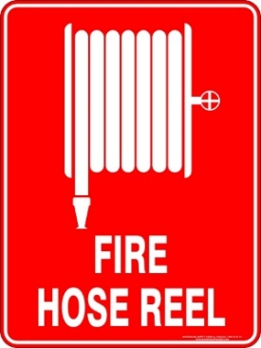

5. Industrial Safety Signs
Safety signs are important hazard communication tools to alert or remind workers of workplace hazards and the safety precautions to take at specific work areas, especially when working with a hazardous machine (see pictograms).
Warning
• Signs (yellow signs with black triangle band) alert
workers of a hazard or hazardous condition.
Mandatory Action
• (Blue circle signs) indicate action that must be carried
out in specific work areas.
Prohibition
• (Red circular band and a red diagonal bar) indicate an
action or activity that is not permitted
Fire Safety
• (Red with white lettering) indicate the location of fire
alarms and fire protection equipment.
Safe Condition
• (Green with white lettering) indicate the location of
emergency-related facilities such as exits, first aid,
and safety equipment.
44
Notes:
Notes to trainer:
For more information on warning signs, see:
• SS 508: 2013, Graphic Symbols - Safety Colours and Safety Signs
–– Part 1: Design principles for safety signs and safety markings
–– Part 3: Design principles for graphical symbols for use in safety signs

Slide 45
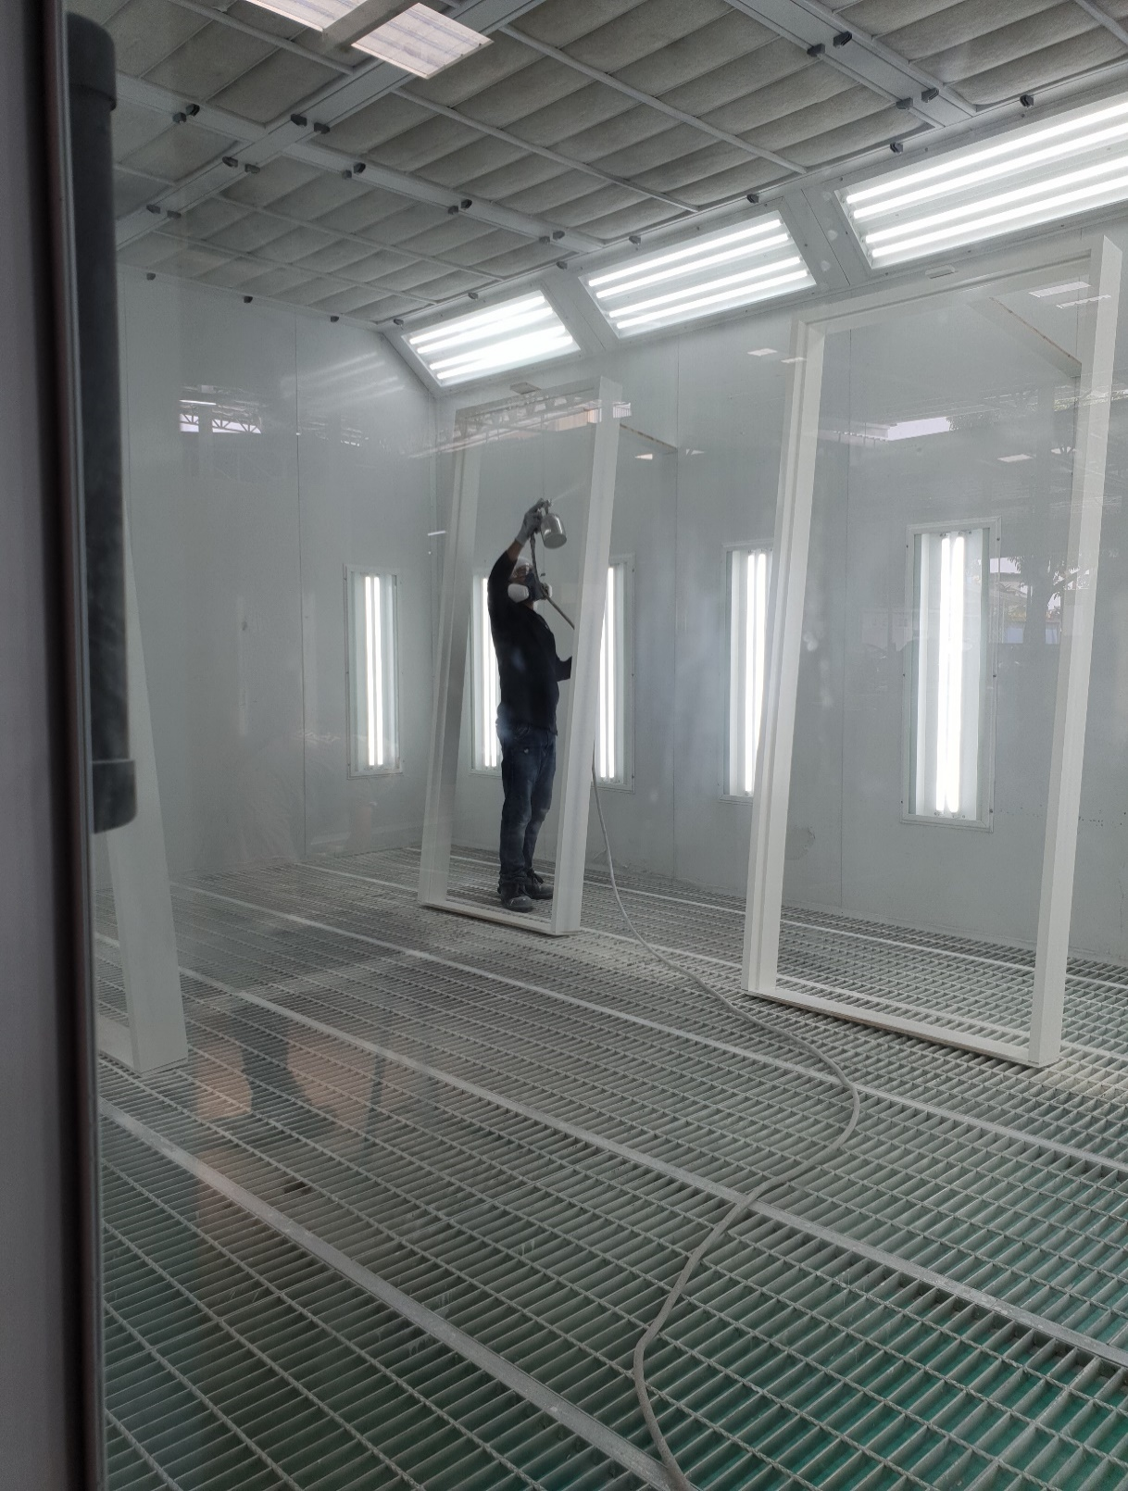
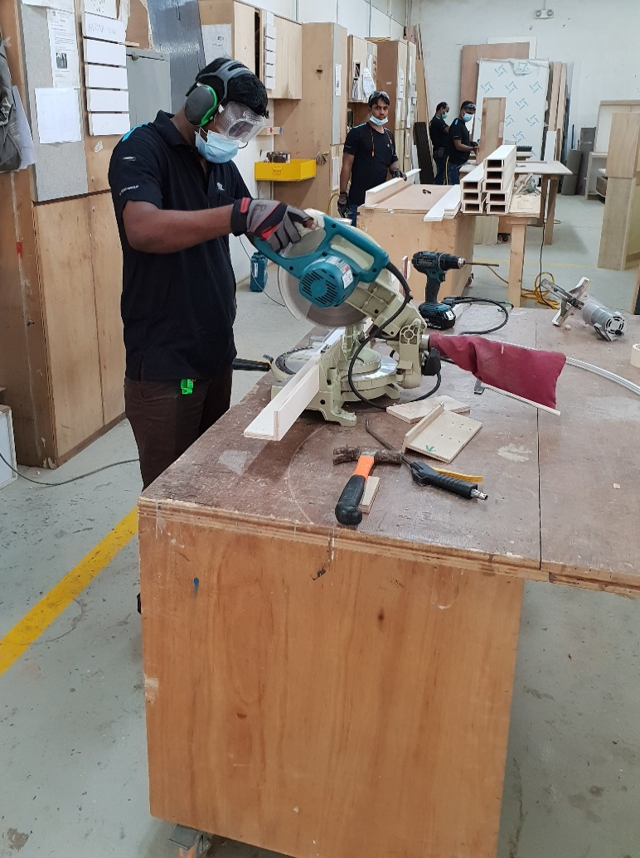
6. Personal Protective Equipment (PPE)
Typical PPE items used in the woodworking industry:
Safety Helmets/hard hats (when necessary)
Safety glasses/goggles and face shields
Gloves (incl. chemically protective gloves)
Steel-toed safety shoes with slip-resistant soles
Earplugs and earmuffs
Particulate-resistant and/or chemically resistant overalls
Respirators
Worker operating a portable
cutting machine
Spray painting in an enclosed environment
45
Notes:
Notes to trainer:
You are free to include and/or contextualize any other PPE relevant to your organisational needs

Slide 46
6. Hand protection
In the woodworking industry, hand gloves is important to protect workers/operators from physical and chemical hazards when using machines. Some of the common types of gloves are shown in the table.
46
Notes:
Notes to trainer:
Pls note that the listed gloves served as examples for the application of relevant works only. Not all are types gloves are needed if the company does not carry out such works

Slide 47
Case studies
  Woodworking industry
    i.e. Amputation cases arising from operating table, circular saws.
47

Slide 48
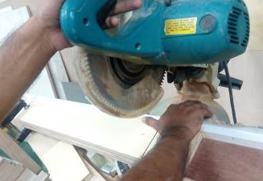
7. Case study 1: Worker’s thumb severed by circular saw
Description of accident
A worker was using a circular saw to cut timbers to the required size. He was holding onto the timber piece using his right hand and holding the handle of the machine with his left hand. During the process of cutting, his right hand’s thumb was cut off (see picture 1).
Investigation Findings
The accident happened when the injured worker was holding onto the shorter side of the timber piece while cutting using the circular saw machine. His right hand’s thumb was placed directly below the blade of the circular saw and was consequently severed off.
Pic 1: Injured’s right thumb during the
accident
Pic 2: Re-enactment of cutting process during the accident
48
Notes:
Notes to trainer:
Sharing of actual cases

Slide 49
7. Case study 1: Worker’s thumb severed by circular saw
Lesson learnt
The method adopted by the injured worker of using the circular saw machine to cut the timber into the desired size by placing one’s hand directly below the rotating saw blade of the circular saw was an unsafe practice
The company should conduct Risk Assessment to identify hazards and implement appropriate control measures for all work activities and operation of machineries in the workplace
Workers should not hold the timber piece (especially the short side of the timber) during the cutting process; and the hand must be kept away from the cutting blade at all times. For thicker and heavier timber pieces, the workers would need to secure them using the F-clamp or appropriate clamp(s) before cutting is carried out
The company should use appropriate machine, equipment or tool when carrying out special task
49
Notes:
Notes to trainer:
Sharing of actual cases

Slide 50
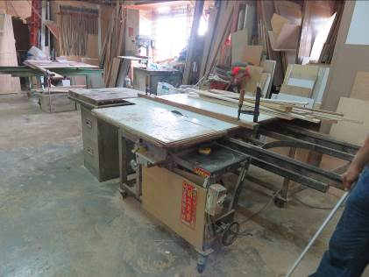
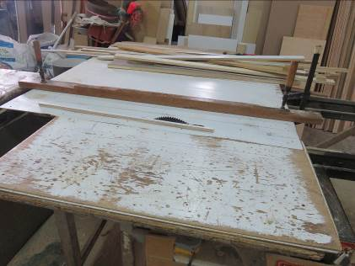
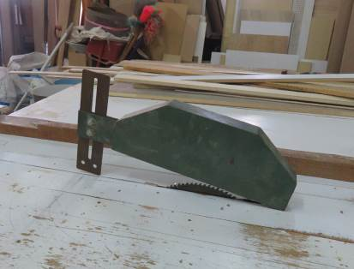
7. Case study 2: Worker’s fingers severed by table saw
Description of accident
The injured worker was cutting a wooden plank using table saw when his left fingers came into contact with the saw-blade. He informed the company director that he had cut his fingers. The carpenter suffered amputations of his left thumb, index and middle fingers, and nail bed grafting on the left ring finger.
Investigation Findings
The carpenter was using the table-saw machine to cut the plank into the desired size, where he hold and push the material towards the rotating saw-blade with his hands that resulted in having his fingers severed by the exposed rotating saw blade.
Pic 1: The table saw that was involved in the accident
Pic 2: Guard was not installed during the day of accident
Pic 3: Table saw guard was available but was removed prior to the accident
50
Notes:
Notes to trainer:
Sharing of actual cases

Slide 51
7. Case study 2: Worker’s fingers severed by table saw
Lesson learnt
The worker was operating the table saw with exposed rotating saw-blade without the safety guard installed
There was no risk assessment conducted for the table saw activities and safe work procedures were also not established for the use of table saw
The company should conduct a risk assessment to identify hazards and implement appropriate control measures for all work activities and operation of machineries in workplaces; such as provision of safety features or devices (i.e. guards) to prevent its accidental removal and to maintain its effectiveness
The method adopted by the injured worker of using the table saw machine to cut the plank into the desired size, where he hold and push the material towards the rotating saw-blade with his hands was an unsafe practice
The company should use safety means or tools for safe handling of the work piece, and in this case, such as a push stick to push the material to the saw blade and prevent the injured’s hands from coming into contact with the rotating saw-blade
51
Notes:
Notes to trainer:
Sharing of actual cases

Slide 52
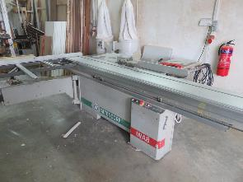
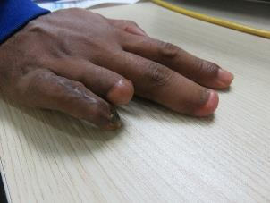
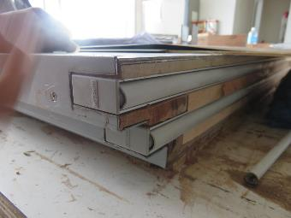
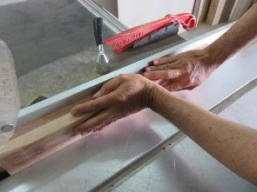
7. Case study 3: Worker’s fingers severed by table saw
Description of accident
The injured worker used the table saw for cutting the groove on the bottom panel of timber door frame (see pic 3) as he had seen his senior did it. In the process of doing that, he used his hands instead of a push stick; the injured’s fingers came into contact with the rotating saw blade of the table saw which resulted in amputation.
Investigation Findings
It was also the occupier practice to use the table saw to cut the groove on timber or wooden plank.
In carrying out such operation, the safe guard hood for the rotating saw blade must be removed as it would obstruct the timber from being pushed forward.
Pic 1: The table saw that was
involved in the accident
Pic 2: Injured worker’s fingers after the accident
Pic 3: To cut the groove
(highlighted in red) for installing
bottom panel of timber door
frames.
Pic 4: Table saw guard was available but was removed prior to the accident.
52
Notes:
Notes to trainer:
Sharing of actual cases

Slide 53
7. Case study 3: Worker’s fingers severed by table saw
Lesson learnt
Safe work procedures on cutting of groove on timber or wooden plank using table saw were not established
The method adopted by the company to remove the safety guard to cut the groove on timber or wooden plank using the table saw machine, where he hold and push the material towards the exposed rotating saw-blade with his hands was an unsafe practice
The company should adopt a safer method to cut the groove for the bottom panel of the timber door frames with an appropriate equipment (router) solution which was available in the market currently, instead of using the table saw
53
Notes:
Notes to trainer:
Sharing of actual cases

Slide 54
Acknowledgement
Company | Credits
Tarkus Interiors Pte Ltd | Pictures in slide 19, 20; 28; 30; 41 & 45
IDV Concepts Asia Pte Ltd | Picture in slide 20
54

