Slide 1
5 WSH tips on SAFE USE OF ELECTRICAL EQUIPMENT
Making Workplaces Safer
Adopt safe work practices

Slide 2
EXPOSURE TO ELECTRIC CURRENT
Every year, up to 2 workers die and more than 10 workers suffer injury
from exposure to electric current.
 | 2016 | 2017 | 2018 | 2019
Fatalities | 2 | 1 | 2 | 1
Major Injuries | 17 | 14 | 10 | 18
WSH National Statistics Report 2016 - 2019
Contact with electricity can occur when working with:
Electrical installations
Industrial machines
Electrical equipment
Notes:
Overloading power points, improper earthing and wet surroundings can cause serious injuries and even death to workers.
Every year, up to 2 workers die and more than 10 workers suffer injury from exposure to electric current.
Do your risk assessment before starting work.
Exposure to electric current is a hazard that involves ALL industry sectors.
From 2016 to 2019, the main contribution was from the following industry sectors
Manufacturing
Professional, Scientific & Technical Activities
Accommodation & Food Service Activities
Wholesale & Retail Trade
Community, Social & Personal Services
Real Estate Activities
Financial & Insurance Activities
Administrative & Support Service Activities

Slide 3
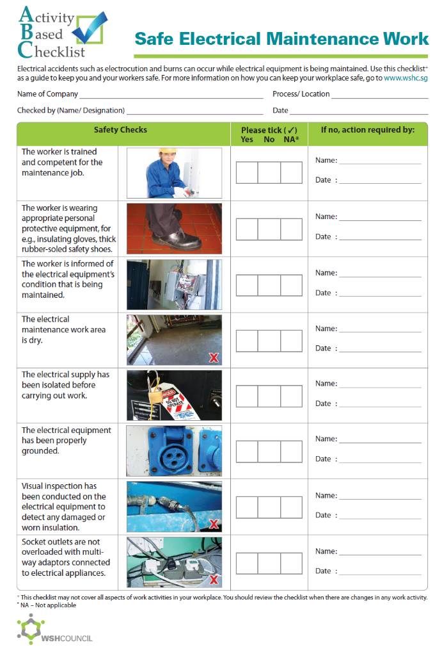
FOR YOUR SAFETY:
Do not work with the equipment or machine if
it is defective
there are damaged electrical cords or exposed wires
the power points or extension cords are overloaded
the work area is wet or damp
you smell something burning
Notes:
Important to carry out on-site Risk Assessment (starting with hazard identification) before starting work.
Do not proceed with the work unless the identified hazards are suitably addressed and/or risk controls are put in place.

Slide 4
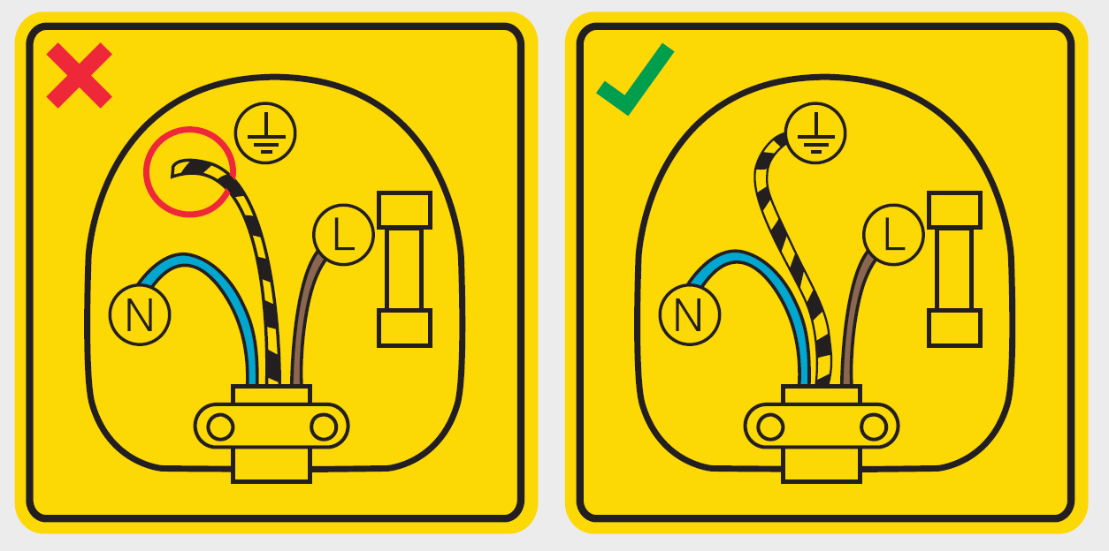
WSH Tip 1
Ensure correct wiring and
proper earthing *
*L: live wire, N: neutral wire, :earth wire
Notes:
In an electrical circuit, there is a live wire, which supplies the power, and a neutral wire, which carries that current back.
An additional earth wire (also often referred to as a grounding wire) is typically attached to electrical outlets and electrical devices which is securely connected to the ground at the circuit breaker box.
This ground wire is an additional path for electrical current to return safely to the ground without danger to anyone in the event of a short circuit.
If a short circuit occurs, the current would flow through the earth wire, causing a blown fuse or tripped circuit breaker – an outcome much more preferable than the fatal electric shock that could result if the current was not grounded.

Slide 5
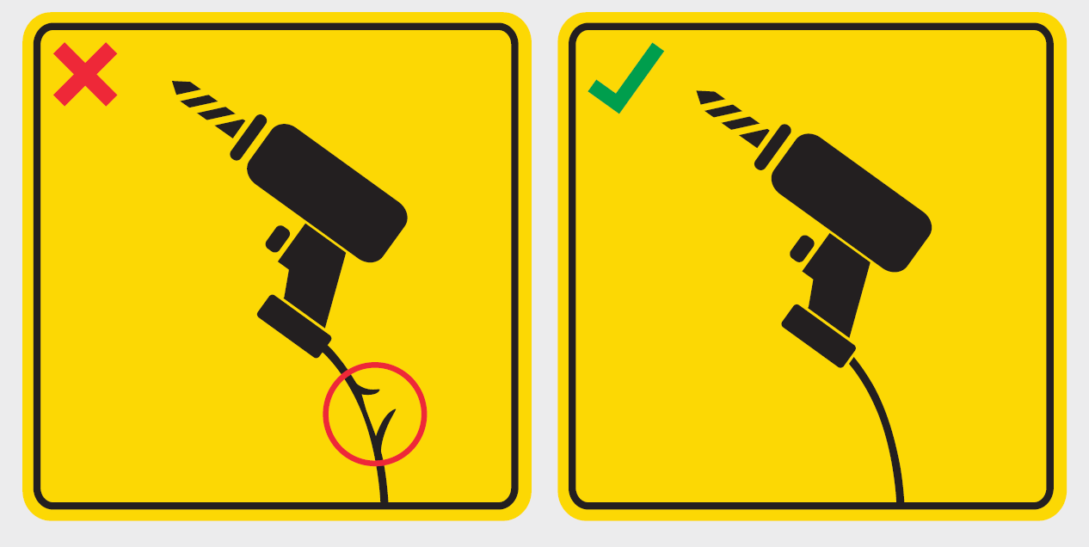
WSH Tip 2
Make sure equipment is in
good condition before use
Notes:
Do not use the equipment if the electrical cord is damaged/frayed or if there is an exposed wire.
You will be exposed to live electric current the moment you contact with the frayed/exposed wire.

Slide 6
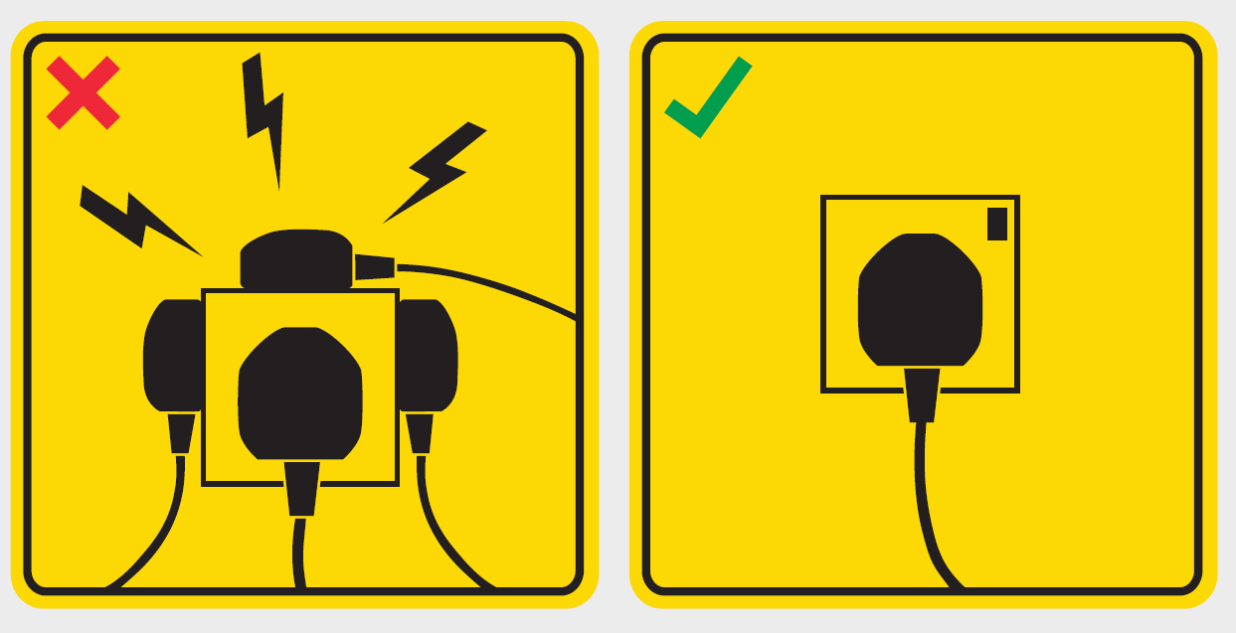
WSH Tip 3
Do not overload power sockets
Notes:
A power point overload occurs when you exceed the maximum amperage (A) of the electrical circuit you are using. This can be caused by plugging too many appliances into the one power point or running appliances that draw high amps at the same time.
The result of an overload can be a short circuit and possibly a fire. The problem occurs when one layers one multi socket adaptor on top of another. This increases the risk of exceeding the circuit’s amperage and is an electrical fire waiting to happen.

Slide 7
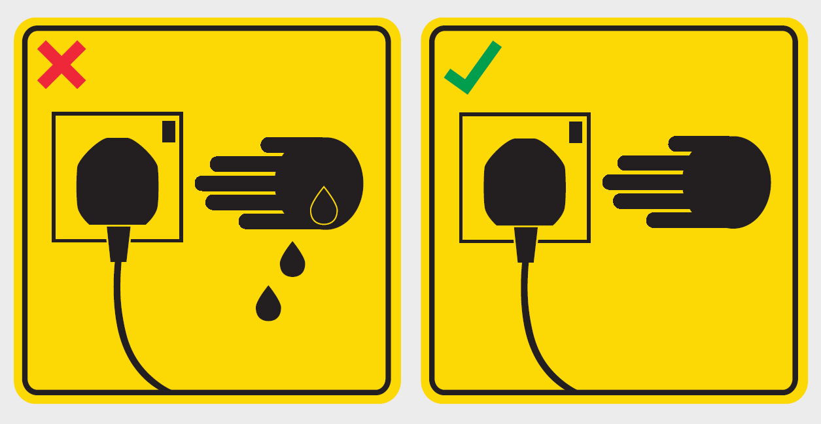
WSH Tip 4
Dry your hands before
touching equipment
Notes:
Water is a conductor of electricity.
Should water enter the equipment, the internal electrical circuitry may be unintentionally completed (closed). Should this happen and your hands are wet when you touch the equipment, the electric current will conduct through you and you face the risk of being electrocuted.

Slide 8
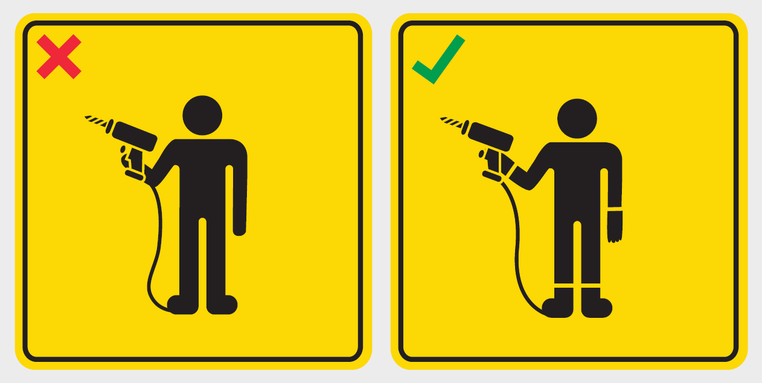
WSH Tip 5
Use the right personal
protective equipment
Notes:
When working with electrical equipment or industrial machines, always put on electrically-resistant safety footwear* (e.g. rubber-soled shoes) and electrically-resistant gloves** (e.g. gloves made of rubber) so that your electrical resistance is high (similar to an open circuit) and the electric current will not pass through you.
* electrically-resistant safety footwear refers to non-conductive electrical hazard (EH) rated footwear
** electrically-resistant safety gloves refer to gloves that are dielectric and electrically-insulated (both desirable traits to prevent electric shock)

Slide 9
LOOK. THINK. DO.
“Electrical Safety”
View video on WSH Council’s YouTube Channel
Notes:
The 3 key messages in the above video are:
Make sure your hands and your work area are dry before handling electrical equipment
Put on the appropriate safety footwear and gloves for electrical work
Inspect electrical equipment before starting work and report any exposed or damaged wires to your supervisor

Slide 10
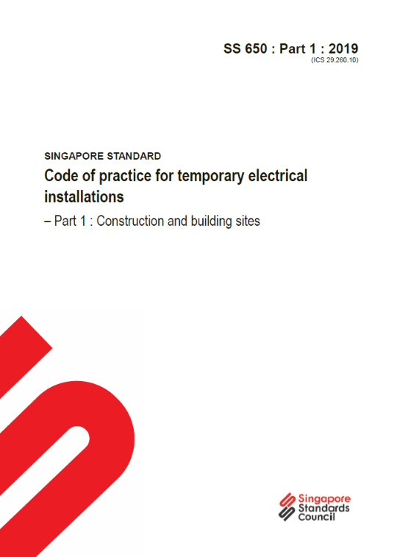
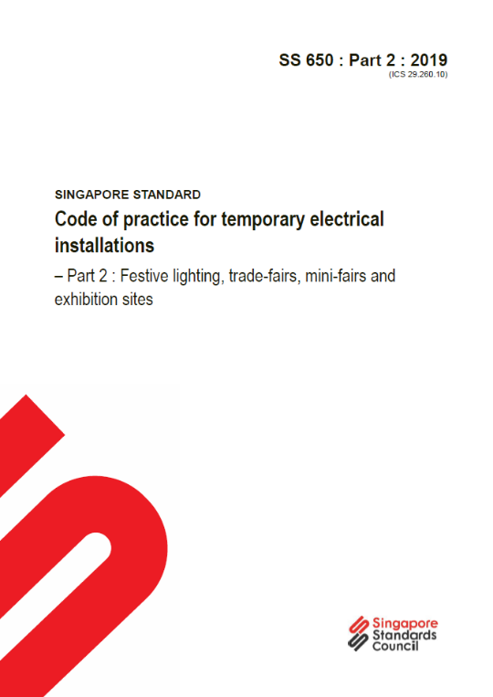
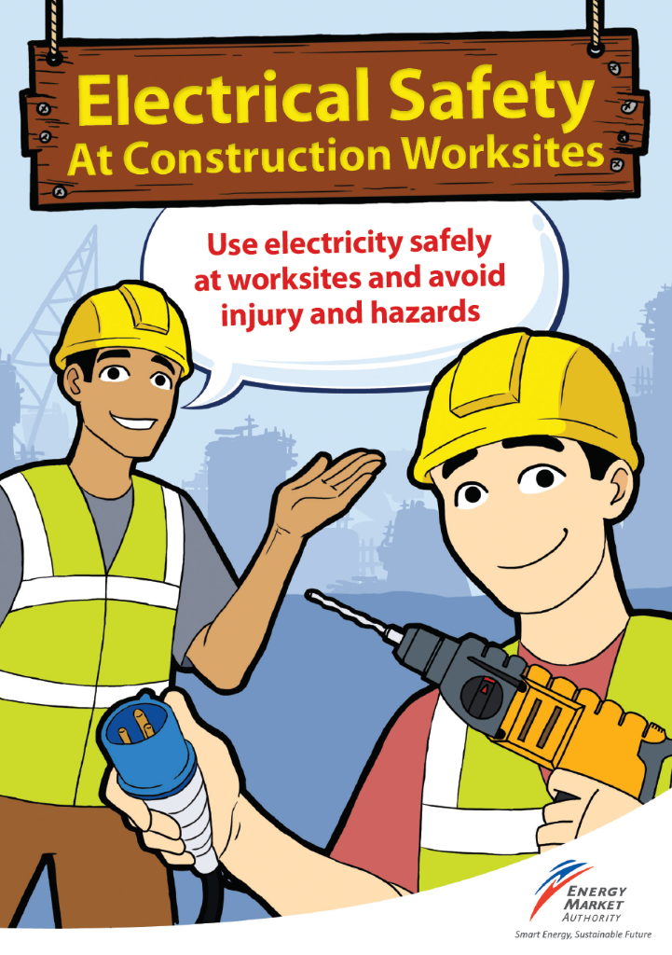
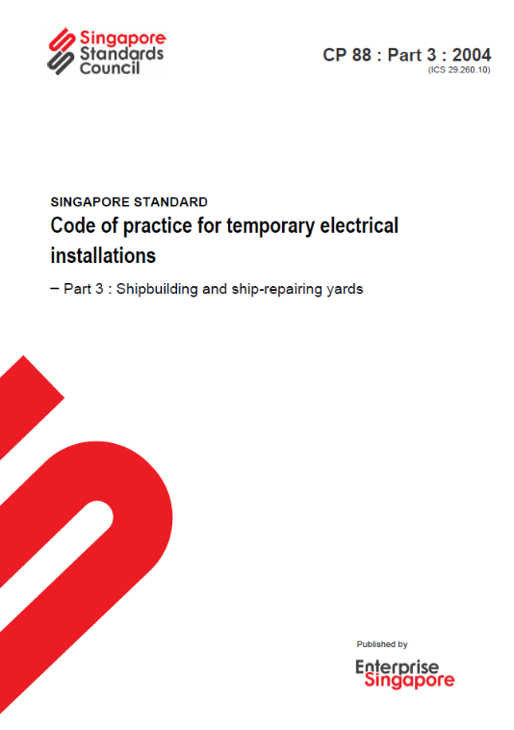
ELECTROCUTION
CAN BE PREVENTED
Available at www.singaporestandardseshop.sg/
Download at
http://elise.ema.gov.sg/

