Slide 1
5 WSH tips on SAFE LOADING ON VEHICLES
Making Workplaces Safer
Adopt safe work practices

Slide 2
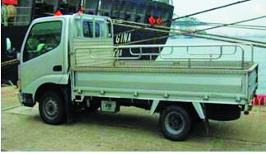
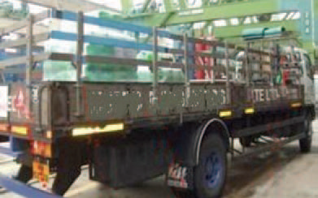
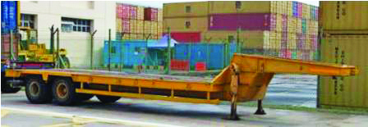
SAFE VEHICLE LOADING
Every year, 6 workers die from unsafe loading and unloading practices.
Use the right vehicle
Vehicle must be wider and longer than the cargo
Vehicle has suitable fittings for securing the cargo
Combined weight of vehicle + cargo
must be less than weight limit of
roads/structures (where the vehicle
will be driven on or parking at)
Truck
Lorry with sideboard
Source: WSH Guidelines on Safe Loading on Vehicles
Low bed trailer
Notes:
The consequences of unsafe loading practices can be hazardous and even fatal.
Every year, 6 workers die from unsafe loading and unloading practices.
Do your risk assessment before starting work.
Safe vehicle loading starts with selecting the right vehicle for your cargo.

Slide 3
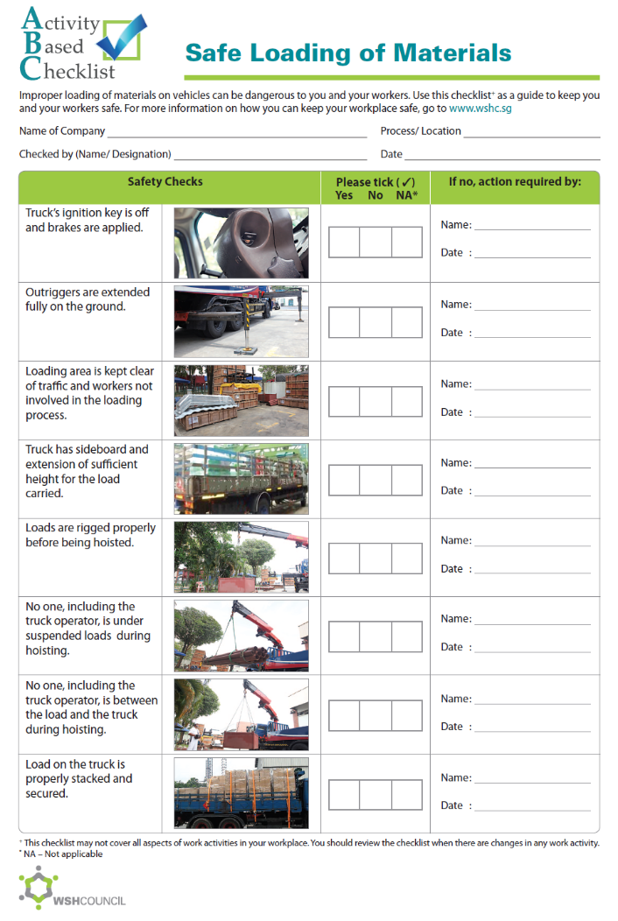
SAFE LOADING
CHECKLIST
Lift the load safely
Stabilise the lorry crane used for transferring the cargo
Rig properly and check that the load being lifted is stable, balanced and secure.
Properly secure the load
Methods of securing
More at:
WSH Training Slides on Safe Securing of Loads
Notes:
With the right vehicle selected, the next step is to transfer the cargo onto the vehicle.
From the warehouse or storage area, the cargo is typically brought to the loading point using a pallet jack, forklift or reach truck. For large or heavy cargo, transfer onto the vehicle typically involves the use of a lorry crane or other lifting equipment. If done properly, no one should get hurt as a result of lifting operations.
Once the cargo is on the vehicle, proper securing is essential so that the cargo remains on the vehicle during the journey and the driver can get to his destination safely.

Slide 4
WSH Tip 1
Use handbrake and wheel
chocks when parking
Notes:
Park only at designated parking areas. Ensure that parking brakes are engaged and wheel chocks and/or stabilisers are properly positioned to prevent unwanted movement of the vehicle after parking.

Slide 5
WSH Tip 2
Fully extend all lorry crane outriggers
on firm level ground
Notes:
Fully extend the outriggers to improve the stability of the lorry crane in preparation for lifting operations and loading/unloading activity. This will help to prevent the lorry crane from toppling.

Slide 6
WSH Tip 3
Stay clear of suspended loads
Notes:
Never go under a suspended load as the load (usually something heavy) will land on you if it falls while it is being lifted. Workers have lost their lives this way and it is important that we do not commit the same mistake.
For supervisors: It is good practice to demarcate the lifting zone to prevent unauthorised persons from entering the lifting zone while the lifting operation is in progress. Under no circumstances should you allow anyone to be under a suspended load at any time.

Slide 7
WSH Tip 4
Do not stack cargo higher
than the headboard
Notes:
When loading a vehicle, do not stack the cargo higher than the headboard. This is because, should there be a need for the driver to jam brake, there is a chance that the cargo stacked above the headboard will slide towards the driver’s cabin, resulting in the driver (and those in the passenger seat) being crushed inside the cabin.
Note that the headboard (also called a cabin guard) is typically a reinforced structure that restrains forward movement of the cargo and it serves to protect the driver’s cabin from getting impacted by the cargo should the cargo slide forward.

Slide 8
WSH Tip 5
Lash and secure load properly
Notes:
Securing equipment (e.g. load binder, turnbuckle, chains, webbing, ropes, nets) are the main means of keeping the cargo anchored to the vehicle.
Select and use the appropriate securing equipment for the type and composition of cargo you are transporting.
Secure the cargo via a combination of lashing, blocking, and/or friction to prevent the cargo from moving during transportation.

Slide 9
LOOK. THINK. DO.
“Take Time to Take Care (Vehicular Safety)”
View video on WSH Council’s YouTube Channel
Notes:
Always engage the handbrake and deploy wheel chocks when parking a heavy vehicle. This will ensure no movement of the vehicle in preparation for loading/unloading activity.
It is also important to take care of yourself by having some rest time between driving jobs to combat driver fatigue.
Note that fatigue can lead to reduced mental & physical performance that can endanger your safety & health.

Slide 10
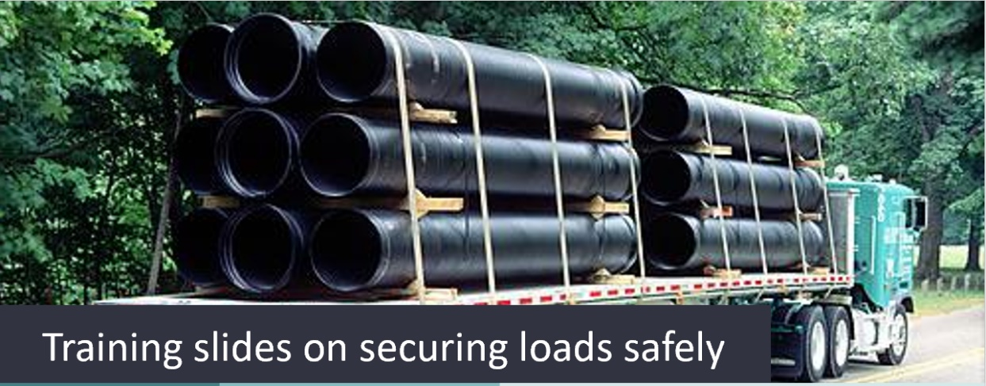
LOADING/UNLOADING ACCIDENTS CAN BE PREVENTED
Download here
Download at www.wshc.sg/resources

