Slide 1
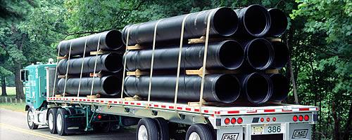
Training slides on securing loads safely
This set of slides is created for transport operators. You can use it to complement your company’s in-house Workplace Safety & Health (WSH) training.
Various types of loads and good load-securing practices are illustrated with diagrams and pictures in the slides and you can customise it by selecting the loads relevant to your company’s operations.
All rights reserved, 2015. The information provided in this training slides is accurate at time of publication. All examples shared in this training slides are meant for learning purposes only. The learning points for each example are not exhaustive and should not be taken to encapsulate all the responsibilities and obligations of the user of this training slides under the law. The Workplace Safety and Health Council does not accept any liability or responsibility for any modifications made to this set of training slides.
Notes:
All rights reserved, 2015. The information provided in this training slides is accurate at time of publication. All examples shared in this training slides are meant for learning purposes only. The learning points for each example are not exhaustive and should not be taken to encapsulate all the responsibilities and obligations of the user of this training slides under the law. The Workplace Safety and Health Council does not accept any liability or responsibility for any modifications made to this set of training slides.

Slide 2
Your company logo here
SAFE LOADING ON VEHICLES
Date
Notes:
Trainer Notes:
Please insert your company logo at the top right corner.
To ensure that the slides are up-to-date, date should be indicated to track version.

Slide 3
Content
Workplace Safety and Health (WSH) Policy
Employee’s Roles and Responsibilities
Types of Vehicles
Fittings for Securing Loads
General Guide on Securing Loads
Securing Methods for various loads:
Tyres Boxes Sacks/Bags Bales/Bundles Drums Empty pallets Palletised cargo | Metal loads Steel Plates/Structural steel Pipes Ingots/Bars Metal sheet coils Steel wire coils Cable drums Metal panels Scrap metal | Timber loads Heavy machines/equipments Containers Precast Concrete blocks/slabs Jumbo bags Car transporters Tote bins
Notes:
Trainer Notes:
This set of slides is customisable, you may choose the cargo types that can be found at your workplace, and take out the rest.
Please also add in any types of cargo that you find is not in the list.
The securing methods are safe practices that are commonly used by the industry.
If your company has stricter requirements than what is recommended, please amend the slides and follow your company’s standards.

Slide 4
1. WSH Policy
Insert your company’s
WSH Policy here
Notes:
Trainer notes:
Please insert company’s WSH Policy here.
Give a brief explanation about your WSH Policy, to help the staff understand the company’s stance on WSH.

Slide 5
2. Employee’s Roles and Responsibilities
Follow all safe work procedures and instructions
Report all unsafe work conditions and work practices to your supervisor
…
…
…
…
…
…
Please add your company’s own
WSH rules and regulations here
Notes:
Trainer Notes:
Please add on your company’s WSH rules and regulations here.

Slide 6
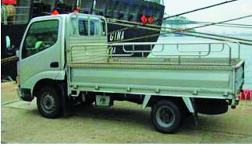
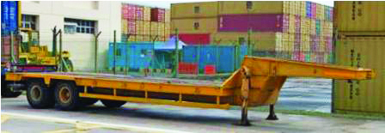
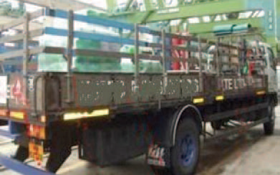
3. Types of Vehicles
Use the right vehicle for transporting the load
Ensure vehicle is long enough, such that loads do not stick out
Ensure vehicle and load do not exceed maximum laden weight
Ensure vehicle has proper fittings for securing loads
Mini truck
Low bed trailer
Lorry with sideboard
Notes:
Trainer Notes:
Emphasis should be placed on picking the correct vehicle.
The vehicle used for transporting needs to be longer than the load, especially when transporting timber or pipes.
Loads sticking out of the vehicle body can pose a danger to workers in the workplace and the public when on the road.

Slide 7
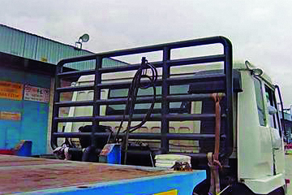
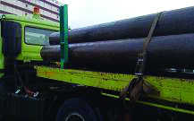
4. Fittings for Securing Loads
Headboard
Headboard
Prevent loads from breaching driver cabin
Height reference when stacking loads
Strong enough to bear the weight of loads
Stanchion
Barrier for keeping loads within lorry bed
Height reference when stacking loads
Strong enough to bear the weight of loads
Minimum number of stanchions needed
20-foot trailer, at least 2 on each side
40-foot trailer, at least 4 on each side
Stanchion
Notes:
Trainer Notes:
The rear glass panel in the driver’s cabin is susceptible to being breached by the load when the load shifts forward during a sudden brake.
Headboards are an important safety fitting that serves as an additional barrier and protects the driver’s cabin.
Stanchions provide additional support and help contain the load.
Wooden side boards serve a similar function but stanchions can withstand heavier loads.
When stacking loads, the stacks should never be stacked taller than the headboards or stanchions, whichever is shorter.
This should apply to all the types of stackable loads in this set of slides.

Slide 8
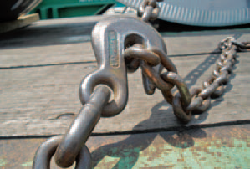
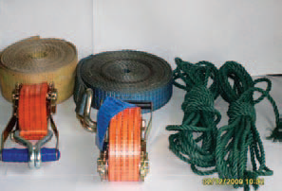
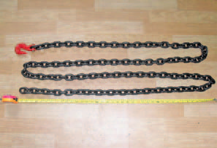
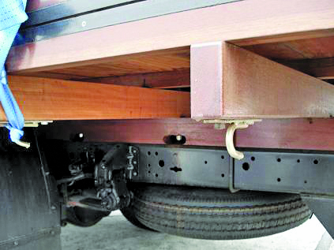
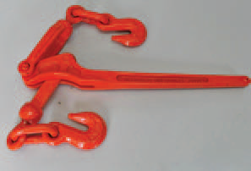
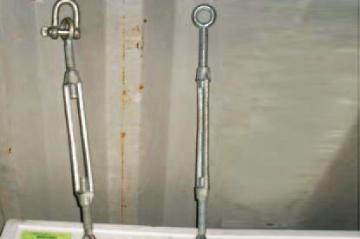
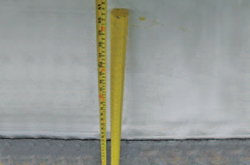
4. Fittings for Securing Loads
Anchorage points & load securing devices
Check working condition before using
Replace worn out or damaged devices
Keep devices well-maintained
Chain sling hook
Steel chain with
grab hook
Lashing belts, rope
Anchorage points
Ratchet load binder
Turn buckle
Steel bar
Notes:
Trainer Notes:
Both anchorage points and lead securing devices are used in conjunction for securing loads to the body of the vehicle.
Damaged lashing devices can give way at any time, and thus pose a huge risk when used on public roads.
Conduct checks before moving off, and replace and devices showing signs of wear and tear.
Similarly, anchorage points that are rusty, or loose, should be replaced when the vehicle is sent for maintenance.

Slide 9
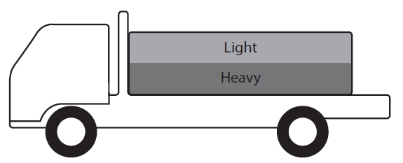
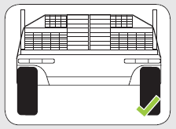
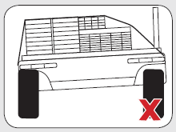
5. General Guide on Securing Loads
Stacking
Stack lighter loads on top of heavy loads (Figure A)
Arrange loads to spread the weight out evenly (Figure B)
Ensure that stacking arrangement is stable
Figure A
Figure B
Notes:
Trainer Notes:
This slide shows the general rule to follow when stacking loads on vehicles.
All three rules are means of improving the stability of the load stack and vehicle.
Stable loads are less likely to move around or fall off the vehicle during transportation.
Even weight distribution allows for better control of the vehicle when making turns on the road.

Slide 10
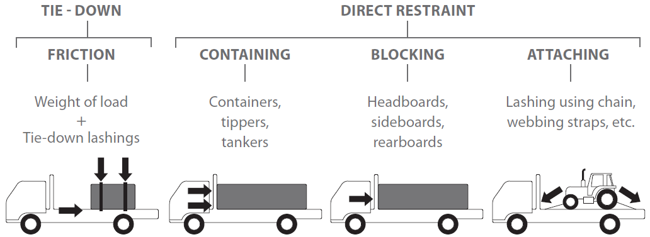
5. General Guide on Securing Loads
Securing
Check lashings for damages before use
Bundle loose loads tightly together
Secure and contain the loads properly
Use friction mats to reduce movement
Notes:
Trainer Notes:
Bundling helps prevent individual load pieces from moving about during transportation.
The tie down uses friction to prevent loads from toppling over or shifting around.
Containing/blocking/attaching methods physically limit the movement of the load.

Slide 11
Tyres
Ensure a headboard is installed on vehicle
Shrink wrap every column of tyres
Lash every row of tyres to the vehicle
Side view:
Shrink
wrapping
Top view:
Lashing device
Notes:
Trainer Notes:
Lashing devices are shown in green lines, wrapping is shown in red dotted outline.
Wrapping each column of tires prevents individual tires from falling off.
Emphasize on the importance of lashing every single column.
Tires can move around easily when travelling on a rough road, so additional securing is essential.

Slide 12
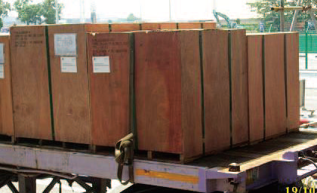
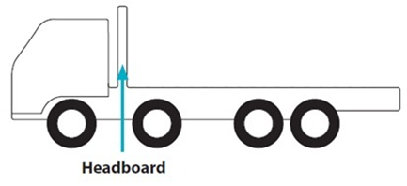
Boxes
Pack boxes as closely as possible
Lash all rows of boxes to the vehicle
Use at least 1 lashing device per 1.5m of box length
Lashing only on one row of boxes
3.2m
1.4m
Lashing device
Notes:
Trainer notes:
Generally, 1 lashing device should be used for every 1.5m in box length.
This guide applies to individual boxes.
If two boxes have a combined length of 1.5m, two lashing devices should still be used.
Workers are encouraged to use more lashing if the box is heavier than 500kg.

Slide 13
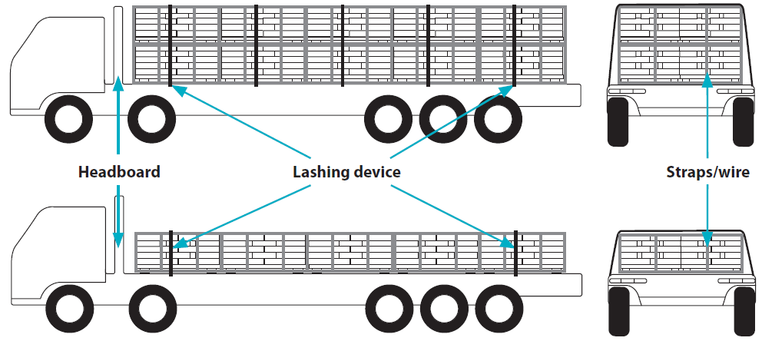
Sacks/ Bags
Place alternate layers in opposite directions
Strap or wrap each stack to a pallet
Lash every single row
If load is not secured to pallet, do not stack the load, and cover the loads with a canvas sheet
Notes:
Trainer notes:
Changing the direction of stacking at every layer helps to stabilise the stack and even out the weight distribution
Strapping/ wrapping the stack to the pallet prevents individual sacks from slipping off, and also makes for easier securing to the vehicle
Same rule for stacking applies; height of stacking in the diagram should not exceed the height of the headboard

Slide 14
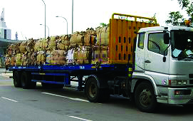
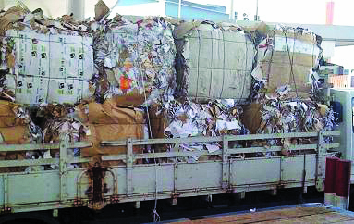
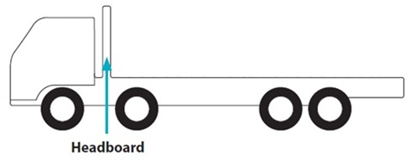
Bales/ Bundled loads
One layer: lash the first and last row
Two or more layers: lash all rows
Insufficient lashing in both examples
Lashing device
Notes:
Trainer notes:
Bales and bundled loads typically bulge at the sides, which reduces stability.
Also, they cannot be packed tightly together due to their uneven shape.
Hence extra lashing is encouraged to prevent loads from rolling or falling off.

Slide 15
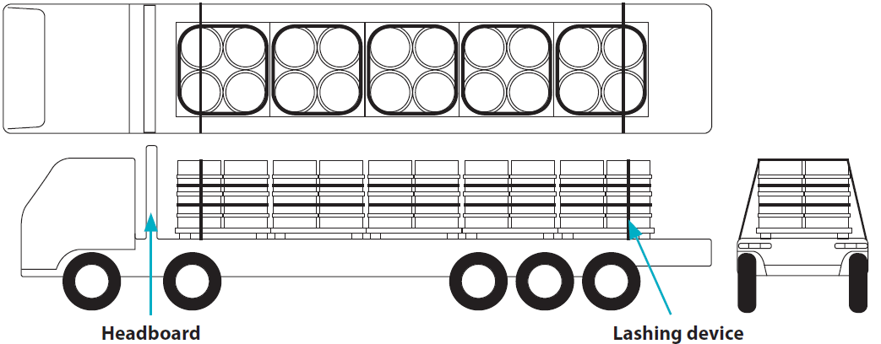
Drums
Drums standing vertically
Load drums on pallets tightly together
Bundle drums on the same pallet with lashing
Secure lash lines above middle of drums
Lash the first and last rows of drums
Lashing device
Notes:
Trainer notes:
Bundling drums on the same pallet together serves two purposes.
1) It affords more stability, easier securing and more resistance to movements during transporting.
2) It reduces knocking between drums during transporting, which would damage the drums.
The diagram above shows two lashing devices for bundling the drums together.
If only one lashing device is used, it should be lashed above the mid-height of the drums.
Use two lashing devices on the last row of pallet for added security.

Slide 16
Drums
Drums lying horizontally
Ensure stanchions or tailboards are fitted at tail of trailer
Lay drums across the vehicle so they only roll forward or backward
Ensure all drums are in contact with the drums beside them
Chock the first and last row to reduce movement
Chocking wood
Notes:
Trainer notes:
Using choking wood only at the first and last row might not be adequate.
Encourage using more choking wood placed at regular intervals in the load to hinder movement.

Slide 17
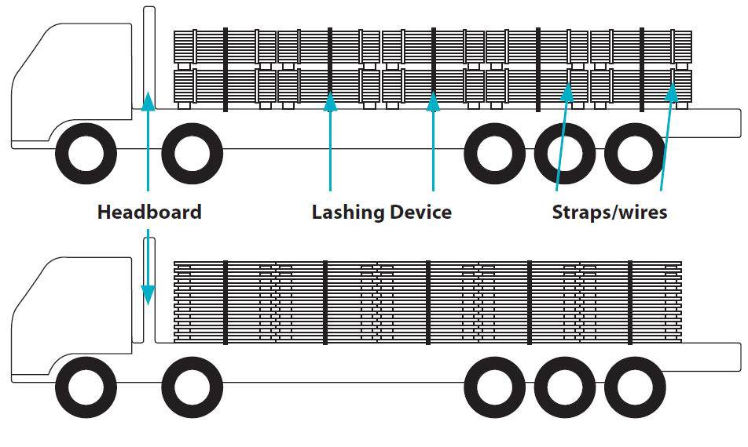
Empty pallets
Pack the pallets tightly together
Lash every row to reduce movement
Notes:
Trainer notes:
The diagram shows two ways of stacking pallets.
Any stacking configuration is acceptable as long as it is stable and securely lashed down.
The pallets should be stacked closely together to minimise space for shifting and knocking during transporting.

Slide 18
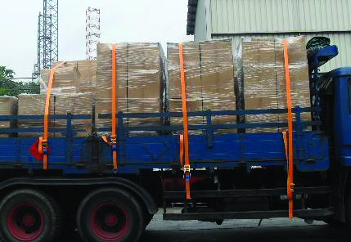
Palletised cargo
Check working condition of pallets
Stack cargo in a stable manner on the pallet
Shrink wrap and secure cargo to the pallet
Lash every row of pallets
Notes:
Trainer notes:
Lashing alone is not sufficient to secure cargo to the vehicle.
Individual loads may still slip out of placement, and shrink wrapping prevents that from happening.

Slide 19
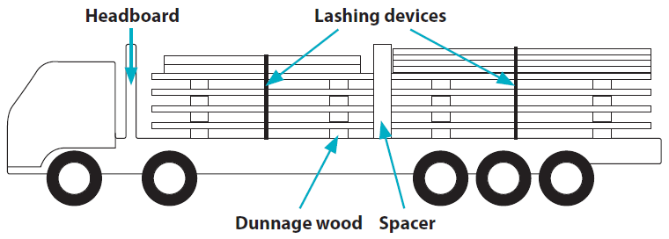
Steel Plates/ Structural steel
Different-sized steel
Place smaller steel pieces on top of larger, heavier ones
Place spacers in between each stack
Ensure that the stacks and spacers are in contact
Use at least two lashing per stack
Notes:
Trainer notes:
Smaller steel plates are placed on top of bigger pieces to improve stability (in diagram).
Spacers absorbs knocks during transportation and prevents steel from getting damaged.

Slide 20
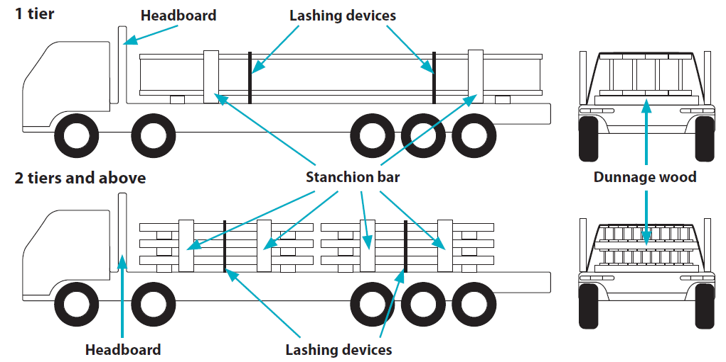
Steel Plates/ Structural steel
Structural steel
Ensure enough stanchion bars are fitted on the lorry bed
Use at least two lashing devices for each piece of steel
Use more lashing devices when stacking in layers
Notes:
Trainer notes:
Ensure that stanchions are in good working condition and are strong enough to contain the load.
Wooden side boards or tail boards should not replace stanchions as they may not be structurally strong enough.

Slide 21
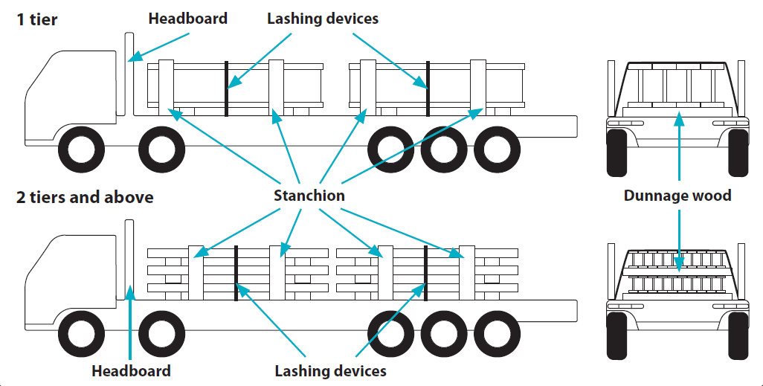
Steel Plates/ Structural steel
Structural steel
Ensure dunnage wood is in good condition, & lay it between layers
Ensure at least two stanchion bars on each side per stack of steel
Use at least two lashing devices per stack
Notes:
Trainer notes:
Diagrams do not show the use of spacers.
Workers are encouraged to use them if stacks are placed too close together, to avoid damaging the steel.

Slide 22
Pipes
Use long trailers so the pipes do not hang out of the trailer
Bundle loose pipes together
Use at least two lashing devices per stack
Pipes stacked in tiers
Pipes stacked in two piles
Notes:
Trainer notes:
It has been mentioned in the earlier slide about choosing the right vehicle.
If pipes are longer than the body of the vehicle, they will stick out of the vehicle and pose a risk to your workers and the public.
Always ensure that the vehicle length can accommodate the length of the loads.

Slide 23
Ingots/ Bars
Tightly pack loads in a stable arrangement
Fill empty spaces in between ingots with dunnage wood when applicable
If empty spaces cannot be filled, wrap ingots to restrict movement
Lash every row of ingots
Notes:
Trainer notes:
Ingots can be irregularly shaped, which makes stacking challenging.
Ensure that loading and stacking are done in the most stable manner possible.
Use dunnage wood to fill up empty spaces. This helps to increase the surface area of contact and improve stability.
When the best arrangement is still inadequately stable, increase number of lashing to compensate.

Slide 24
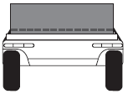
Metal sheet coils
Coils placed without pallets
Coils can be loaded along or across the trailer, as long as they do not stick out of the lorry bed.
Across trailer
Along trailer
Notes:
Trainer notes:
Top diagram (across trailer) shows an example of how lashing should be done, depending on the number of coils loaded.
In practice, there is no need to leave spaces between the coils.
The axle of the coils will be used for referencing direction of loading.
Hence, the top diagram is referred to as ‘across’, and lower diagram referred to as ‘along’.

Slide 25
Metal sheet coils
Coils placed without pallets
Load wider coils at the front
Load coils neatly in a straight line and in contact
Use choking wood between every coil to prevent rolling
(wood thickness should be at least 10cm by 10cm)
Lash all coils down vertically, except the last coil
Use two lashing devices on the last coil; one lash secured forward and the other lash secured backward
Notes:
Trainer notes:
The guidelines on this slide apply to the next 4 slides on coils.

Slide 26
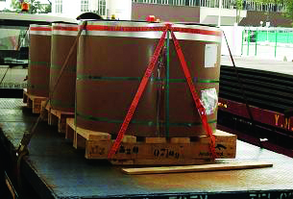
Metal sheet coils
Coils placed on pallets
Secure coil to the pallet
Pallets must be in contact with pallets beside it
Lash the first and last rows to the vehicle
Use loop lashing for better security
Notes:
Trainer notes:
Lashing devices may slip off the coil easily, when employing regular lashing methods.
Loop lashing would be better for securing the coils.
Loop lashing is an alternative lashing method.
Both ends of the same lashing device is attached to the same anchorage point.
It will require 2 to 4 times as many devices to secure the same load, compared to regular lashing.

Slide 27
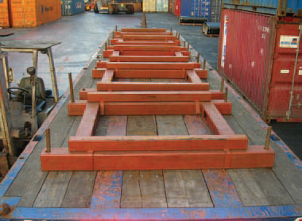
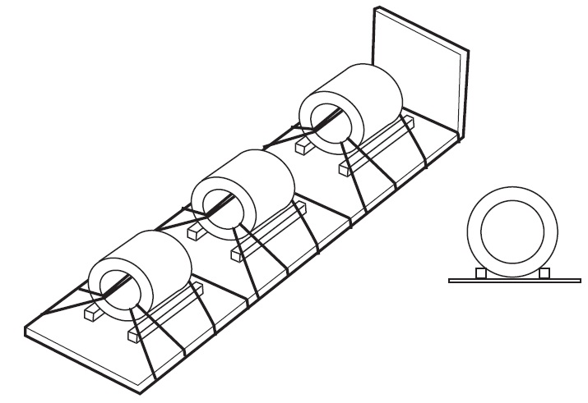
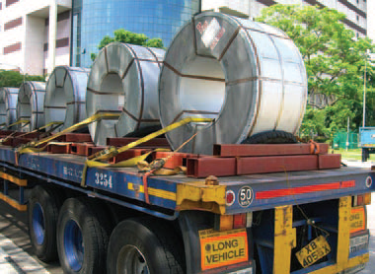
Metal sheet coils
Coils placed on brackets
Secure every row to the vehicle
Use loop lashing or edge protection to better restrict movements
Brackets for securing coils
Lashing device
Loop lashing, side view
Notes:
Trainer notes:
Brackets are usually available only upon special requests made by customers.
The function is similar to dunnage wood; it impedes the movement of the loads.
Loop lashing is an alternative lashing method and can be used for better securing of loads placed in brackets.
Both ends of the same lashing device is attached to the same anchorage point.
It will require 2 to 4 times as many devices to secure the same load, compared to regular lashing.

Slide 28
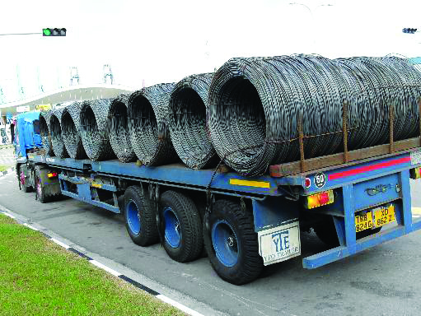
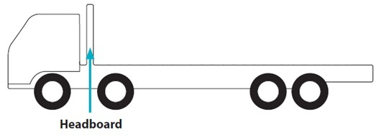
Steel wire coils
Load coil across the trailer
Place wider coils at the front
Load coils in a straight line and in contact
Use chocking wood between every row
(at least 10cm by 10cm)
Use two lashing devices each on the first and last coils
Insufficient lashing &
lack of chocking
Lashing device
Chocking wood
Notes:
Trainer notes:
Coils are light and flimsy, and thus move about more easily when transporting.
Hence, all rows need to be lashed and chocked to restrain movement.
Picture shows example of insufficient lashing:
not all rows are lashed,
last row needs two lashing

Slide 29
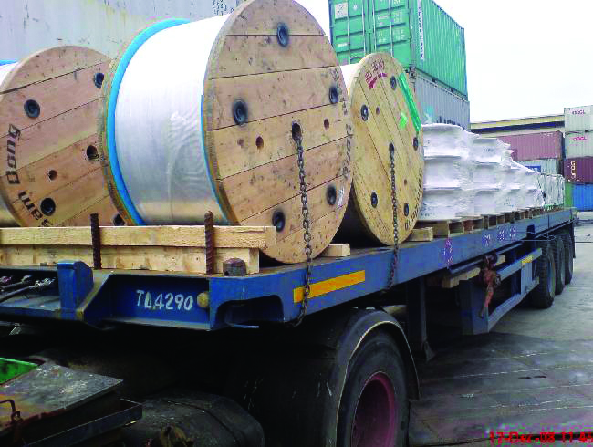
Cable drums
Load drum across the trailer
Load wider drums at the front of the truck
Load drums in a straight line and in contact
Use choking wood between all drums
Lash all drums vertically with steel chains
Use two lashing devices on the last drum; one secured forward, and the other secured backward
Insufficient lashing and containment
Notes:
Trainer notes:
Choking wood is not sufficient to prevent the cable drum from rolling off.
A tail board or large stanchions should be installed to contain the cable drums.
Picture shows example of insufficient lashing and containment:
insufficient lashing - last row requires double lashing
inadequate containment - no barrier (tailboard or stanchion) installed on tail-end of trailer

Slide 30
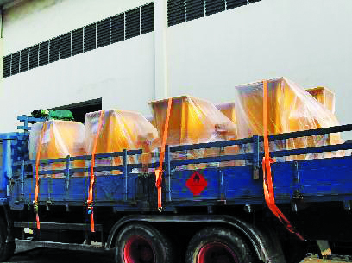
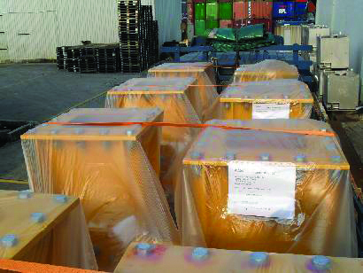
Metal panels
Fit sideboards to prevent sideway movement
Load cargo close to headboard to prevent forward movement
Lash every row to the vehicle along the length and breadth of the vehicle
Notes:
Trainer notes:
Metal panels can be irregularly shaped, and are typically heavy.
The conventional lashing method may not be sufficient to restrain the loads.
Additional vertical lashing is employed to prevent the forward and backward movement of the loads.

Slide 31
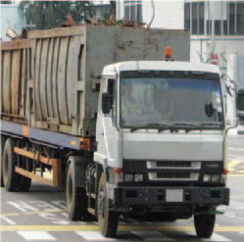
Scrap metal
Load scrap metal into a container bin
Avoid overloading the container
Cover container bin with a canvas sheet or netting to prevent lighter cargo from falling out
Notes:
Trainer notes:
It is important to leave some room in the bin, and not overload it.
Scrap metal sticking above the level of the bin can be blown off by wind during transportation.
Or it may easily fall off when travelling over uneven road surfaces.
Scrap metal can come in all sizes and weight.
The lighter pieces may fall off easily during transporting.
Covering with a canvas sheet can prevent loose pieces from falling off.

Slide 32
Timber loads
Choose a trailer that is longer than the loads
Bundle loose timber at two ends
Stack loads at a uniform height
Use two lashing per stack when loads are taller than sideboard
Notes:
Trainer notes:
Similar to pipes, the practice of tying a piece of red cloth to overhanging timber should not be encouraged.
Hence, loads should never be left sticking out of the truck body.
Other road users cannot judge the length of protrusion, and may drive too close to it.
Picture (of wooden plank breaching windscreen) taken from video of ABS news - http://www.youtube.com/watch?v=xjV2m70hA4o
The plank fell off a truck on the highway and struck the car behind the truck.
From this case study, we see that seemingly harmless loads can become deadly projectiles when travelling at high speeds.

Slide 33
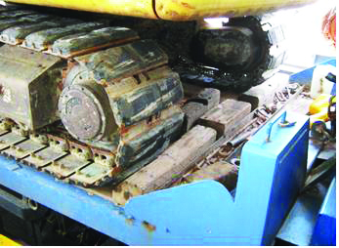
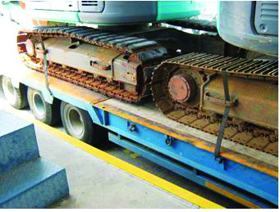
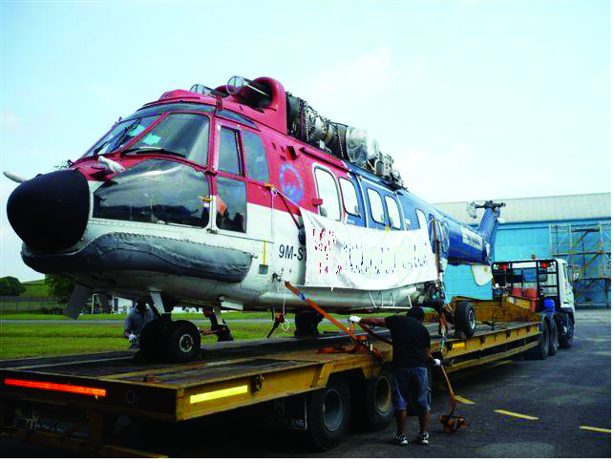
Heavy machines/ Equipments
Use low bed trailers
Remove loose dirt or grease from machine tracks before loading
Position machines to minimize sections/components from sticking out of the trailer
Apply parking brakes for wheeled or track machines
Use chocking wood and lashing for better securing
Notes:
Trainer notes:
Low bed trailers are required for transporting heavy machines for two reasons:
To abide to height constraints on the public roads.
To lower the centre of gravity for more stability during transporting.
Dirt and gravel can come loose during transporting and damage other vehicles on the road.
Grease left on the tracks can reduce friction, and impede securing.

Slide 34
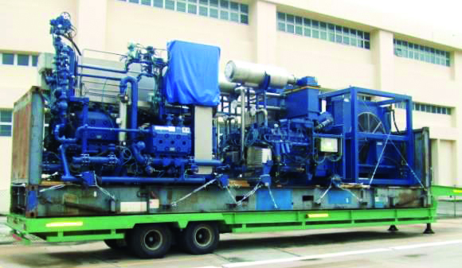
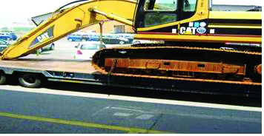
Heavy machines/ Equipments
Lash the machine according to manufacturer’s instructions and movable parts down to prevent movement when transporting
If instructions are not given, use lashing devices on non-movable parts of the machine to secure to vehicle
Use the loop lashing method for more security
Ensure that the machines don’t exceed public road weight and height restrictions
Notes:
Trainer notes:
Manufacturers of such machines should provide instructions on adequate securing for the loads.
Heavy machineries should have fittings/ anchorage points on them for securing to the trailer.
Machines without anchorage points should have additional lashing when securing to the trailer bed.

Slide 35
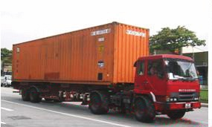
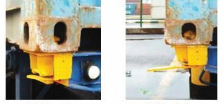
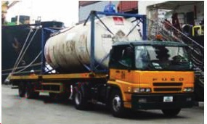
Containers
Use trailers fitted with at least four twist locks
Check working condition of twist locks before use
Secure twist locks immediately after loading
Twist lock in locked position
Twist lock in unlocked position

Slide 36
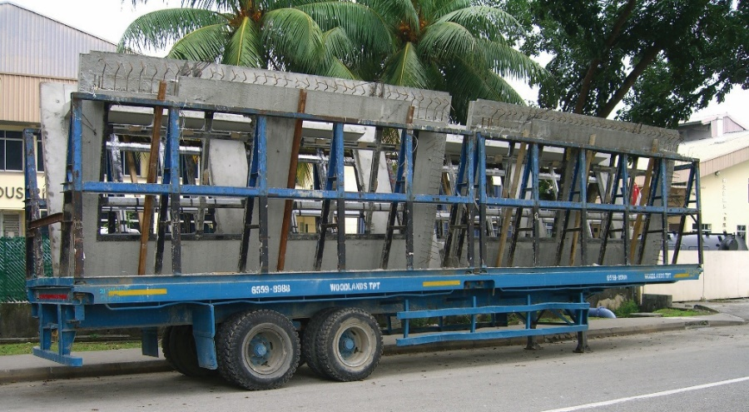
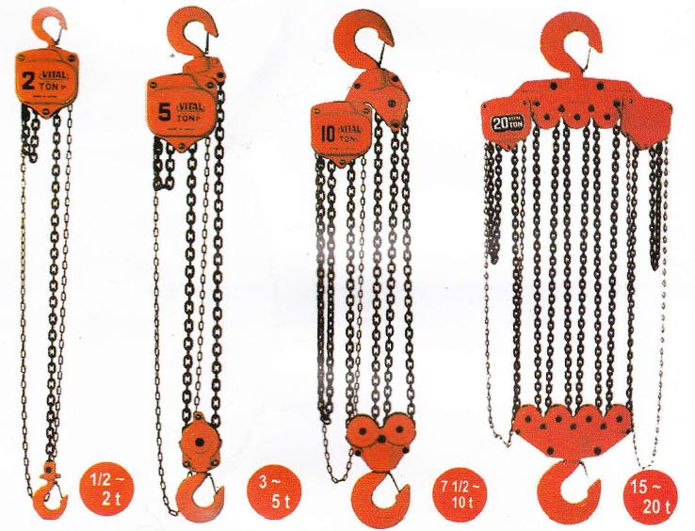
Precast
Ensure weight is evenly distributed on the trailer
Ensure that tallest point of the precast does not exceed traffic height limits (measured from ground level)
Securing horizontally: use sling belts and stoppers
Securing vertically: use galvanised wires and chain blocks
Avoid overloading the trailer
Galvanised chains with hooks
Notes:
Trainer notes:
Galvanised chains are preferred over lashing belts for its greater tensile strength.

Slide 37
Concrete blocks and slabs
Ensure weight is evenly distributed on the trailer
Do not stack slabs higher than headboard or tailboard, whichever is shorter
Use 2 lashings for slabs up to 3m in length
Use 1 additional lashing for every additional 3m in length
Notes:
Trainer notes:
Galvanised chains are preferred over lashing belts for its greater tensile strength.

Slide 38
Jumbo bags
Place bags close to the headboard
Pack the bags tightly so they are in contact
Stack only one layer of bags whenever possible
Lash every row of bags
Notes:
Trainer notes:
Jumbo bags carry loose cargo and do not hold their shape.
Thus stacking of these bags are not encouraged, as lashing cannot provide adequate security.
Packing the bags tightly together reduces the space for movement during transporting.

Slide 39
Car transporters
Apply brakes of vehicle after loading
Secure vehicle according to vehicle manufacturers’ instructions
Use two wheel chokes at every wheel
Lash the restraining points on the vehicle to the anchorage points on the transporter
Notes:
Trainer notes:
Car transporters are specially designed trailers, used in carrying motor vehicles.
The tail-end of the trailer has ramps to allow vehicles to be loaded.
Wheel chokes are required in the front and back of the wheels to prevent movements in both directions.

Slide 40
Tote bins
Place tote bins as close to the headboard as possible
Minimise the spaces between the bins during loading
Lash every row of bins

Slide 41
END

