Slide 1
5 WSH tips to preventing
SLIPS, TRIPS AND FALLS
Making Workplaces Safer
Adopt safe work practices

Slide 2

SLIPS, TRIPS AND FALLS
Every year, more than 3,000 workers are injured due to STF accidents.
2019
Fatalities | 3
Major Injuries | 216
Minor Injuries | 3,694
2018
Fatalities | 7
Major Injuries | 203
Minor Injuries | 3,407
2017
Fatalities | 4
Major Injuries | 177
Minor Injuries | 3,323
Source: WSH National Statistics Report 2017 - 2019
Notes:
Slips, trips and falls at work can lead to injuries or even death.
Every year, more than 3,000 workers are injured due to slips, trips and falls accidents.
Do your risk assessment before starting work.
Major injuries incl: amputation, blindness, paralysis, fracture/dislocation, concussion, etc

Slide 3
WHAT ARE STFS?
Slips
Loss of balance when there is too little friction between the foot and the floor.
Trips
Loss of balance when the foot collides with, strikes or hits an object in its path.
Loss of balance when one steps down unexpectedly to a lower surface (misstep).
Falls
To move downward, typically rapidly and freely, from a higher to a lower level.
Notes:
Slips or Trips can lead to a Fall.
Slips tend to cause one to fall backwards.
Tripping over an object tends to cause one to fall forward.
Misstep can cause one to fall forward or backwards.
STFs can result in fatality – even though STFs occur on level ground or steps, it is how a person falls (e.g. hit head against something on the way down or head hits the ground) that can cause severe injuries leading to possible fatality.

Slide 4
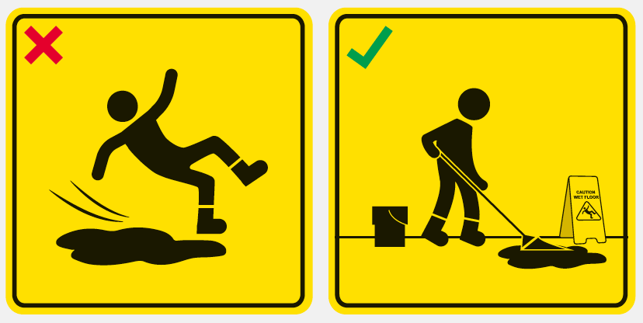
WSH Tip 1
Clean up spills immediately
Notes:
Spills can be wet (e.g. water, oil) or dry (e.g. sawdust, powder).
Clean up spills immediately to prevent STFs.

Slide 5
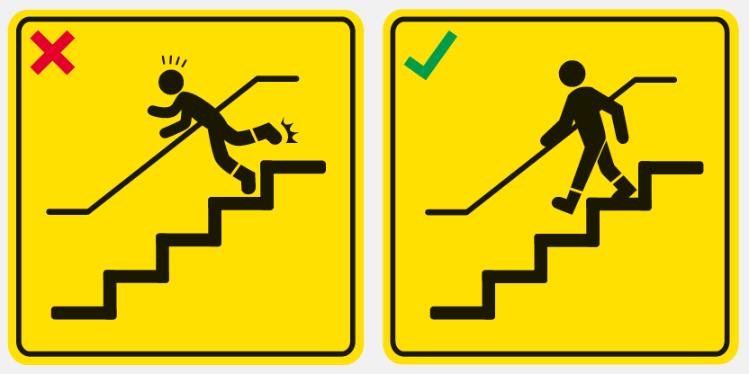
WSH Tip 2
Always hold the handrail
Notes:
Hold the handrail for better balance and stability while moving up or down the stairs.
Report steps that are damaged to building/facility management so that these can be fixed before an accident occurs.

Slide 6
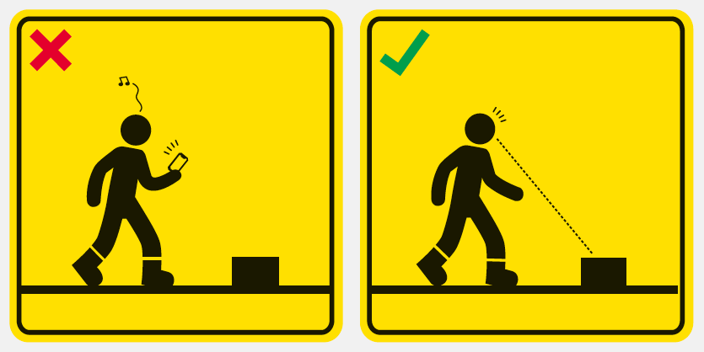
WSH Tip 3
Do not get distracted while walking
Notes:
Distracted walking are a cause of STFs.
Look where you’re going so that you are aware of the hazards (e.g. obstacles, drain, uneven ground, damaged tile) in your path.

Slide 7
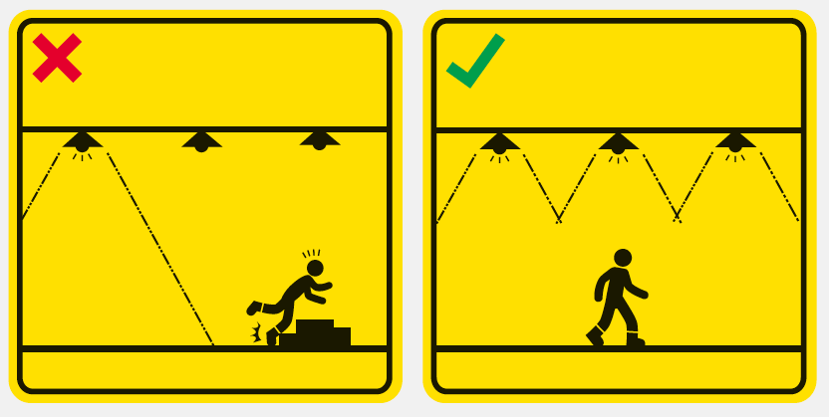
WSH Tip 4
Keep walkways well-lit and free of obstructions
Notes:
Poor lighting can cause STFs. Work areas and walkways need to be well-lit so that workers can see where they are going and look out for possible hazards (e.g. obstacles along the walkway). Practise good housekeeping to keep walkways free of clutter and obstruction.

Slide 8
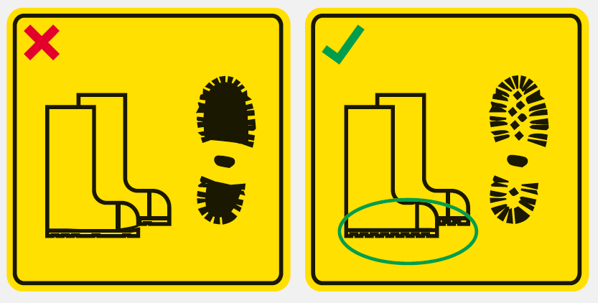
WSH Tip 5
Use non-slip footwear and replace it when worn out
Notes:
Worn out footwear reduces the friction between your feet and the floor – this makes the floor feel more slippery and raises your chance of slip & fall.
Inspect the soles of your shoes regularly (e.g. once a month) and replace your shoes as necessary.

Slide 9
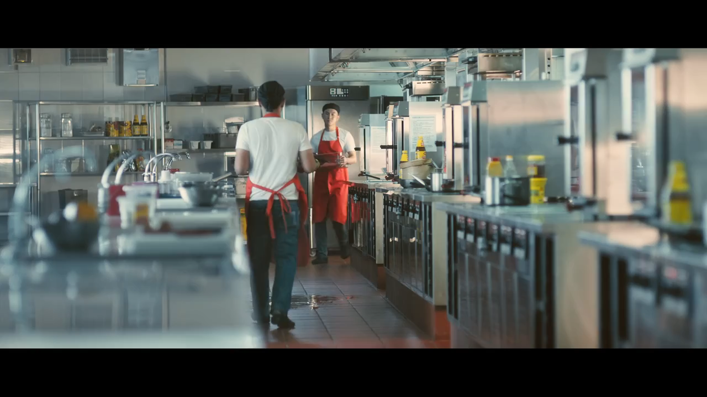
LOOK. THINK. DO.
“I Can Prevent Falls: Slippery Floor”
View video on WSH Council’s YouTube Channel
Notes:
By cleaning up spills immediately after they occur, you can do your part to prevent slips and fall at your workplace.

Slide 10

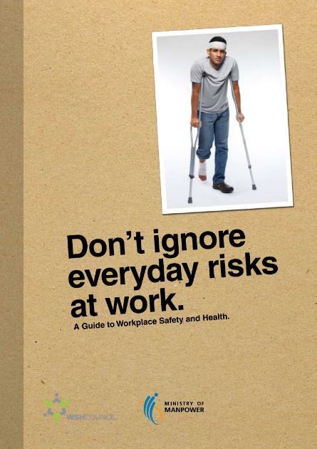

SLIPS, TRIPS AND FALLS
CAN BE PREVENTED
Download at www.wshc.sg/resources
Notes:
Personal Habits
“Go where you are looking, and look where you going”
Good Housekeeping
“Pick up anything you drop, clean up anything you spill”

