Slide 1
5 WSH tips to preventing MUSCULOSKELETAL DISORDERS
Making Workplaces Safer
Adopt safe work practices

Slide 2
MUSCULOSKELETAL DISORDERS
Work-related musculoskeletal disorders (MSDs) were the leading occupational disease for the past three years in Singapore.
 | 2017 | 2018 | 2019
Musculoskeletal Disorders | 337 | 326 | 293
Noise-Induced Deafness | 329 | 163 | 169
Occupational Skin Diseases | 78 | 48 | 39
Others | 55 | 26 | 16
Source: WSH National Statistics Report 2017 - 2019
Notes:
Work-related musculoskeletal disorders (MSDs) can cause severe pain, affecting both your health and productivity.
MSDs were the leading occupational disease from 2017 to 2019 in Singapore.
Do your risk assessment before starting work.
One of the most common MSDs was back injury due to ergonomic risks.

Slide 3
WHAT ARE MSDs?
MSDs are characterised by discomfort, ache or pain in affected body parts.
Causes
Poor ergonomic practices at the workplace that can lead to MSDs include:
Overexertion
Awkward posture
Repetitive action
Notes:
MSDs are characterised by discomfort, ache or persistent pain in the affected body parts like joints and muscles.
Poor ergonomic practices at the workplace can lead to the development of MSDs. These include:
overexertion e.g. heavy lifting or pushing
Awkward posture e.g. prolonged static or bent posture
Repetitive action e.g. typing or item picking at a production line

Slide 4
WSH Tip 1
Use a trolley to transport heavy goods
Notes:
Carrying heavy items over long distances can result in lower back pain.
Use a mechanical aid (such as a suitable trolley) to help you.

Slide 5
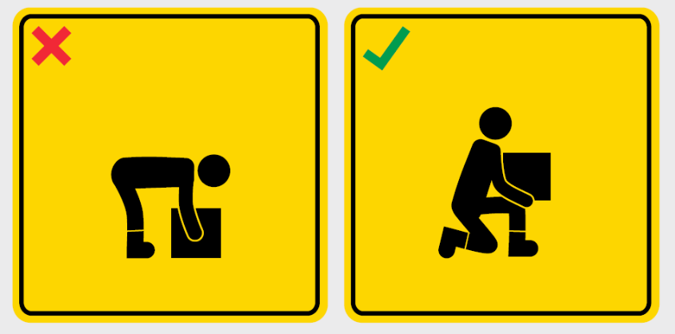
WSH Tip 2
Apply the correct lifting technique
Notes:
Bending over to lift heavy objects off the ground can hurt your back.
Apply the correct lifting technique by lowering your body, bending your knees and keeping your back straight whilst lifting.

Slide 6
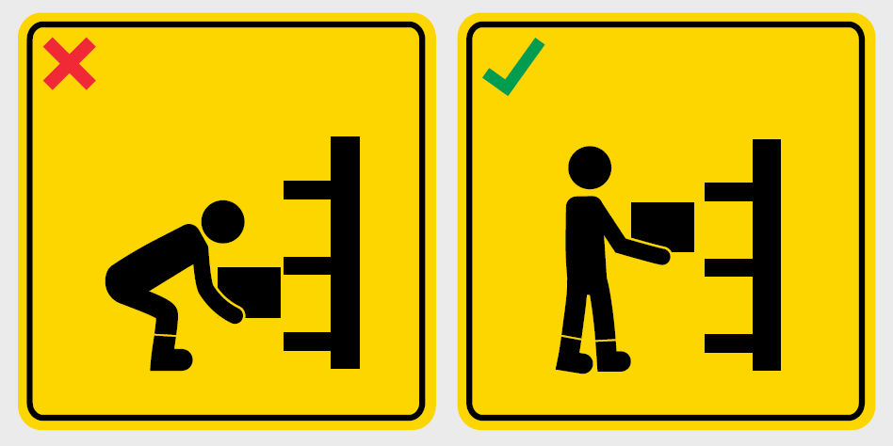
WSH Tip 3
Store heavy objects at waist level
Notes:
In a storeroom environment, store bulky, heavy or more frequently used objects at waist level.
This will allow for easier retrieval as it reduces the need to bend/squat down or stretch above the chest/head level to retrieve the heavy item.

Slide 7
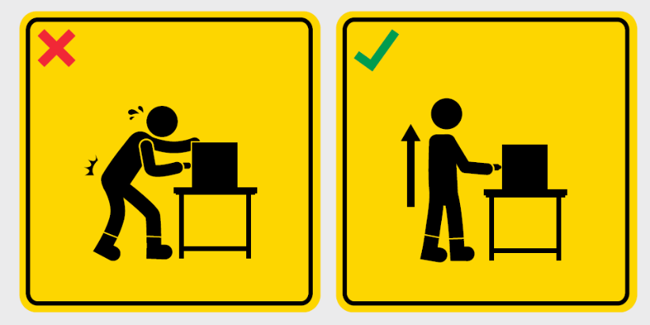
WSH Tip 4
Adopt proper posture at your workstation
Notes:
Adopt a good posture and work position at your workstation.
Raise the table height as necessary so that you do not have to frequently bend over.
This will reduce excessive and prolonged bending of your back, resulting in no or less backache.

Slide 8
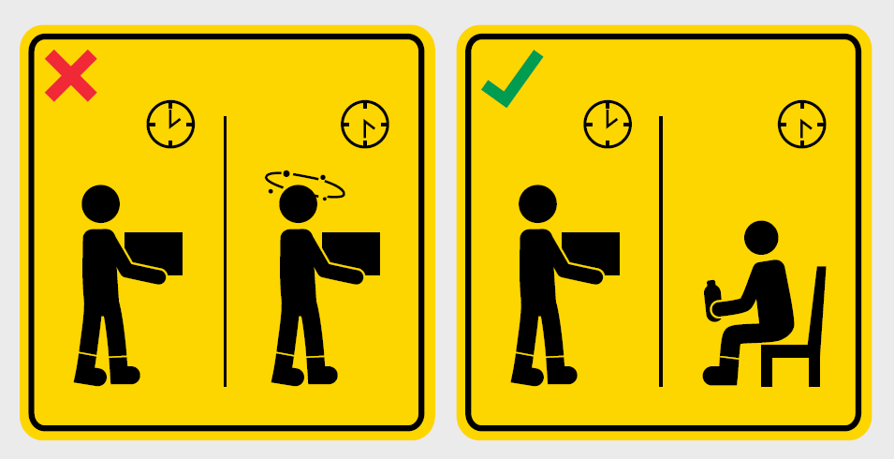
WSH Tip 5
Take sufficient rest breaks
Notes:
Avoid working or staying in the same posture for long periods of time.
Take adequate breaks, and change posture, stretch and stand or walk around whenever you feel tired.

Slide 9
LOOK. THINK. DO.
“Reducing Ergonomic Risks at the Workplace”
Source: WSH Council’s YouTube Channel
Notes:
Find out how two companies in Singapore have improved both workplace productivity and WSH through ergonomic interventions.

Slide 10
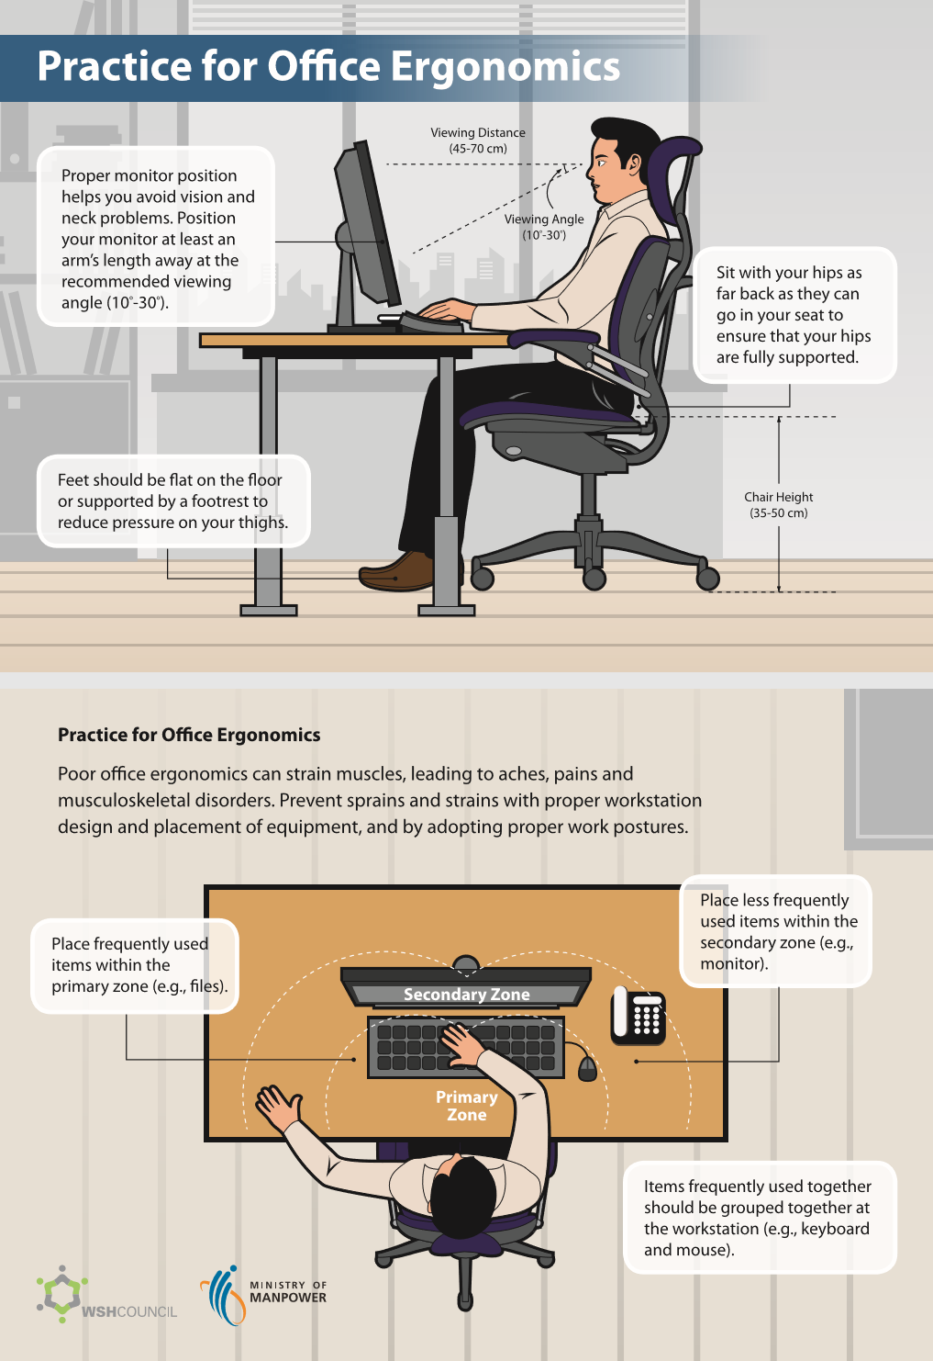
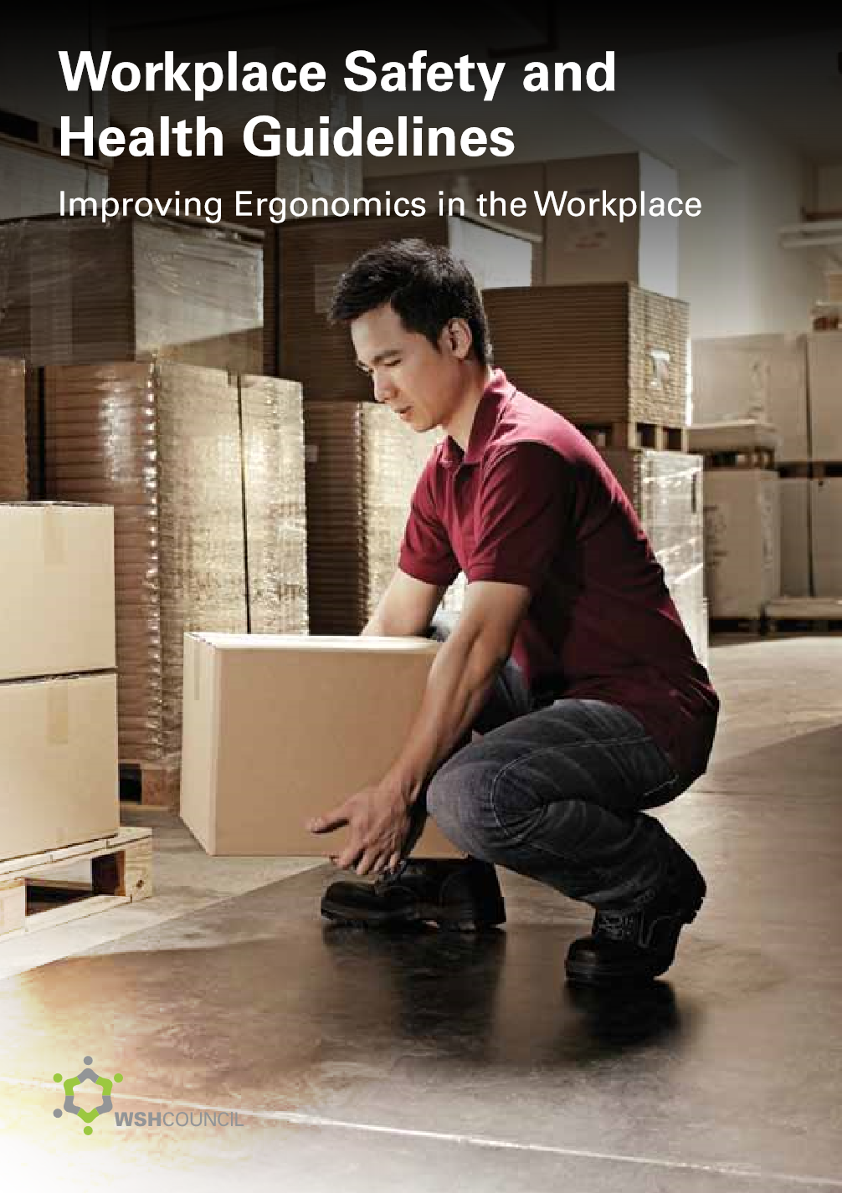
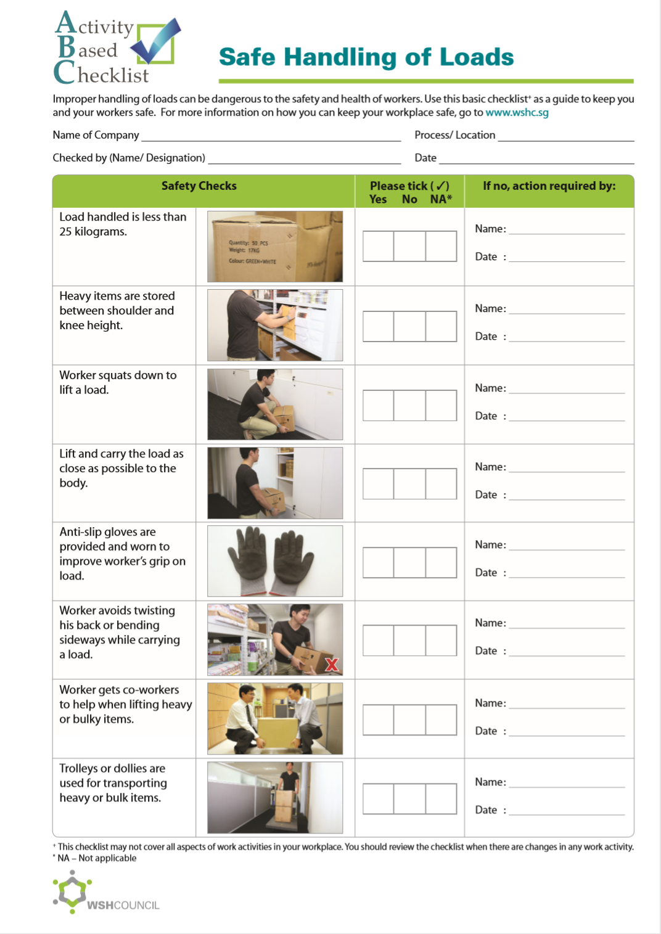
MUSCULOSKELETAL DISORDERS
CAN BE PREVENTED
Download at www.wshc.sg/ergonomics

