Slide 1
6 WSH tips for SAFE RIDING
Making Workplaces Safer
Adopt safe work practices

Slide 2
SAFE RIDING
In 2019, there were 4 fatalities and 17 major injuries resulting from workplace-related traffic accidents.
The rising popularity of online ordering over the years has fuelled a strong demand for delivery services.
This demand is increasingly met by motorcycles, bicycles and
power-assisted bicycles.
Unsafe riding practices are dangerous and cause harm
to riders, pedestrians and other road users.
Riders must adopt safe riding habits on the roads to
protect themselves and the public.
Do your risk assessment before starting work.
Notes:
Every workplace accident is one accident too many. All workplace injuries can be prevented, including those that involve riding.
Do your part by carrying out risk assessment before you start work.

Slide 3
GUIDE TO SAFE RIDING
Risk Assessment (RA) is key to preventing injuries when riding.
Examples of Possible Hazards
Route taken | Uneven surfaces & slopes Roads with fast vehicles
Environment | Heat Rain | Air quality Night work
Equipment | Condition of tyres Condition of brakes Battery type & condition
Rider’s behaviour | Speeding Use of phone while riding
Rider’s health | Fatigue Ergonomic risks
Download at
www.wshc.sg/resources
Notes:
Above are examples of possible hazards you may face as a rider. Download WSH Council’s Guide to Safe Riding to find out more.

Slide 4
SAFE WORK PRACTICES (non-exhaustive)
For riders
Ride only if you are fit for work
Check your equipment before the start of each workday
Wear bright-coloured clothing
Accept jobs with reasonable delivery times
Do not speed
Choose the safer delivery route
Be aware of your surroundings when you ride
Look out for and give way to pedestrians
Stop if you need to look at your phone
Dismount and walk when navigating through a crowd
Stop the delivery or decline jobs during heavy rain
Notify customers to expect delays during bad weather
Take rest breaks as necessary
Do not work excessive hours
Send your equipment for regular inspection/routine maintenance
Notes:
Above is a non-exhaustive list of recommended safe work practices for riders.
Adopt these practices (and the 6 WSH tips that follow) to take care of your health and safety while at work.

Slide 5
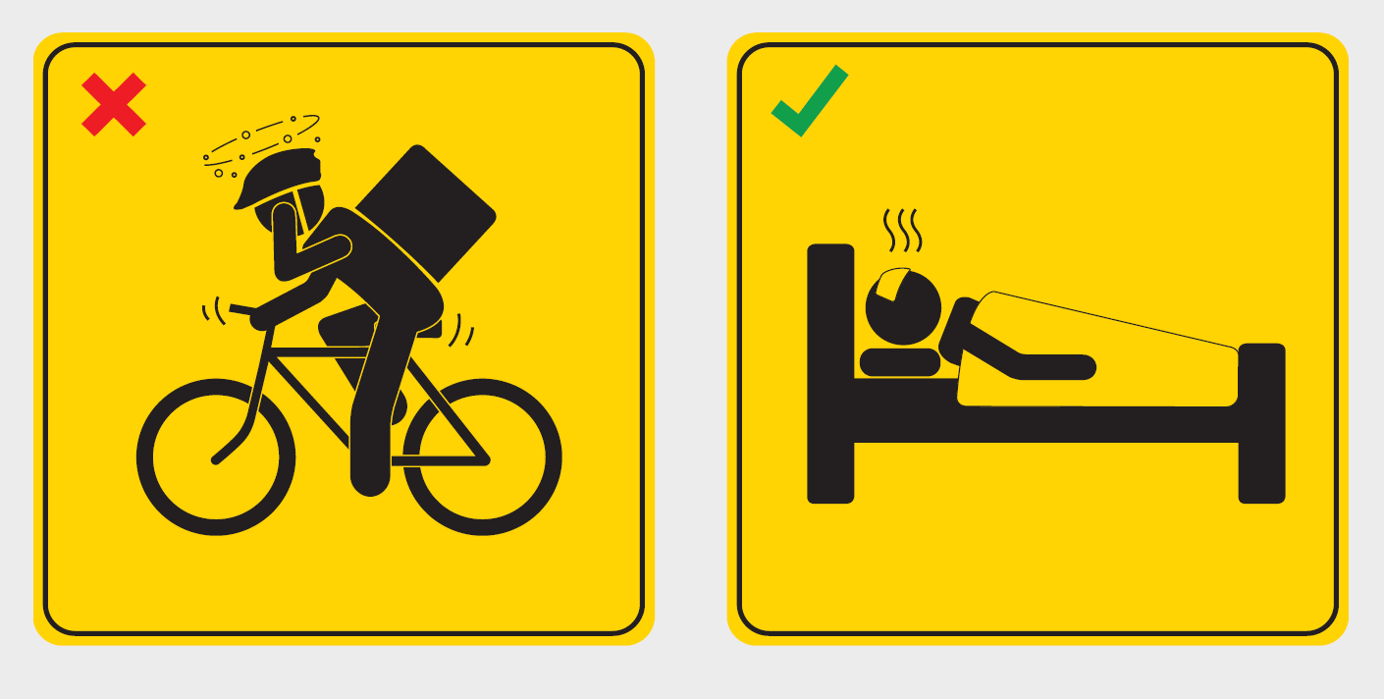
WSH Tip 1
Do not ride when ill
Notes:
Do not ride when you are not feeling well.
Cycling, in particular, can be a very strenuous activity and the weather (regardless of whether hot or rainy) can make you feel worse when you are not feeling well – this may cause you to lose your balance or result in you being more prone to accident.

Slide 6
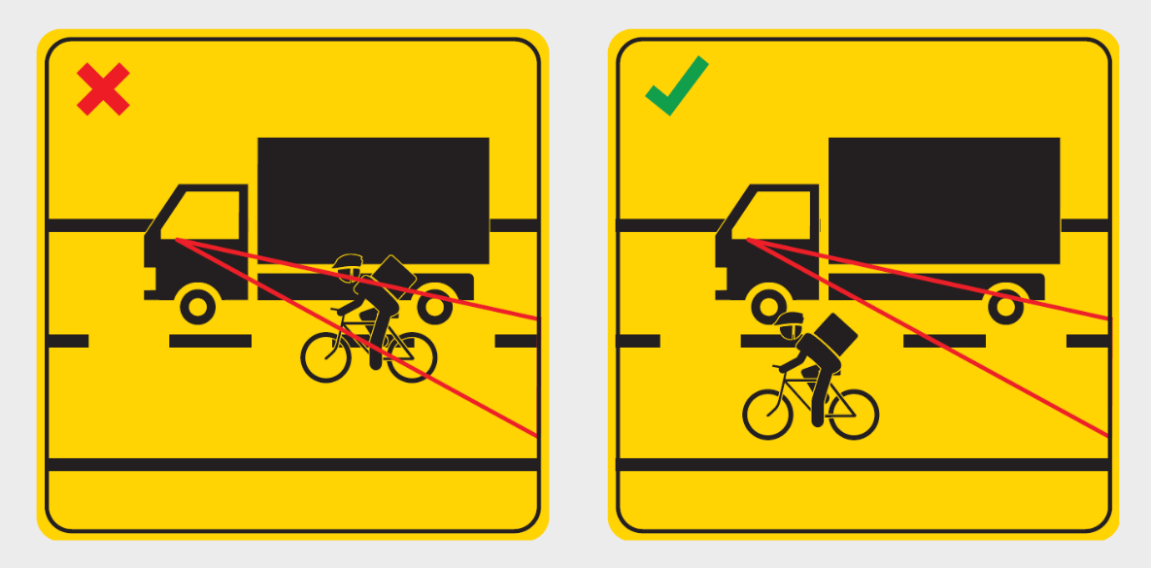
WSH Tip 2
Do not ride within blindspot zone
of other drivers
Notes:
A blind spot is defined to be an area or zone where a driver's view is obstructed.
This means that if you ride within a driver’s blind spot, the driver will be unable to see you.
This significantly increases the risk of a road accident.
Always ride outside the blindspot zone of other drivers.

Slide 7
WSH Tip 3
Wear mask when necessary
Notes:
Cycling on the road inevitably exposes you to increased levels of air pollution (in particular, vehicle exhaust).
Use a suitable mask to protect yourself when riding.

Slide 8
WSH Tip 4
Stay hydrated at all times
Notes:
As cycling can be a very strenuous activity, always carry a water bottle with you and drink more to prevent dehydration.
Refill your water bottle every time the opportunity allows.

Slide 9
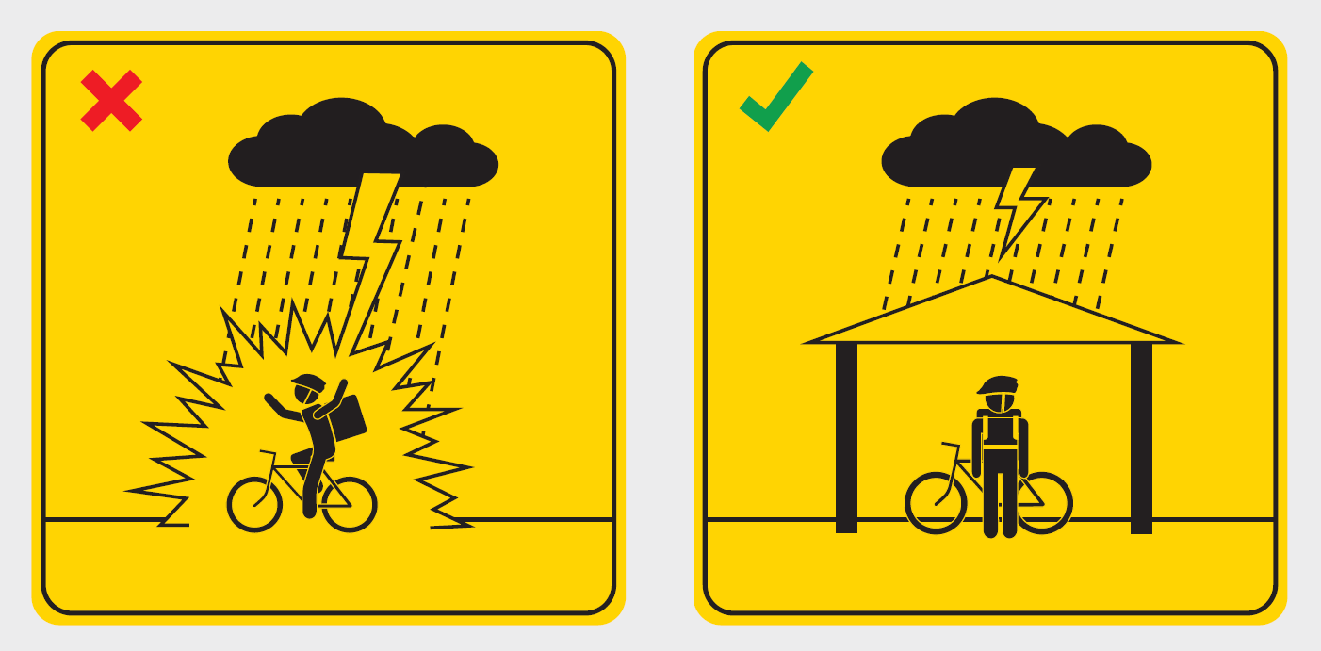
WSH Tip 5
Take shelter during bad weather
Notes:
Do not ride during bad weather (heavy rain) and especially when there is lightning activity.
Heavy rain will cause you to be soaked (thereby increasing your risk of falling sick) and a heavy downpour may affect your visibility when riding.
For your own health and safety, stop at a proper shelter (that offers lightning protection) and proceed only when the weather improves.

Slide 10
WSH Tip 6
Do not hold phone when riding
Notes:
Keep both your hands on the bicycle handlebars when riding.
Using a phone while riding may cause you to lose balance or be distracted (resulting in you being less attentive to the
persons or obstacles in your path of travel).

Slide 11
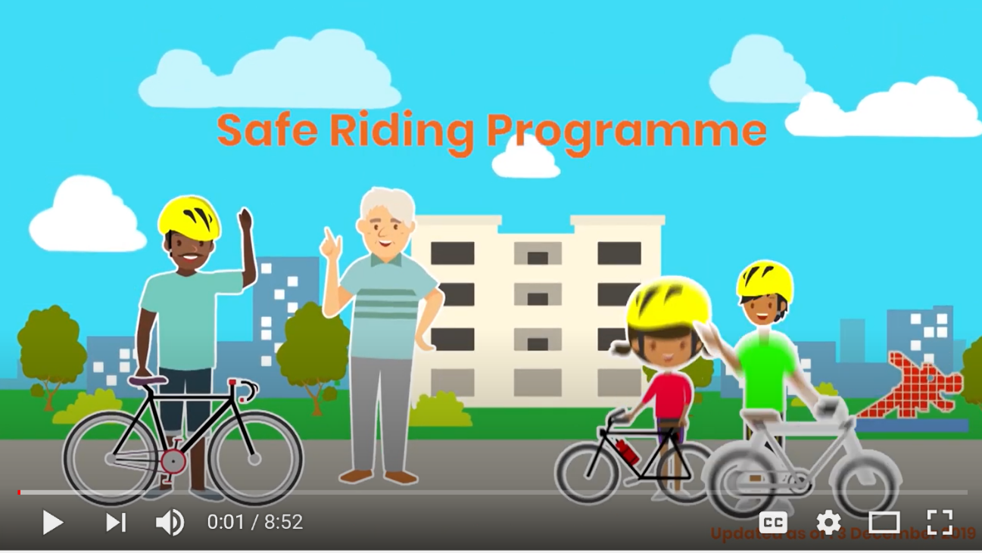
LOOK. THINK. DO. “Safe Riding Programme”*
* Applicable to all riders in Singapore including delivery riders
Source: LTA
Notes:
Safe riding of bicycles, Power-assisted Bicycles (PABs) and Personal Mobility Devices (PMDs) in Singapore begins with you!
Get an overview of the safe riding practices, as well as the rules and code of conduct for riding on public paths and roads in this video.
The LTA Safe Riding Programme covers the following modules:
Equipment and pre-journey preparations
Infrastructure familiarisation
Skills training
Rules and code of conduct
Find out more about the full LTA Safe Riding Programme at https://go.gov.sg/srp.

Slide 12
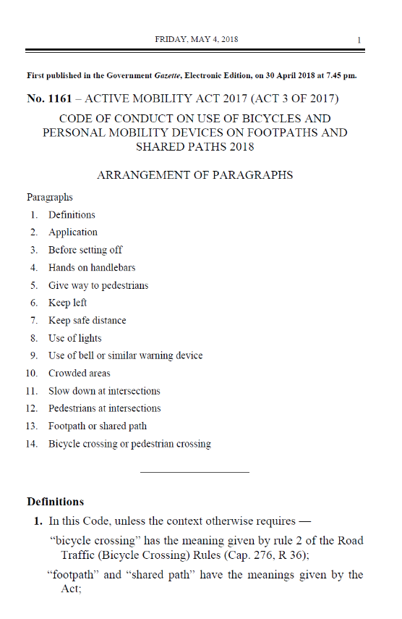
RIDE SAFELY, GO HOME SAFELY
Download Road Safety Tips
Download the Active Mobility Act at sso.agc.gov.sg/Act/AMA2017
Download at srsc.org.sg/images/YourGuidetointra-TownCycling.pdf

