Slide 1
6 WSH tips to WORKPLACE HOUSEKEEPING
Making Workplaces Safer
Adopt safe work practices

Slide 2
WHAT IS WORKPLACE HOUSEKEEPING?
Workplace housekeeping refers to activities undertaken to create or maintain a tidy, clean, organised and safe working environment.
Benefits
Improved productivity
Hygienic working conditions
Elimination of hazards
Better WSH performance
Enhanced company image
Notes:
Effective housekeeping can eliminate many workplace hazards, and help get work done safely and properly.
Every year, accidents have occurred as a result of poor housekeeping.
Do your risk assessment and practice good workplace housekeeping.
By regularly housekeeping your work area, you will be demonstrating your commitment towards your work and your safety and health.

Slide 3
WSH Tip 1
Organise for safety and productivity
Notes:
Workplace housekeeping covers how your warehouse or storeroom is organised.
Strictly adhere to the Safe Working Load (SWL) of each shelf.
Store heavier items on the lower shelves to increase the stability of the rack.
Store loose items (anything that can roll or fall off the storage shelf) in a suitable container.
For materials stored on pallets, secure the materials by stretch wrapping them to the pallet.
Label (or barcode) items for quick identification and fast retrieval.

Slide 4
WSH Tip 2
Keep walkways and stairways free of obstruction
Notes:
Walkways and stairways are frequently used passageways.
Ensure all passageways are free of obstruction (e.g. stored items, personal belongings, wires, debris) that may cause someone to trip and fall.

Slide 5
WSH Tip 3
Keep floors clean and dry
Notes:
Wet spills (e.g. water, oil) and dry spills (e.g. powder) can lead to slip and fall accidents.
Prevent accidents by keeping floors clean (free of spills) and dry.

Slide 6
WSH Tip 4
Return hand tools to original place
Notes:
Return all hand tools to its original place / intended tool storage location such as a tool rack or tool box. This will ensure that no tool is accidentally left inside the machine (a safety hazard) and that the tools will be easily available the next time you need them.

Slide 7
WSH Tip 5
Regularly inspect the condition of equipment and safeguards
Notes:
Housekeeping includes conducting regular checks to ensure that equipment is functioning properly and safeguards are in good condition and working as intended.
An effective safeguard will help to protect you from injury when working with the equipment/machine.

Slide 8
WSH Tip 6
Check that signs, labels and floor markings are clearly visible
Notes:
Signs, labels and floor markings must be clearly visible, otherwise they do not serve their intended purpose.
Workplace housekeeping includes walking around to check that signs (including hazard signs), labels and floor markings are visible from afar.
Report to your Supervisor / Facilities Management Team should any sign, label and floor marking need to be refreshed.

Slide 9
LOOK. THINK. DO. “I Can Prevent Falls: Slippery Floor”
Source: WSH Council's YouTube Channel
Notes:
Housekeeping includes keeping floors clean and dry. Clean up spills immediately.
Do your part to prevent slips and falls at your workplace.

Slide 10
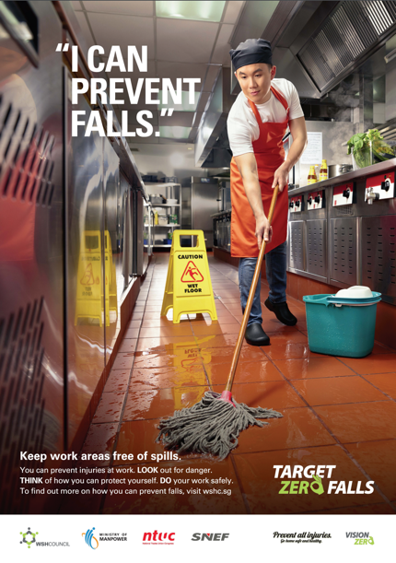
PRACTISE WORKPLACE HOUSEKEEPING TO PREVENT ACCIDENTS
Download at www.wshc.sg/resources

