Slide 1
5 WSH tips to preventing KITCHEN HAZARDS
Making Workplaces Safer
Adopt safe work practices

Slide 2
KITCHEN HAZARDS
Kitchen hazards can result in incidents such as contact with hot surfaces or sharp objects, slips, trips and falls, fires and explosions, amongst others.
Examples of common kitchen hazards include:
Wet or oily floor
Uneven or loose flooring
Obstructions placed on the floor (e.g. boxes and bins)
Gas accumulation and flammable vapor cloud formation
Hot kitchen equipment (e.g. ovens and stoves)
Knives and other sharp kitchen objects
Unattended cooking
Notes:
Kitchen hazards can result in accidents. These accidents include slips, trips and falls, which is one of the top workplace injuries in the food and beverage industry. Fires and explosions may also occur due to the abundance of flammable materials typically used in kitchens such as cooking gas (e.g. piped-in from LPG cylinders), cooking oils, oily kitchen towels and fine dust (e.g. flour or icing sugar).
Examples of common kitchen hazards include:
Wet or oily floor
Uneven or loose flooring
Obstructions placed on the floor (e.g. boxes and bins)
Gas accumulation and flammable vapor cloud formation
Hot kitchen equipment (e.g. ovens and stoves)
Knives and other sharp kitchen objects
Unattended cooking
Reduce the risk of kitchen accidents by making simple changes in the way you work. Always do your risk assessment before starting work.

Slide 3
HOUSEKEEPING IS IMPORTANT!
Always keep the kitchen clean and tidy to prevent incidents.
Good housekeeping practices
Keeping walkways free from obstructions
Keeping walkways dry and free from oil
Repairing leaks and broken tiles immediately
Storing sharp objects safely after use
Storing flammable materials safely
Locating gas cylinders away from heat sources and in well-ventilated areas
Notes:
In general, you should establish a good housekeeping system to keep the kitchen clean and tidy.
Good housekeeping can prevent hazards from being created in the kitchen as the work progresses.
Some good housekeeping practices include:
Keeping walkways free from obstructions, especially fire exits
Repairing leaks and broken tiles as soon as possible as these present trip hazards. Cordon off dangerous areas until they have been fixed
Storing flammable materials safely
Locking gas cylinders in fireproof cabinets, and/or locating them away from heat sources and in well-ventilated areas

Slide 4
WSH Tip 1
Place and store knives safely
Notes:
Place and store knives safely after use. Do not leave knives lying around haphazardly.

Slide 5
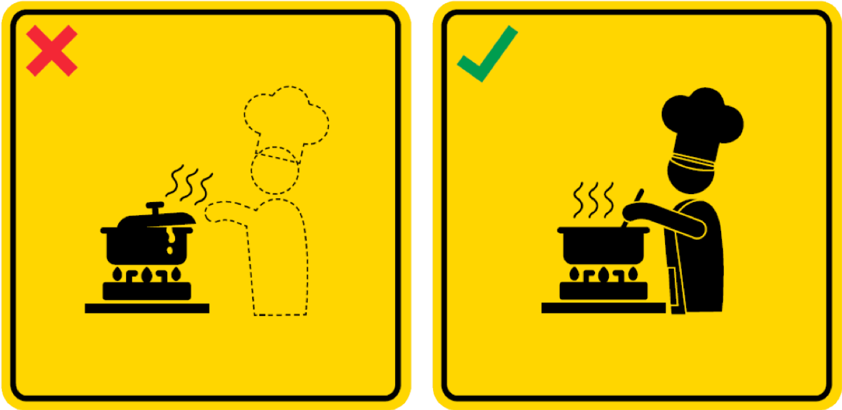
WSH Tip 2
Do not leave pots unattended on the stove
Notes:
Always attend to the cooking on the stove. Unattended cooking such as boiling pots can result in possible fire risk.

Slide 6
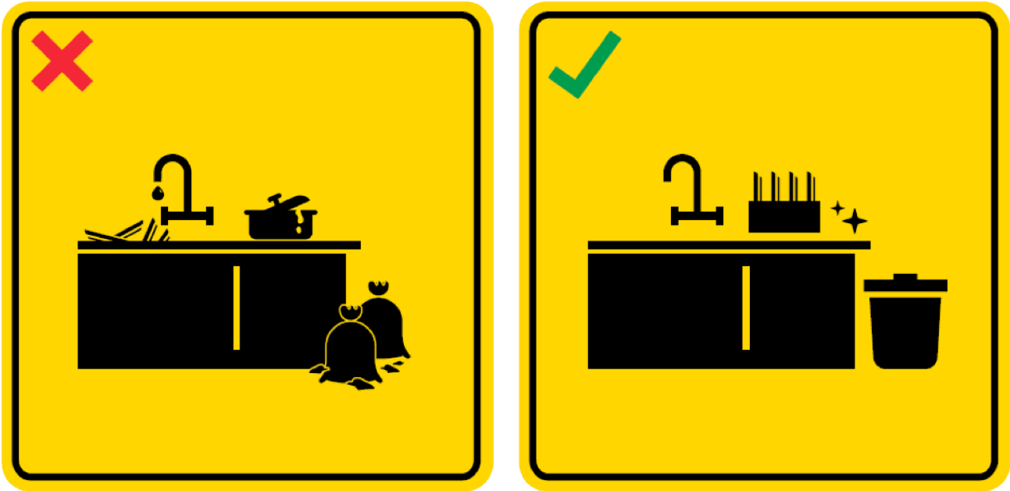
WSH Tip 3
Keep the kitchen tidy and clear of clutter
Notes:
Keep the kitchen clean and tidy to maintain a safe environment for preparing food.

Slide 7
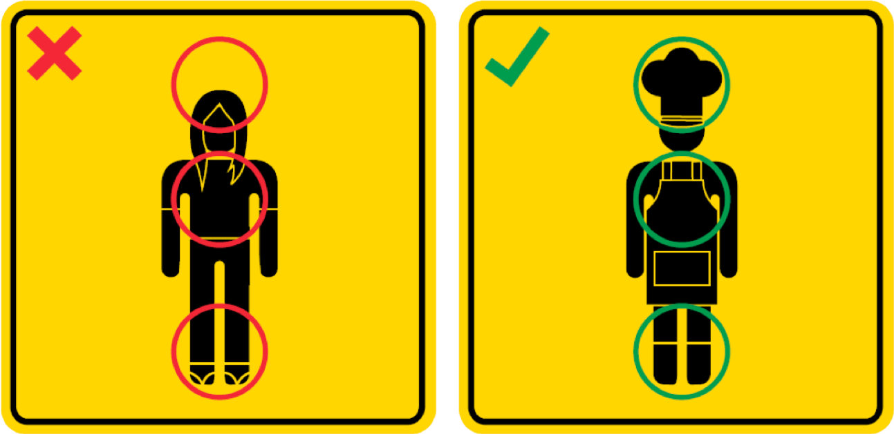
WSH Tip 4
Dress properly in the kitchen
Notes:
Dress appropriately to protect yourself in the kitchen. Wear a kitchen hat (or hair net), chef’s apron and covered non-slip shoes.

Slide 8
WSH Tip 5
Clean up spills immediately
Notes:
Any spill or contamination on the floor must be cleaned up as soon as possible to prevent slips and falls.

Slide 9
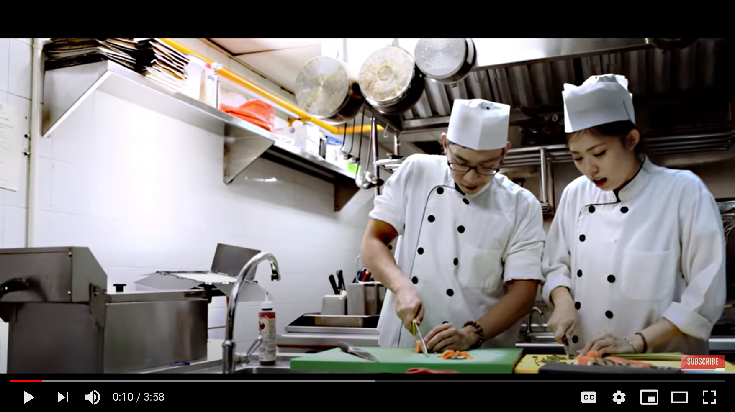
LOOK. THINK. DO
“Ying Yang Twins”
Source: WSH Council's YouTube Channel
Notes:
Find out some of the common hazards lurking in the kitchen environment.

Slide 10
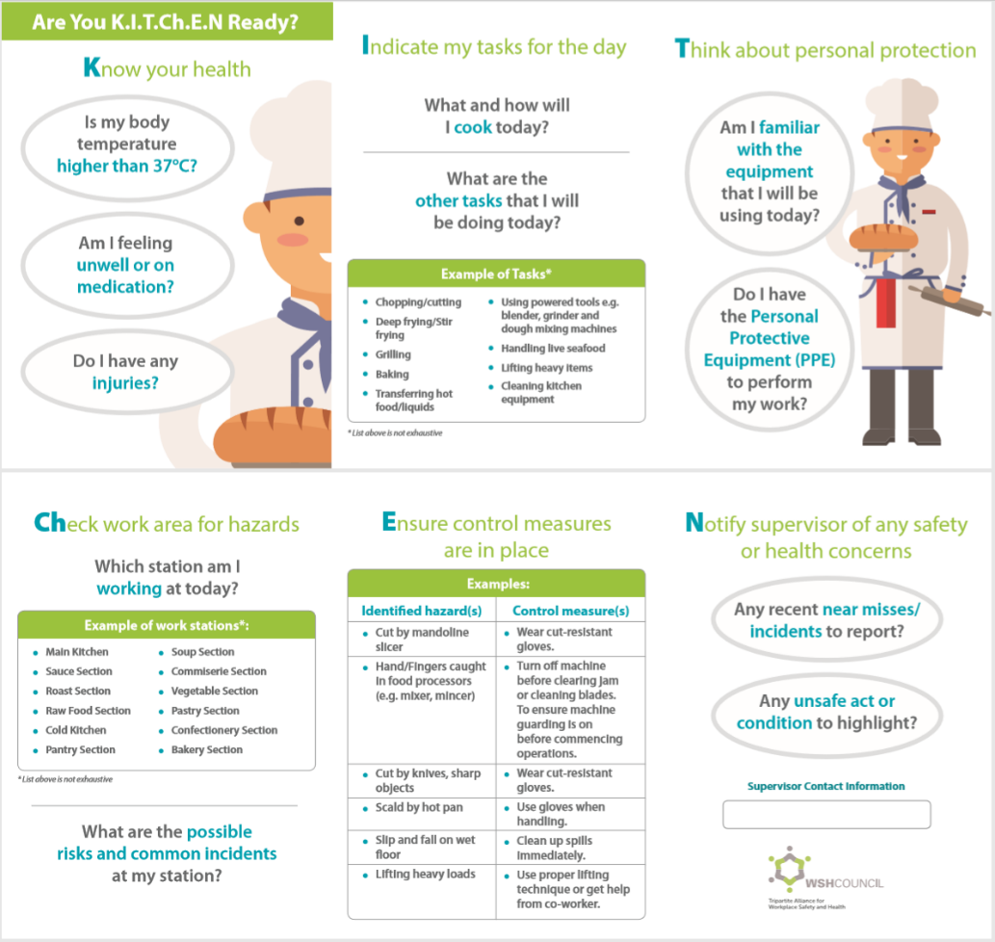
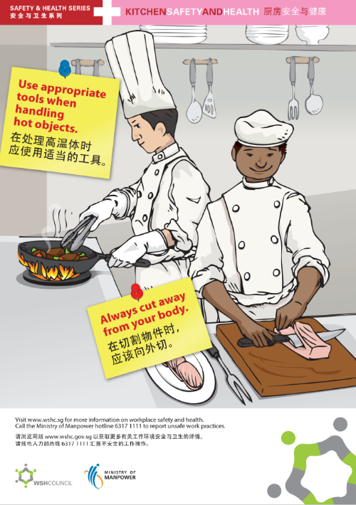
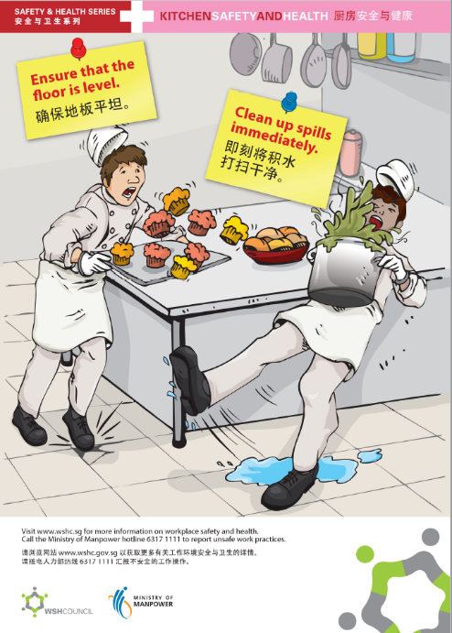
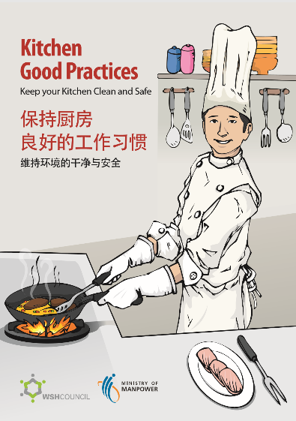
KITCHEN HAZARDS CAN BE PREVENTED
Download at www.wshc.sg/resources
Notes:
The kitchen can be a safe work environment so long as you adopt good WSH practices.
Remember, kitchen hazards can be prevented and safety starts with you!

