Slide 1
5 WSH tips to preventing NOISE-INDUCED DEAFNESS
Making Workplaces Safer
Adopt safe work practices

Slide 2
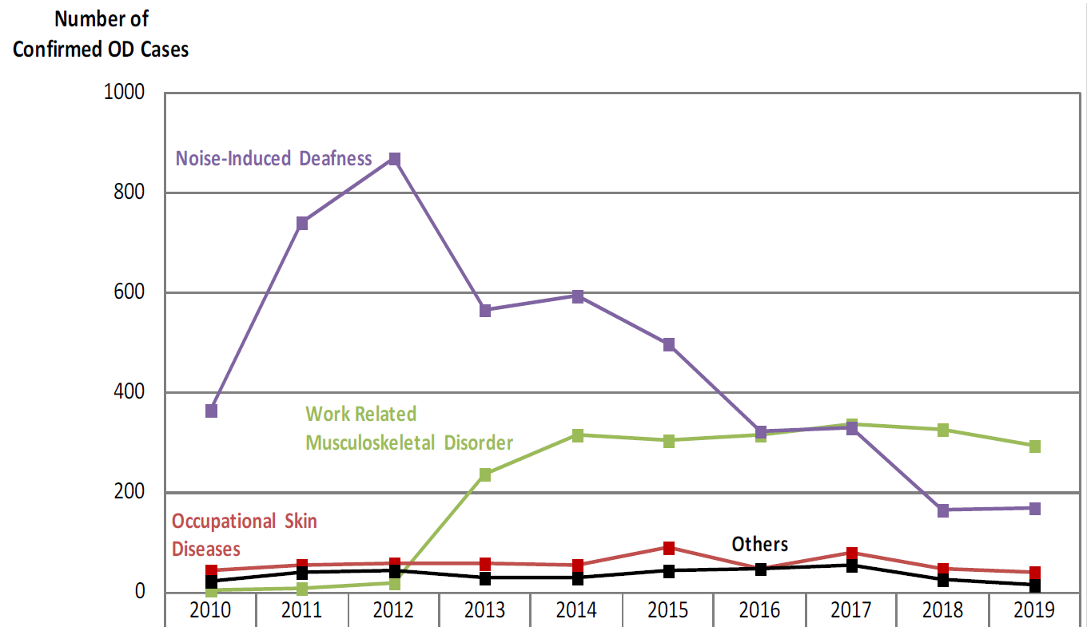
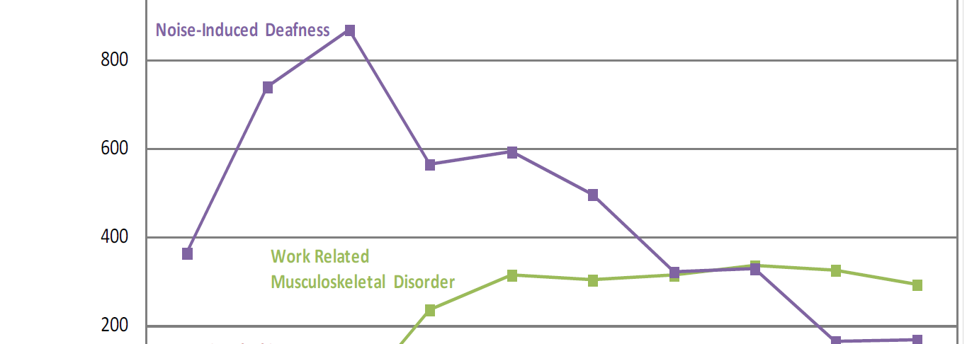
NOISE-INDUCED DEAFNESS (NID)
Noise-induced deafness (NID) remained as one of the top two occupational diseases in Singapore over the past ten years.
Source: WSH National Statistics Report 2019
Notes:
Noise-induced deafness (NID) remained as one of the top two occupational diseases in Singapore over the past 10 years.
From 2010 to 2019, a total of 4,613 workers were diagnosed with work-related NID.
Do your risk assessment and determine your noise exposure before starting work.

Slide 3
WHAT IS NID?
NID refers to a permanent loss of hearing in the human ear.
Cause
Prolonged exposure to excessive loud noise
Consequences
Irreversible hearing loss
Communication difficulties
Quality of life affected
Notes:
Prolonged exposure to excessive loud noise at the workplace can lead to noise-induced hearing loss or noise-induced deafness (NID).
NID impairs hearing permanently, leading to communication difficulties and a severe impact on the quality of life.

Slide 4
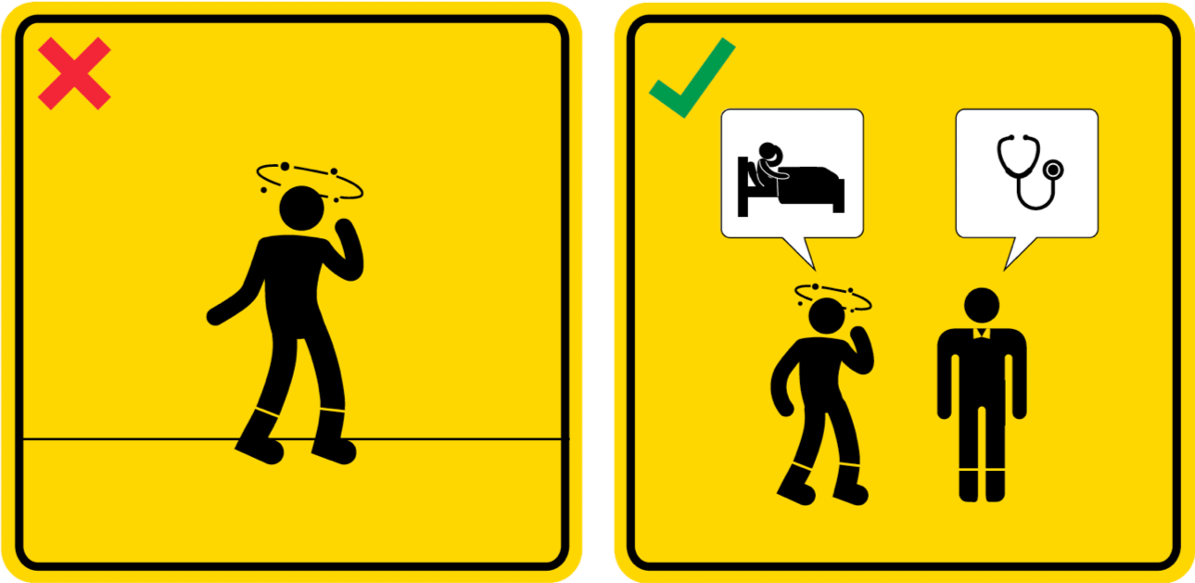
WSH Tip 1
Report to your supervisor if you feel unwell
Notes:
Use only hearing protectors (e.g. ear plugs, earmuffs) that are in good condition so that they are effective in protecting you from loud noise at your workplace. Replace damaged hearing protectors and hearing protectors that have deteriorated with new ones.

Slide 5
WSH Tip 2
Check that hearing protectors are in good condition
Notes:
Use only hearing protectors (e.g. ear plugs, earmuffs) that are in good condition so that they are effective in protecting you from loud noise at your workplace. Replace damaged hearing protectors and hearing protectors that have deteriorated with new ones.

Slide 6
WSH Tip 3
Use hearing protectors in noisy areas
Notes:
Protect your ears using appropriate hearing protectors (such as ear plugs and/ or earmuffs) when working at or near noisy areas or machines.
Exposure to loud noise for extended durations can damage your ears’ hearing sensitivity.

Slide 7
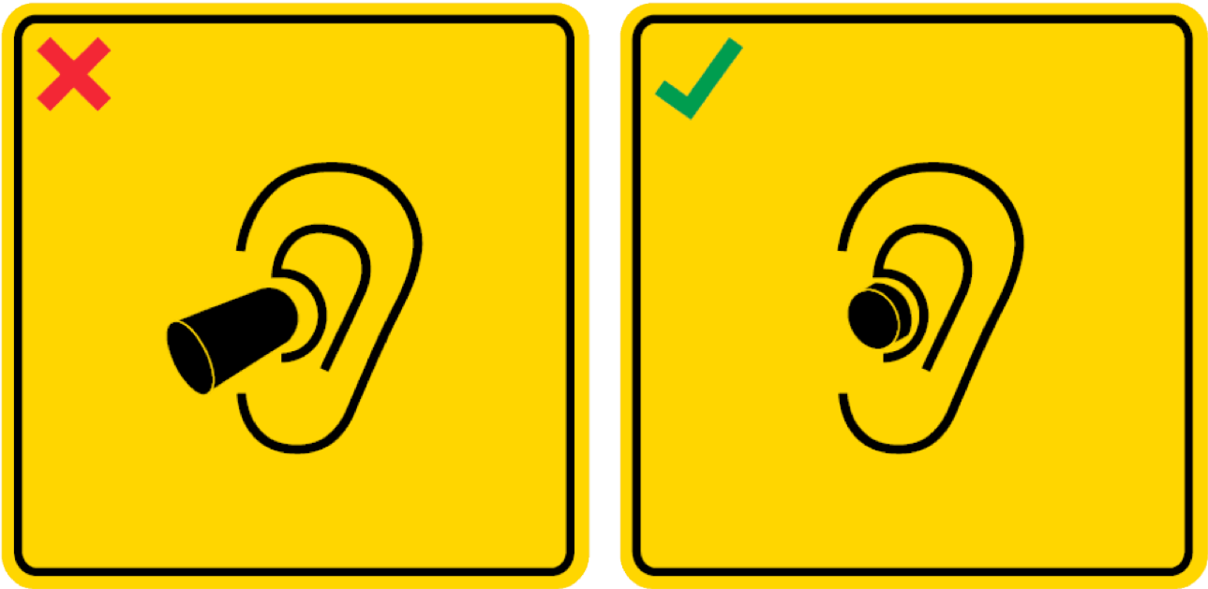
WSH Tip 4
Put on your hearing protector properly
Notes:
Ensure that the hearing protector fits (or sits) well in or over your ears.
Your ears may be inadequately protected if you use the hearing protectors incorrectly.

Slide 8
WSH Tip 5
Minimise time spent in noisy areas
Notes:
Spending extended periods of time in noisy work areas can damage your hearing.
Reduce your noise exposure by spending time away from noisy areas at regular intervals when possible.

Slide 9
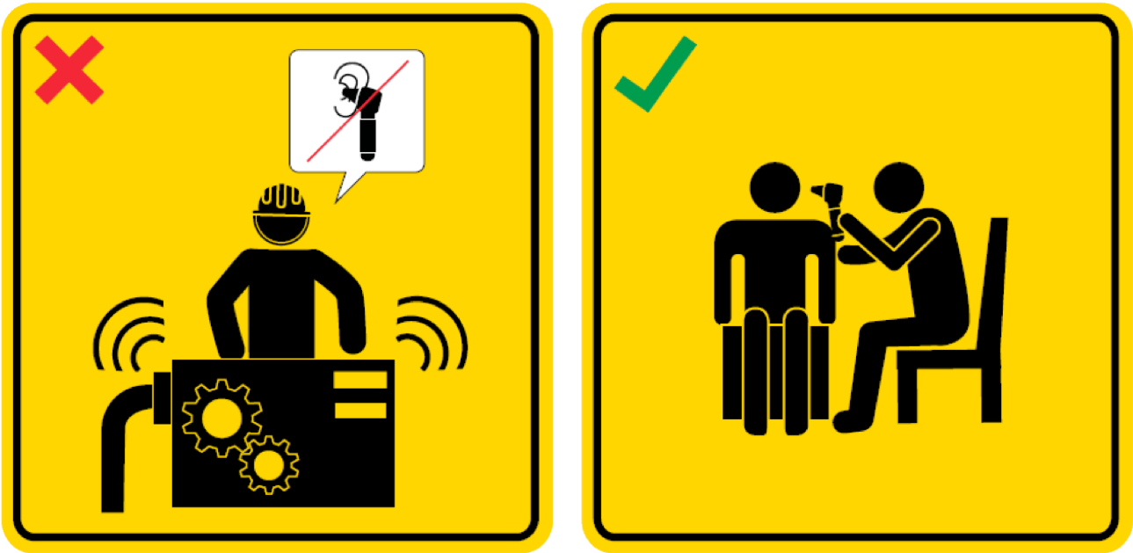
WSH Tip 6
Go for yearly audiometric examination
Notes:
If you work in noisy work areas or are exposed to excessive loud noise in your workplace, you should go for yearly audiometric examination.
The audiometric examination will help to detect any ear damage or hearing issue early so that timely treatment can be administered.

Slide 10
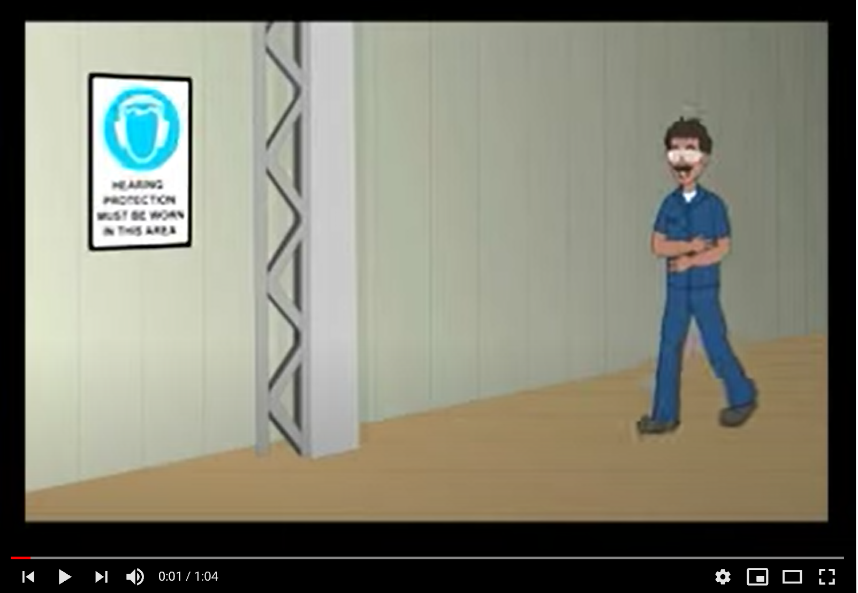
LOOK. THINK. DO
“Correct Way of Wearing Ear Plugs”
Source: WSH Council's YouTube Channel
Notes:
Watch this video to learn the correct way of using your ear plugs.

Slide 11
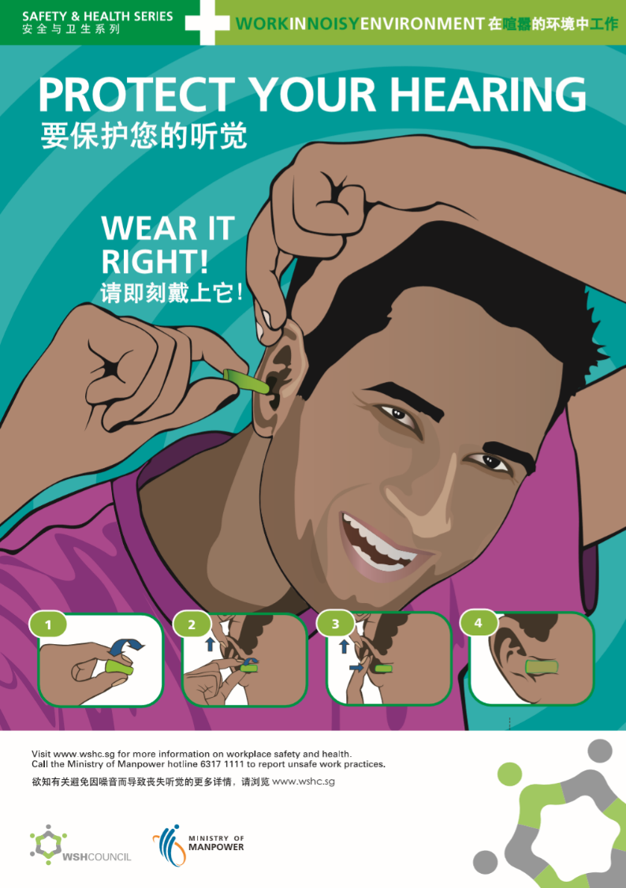
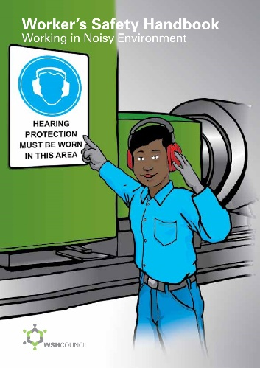
NOISE-INDUCED DEAFNESS
CAN BE PREVENTED
Download at www.wshc.sg/resources

