Slide 1
5 WSH tips for WORKING SAFELY IN EVENT MANAGEMENT
Making Workplaces Safer
Adopt safe work practices

Slide 2
EVENT MANAGEMENT
Covers both indoor and outdoor events
Events can range widely in scale and complexity – from 1-day seminar to public exhibitions to trade fairs that span days.
3 key stages of event management:
Pre-event – Build the event space
Key activities: Tent setup (for outdoor events), stage setup, installation and testing of audio-visual & lighting equipment.
During the event – Execute the event
Key activities: Event programme, operation of audio-visual & lighting equipment, food catering and crowd control/ security.
Post-event – Dismantle the event space
Key activities: Tent takedown (for outdoor events), stage disassembly, takedown of audio-visual & lighting equipment, restore venue to original configuration.
Notes:
There are many kinds of events:
Indoor (e.g. at a function room/ hall, exhibition hall, auditorium, convention centre) vs outdoor (fully outdoor or under a tent)
Short event (0.5 to 1 day) vs long event (lasting days or weeks)
Small scale (few persons) vs large scale (thousands of persons)
In general, there are 3 key stages to event management (see above slide).
Accident prevention and worker safety & health are important at each stage of event management.

Slide 3
EVENT MANAGEMENT
Common accident types during pre-event and post-event:
Slips, trips & falls
Struck by falling object
Struck by vehicle or machine
Falling from height
Cut and stabs
Poor ergonomics
Heat injury
Fatigue
In all 3 stages of event management:
Carry out Risk Assessment to identify on-site hazards and implement suitable risk controls to eliminate or reduce the risk of accident
Notes:
The following slides provide examples of risk controls (non-exhaustive) that you can follow to make your workplace safer while carrying out event management activities.

Slide 4
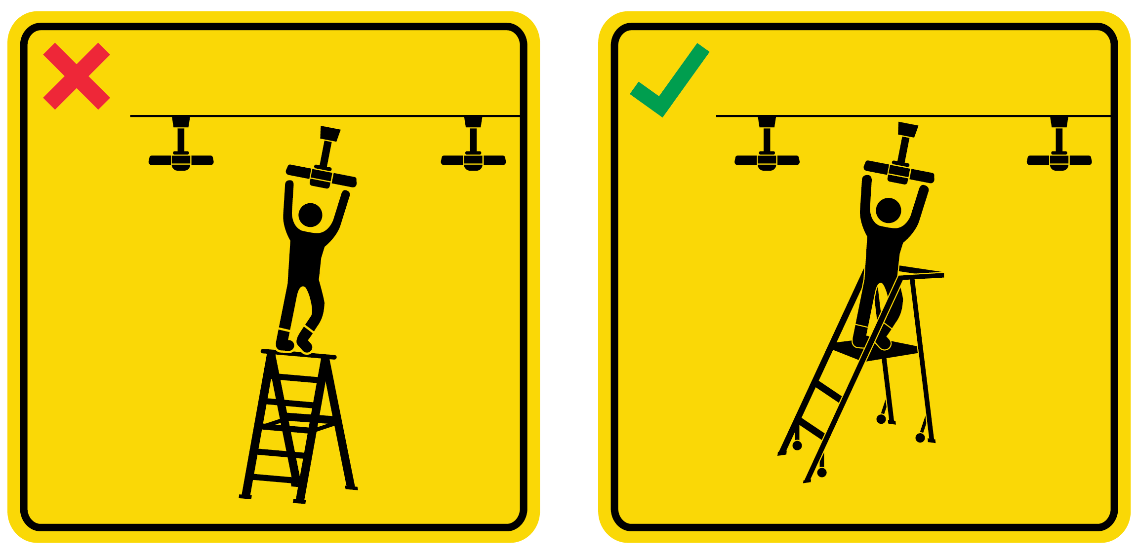
WSH Tip 1
Do not stand on the top rung of a ladder. Use a safer option.
Notes:
Always select a ladder of the appropriate height. A ladder of the correct height will allow you to reach the working height while you are standing on the 2nd or 3rd rung below the top rung of the ladder. Never stand on the top rung of a ladder as you could easily fall from the ladder.
Instead of a ladder, use a safer option where possible e.g. step platform, personnel lift, tower scaffold or scissor lift.

Slide 5
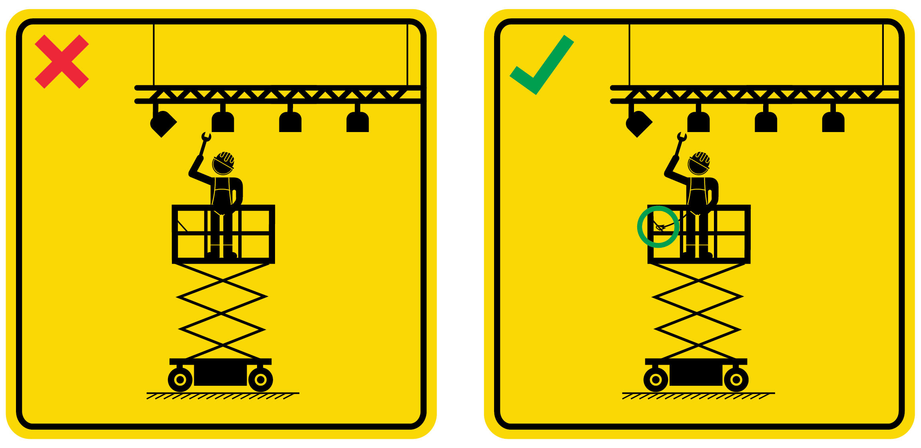
WSH Tip 2
Anchor your harness when working at heights
Notes:
When working on a mobile elevating work platform (MEWP) such as a scissor lift, secure your harness to the designated anchor point.
This is to keep you within the cage of the working platform, thereby preventing you from falling from heights.

Slide 6
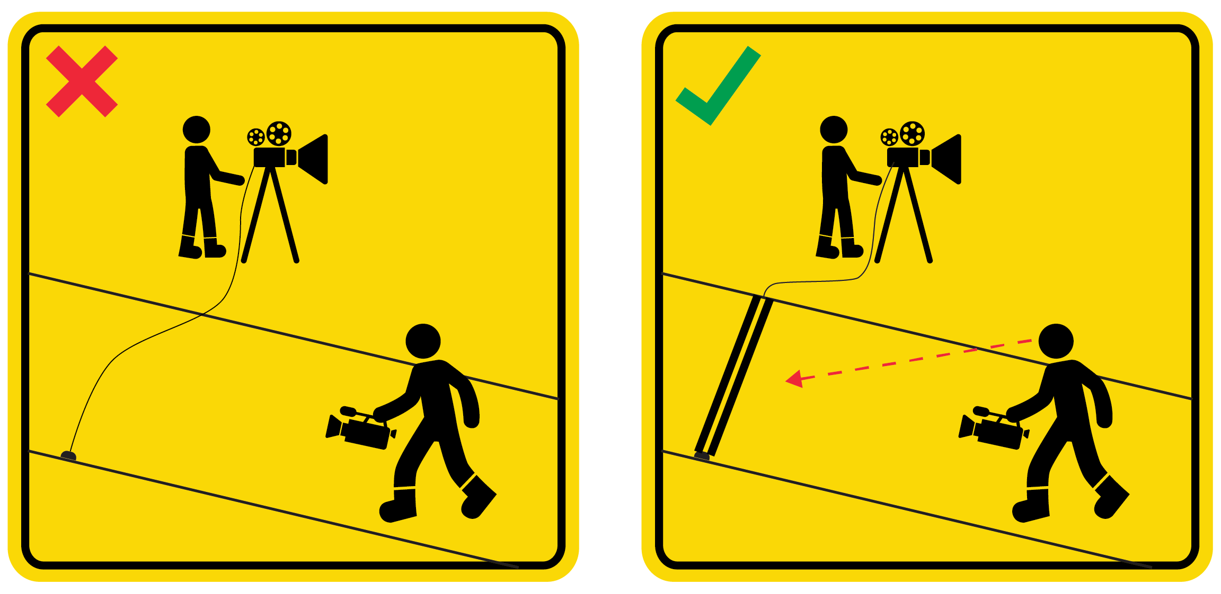
WSH Tip 3
Look out for tripping hazards. Cover floor wiring with cable trench.
Notes:
Be vigilant and always look where you are going.
A brightly-coloured cable trench may be used to cover floor wiring to make such hazards easier to spot and prevent tripping.

Slide 7
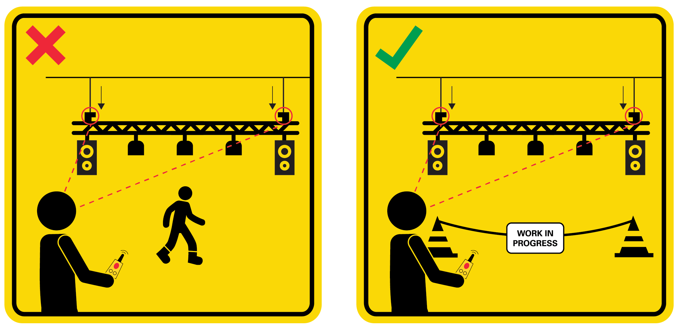
WSH Tip 4
Never suspend a load over any person. Demarcate lifting zones.
Notes:
Do not allow anyone to go under a suspended load during a lifting operation.
This is to ensure that no one will be injured should an object (e.g. audio-visual equipment) fall while it is being lifted.
Clearly demarcate lifting zones with hazard signage and cordoning tape or a suitable barrier.
This is to prevent anyone from straying into the lifting zone including passersby at the event location.

Slide 8
WSH Tip 5
Use a trolley to transport heavy goods
Notes:
To prevent back injury, use a trolley to transport heavy goods.
Should a trolley be not available, fellow colleague(s) may be able to assist you in transferring the heavy load.

Slide 9
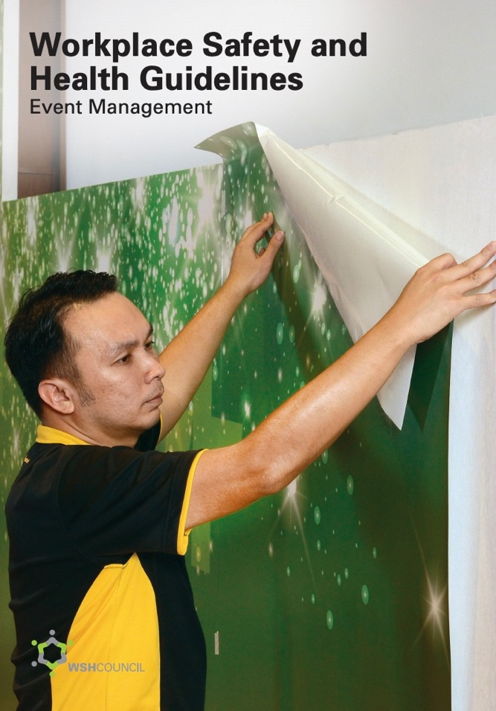
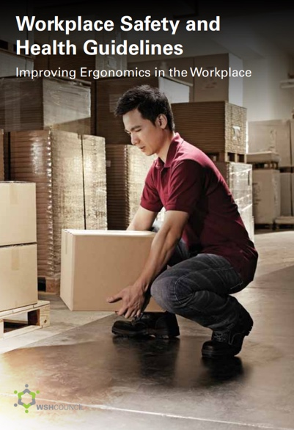
EVENT-RELATED ACCIDENTS
CAN BE PREVENTED
Download at www.wshc.sg/resources

