Slide 1
12 SAFE MANAGEMENT MEASURES FOR WORKERS
Making Workplaces Safer
Adopt safe work practices

Slide 2
WHY SAFE MANAGEMENT MEASURES (SMM) ?
Many companies have resumed work activities since 2 June 2020 after Singapore exited the Circuit Breaker.
Implementing Safe Management Measures (SMM) at the workplace helps to minimise the risk of widespread re-emergence of COVID-19 in the community.
Employers must ensure that SMM is properly implemented, adequately communicated and explained to employees before allowing work to resume.
For more information on SMM:
https://www.mom.gov.sg/covid-19/requirements-for-safe-management-measures
Notes:
As Singapore embarks on a 3-phase approach to resume work activities upon exiting the Circuit Breaker, all workplaces and all employees must adhere to Safe Management Measures to curb the re-emergence of widespread transmission of COVID-19.

Slide 3
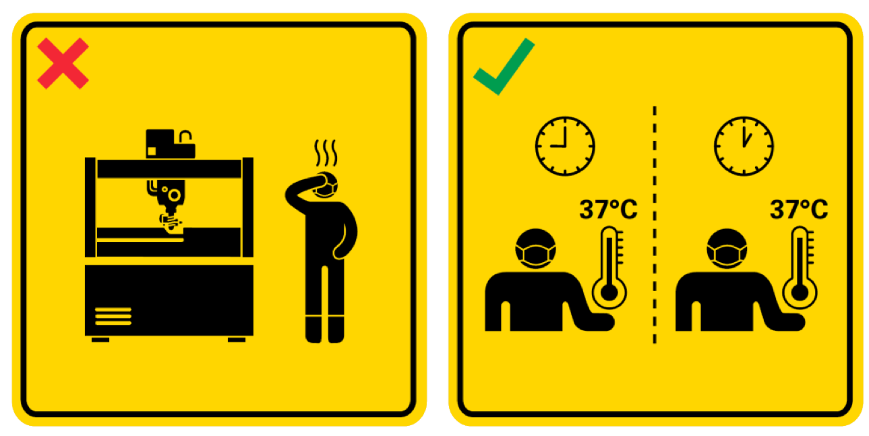
SMM Tip 1
Check temperature twice daily. See doctor if unwell. Do not doctor-hop.
Notes:
Check your temperature at least twice daily. If you are feeling unwell or showing symptoms of illness or respiratory infection, report to your supervisor, leave your workplace and consult a doctor immediately
Do not doctor-hop – this means you should only visit one clinic for medical check-ups if you are unwell. This is to minimise the risk of community spread and so that the same clinic can monitor your progress.

Slide 4

SMM Tip 2
Wash or disinfect hands regularly
Notes:
Observe good personal hygiene by washing and/ or disinfecting your hands frequently throughout the day and refrain from touching your face, to minimise the risk of you being infected.

Slide 5
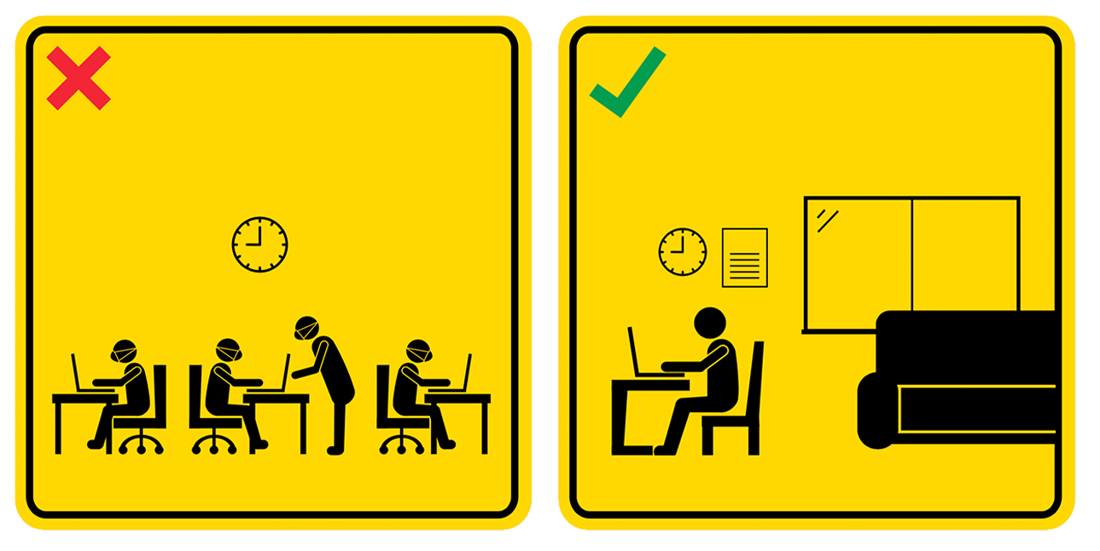
SMM Tip 3
Work from home (WFH) whenever possible
Notes:
Employees are advised to work from home, if possible, during an epidemic/ pandemic – isolation from the community is the best way you & your family can protect yourselves from the risk of community spread.
Also, working from home helps to significantly reduce the density of persons at the workplace, hence reducing the risk of disease transmission. It also helps to reduce the density of persons commuting on public transport (especially trains & buses).

Slide 6

SMM Tip 4
Use the phone, or explore
teleconferencing to communicate.
Notes:
Avoid physical meetings as much as possible and make use of technology options for tele- or video- conferencing.
This helps to reduce contact between persons at the office, thereby lowering the risk of disease transmission.
If there is a critical need for a physical meeting to proceed, limit the number of attendees, maintain safe distancing of at least 1m between meeting participants and keep the meeting as short as possible.

Slide 7

SMM Tip 5
If WFH is not possible, avoid crowds by adopting staggered working hours and meal times.
Notes:
For employees unable to work from home due to the nature of their work (such as frontline operations and fieldwork at construction sites, shipyards or manufacturing plants), employers and principals are to implement staggered working hours so that workers can avoid crowds during peak hours.
The staggered hours should apply to :
Reporting time for work and dismissal time from work (to avoid crowds during the commute to-and-from work)
Start and end time for meals (to avoid crowds at public eating places and/or the office canteen)
Start and end time for breaks (to avoid crowding in the office pantry or rest areas)
Suggestion is to implement staggered working hours over at least three 1-hourly blocks, with not more than 50% of the employees reporting to work or having their meals within each 1-hour block.
For example, if the normal working hours are from 9am to 6pm, employers could stagger employees’ reporting times at one-hour intervals between 7.30 am and 10.30 am (e.g. 7.30 am to 8.30 am, 8.30 am to 9.30 am and 9.30 am to 10.30am), with corresponding staggered timings for end of work.
Do your part to adhere to the staggered working hours and meal times set by your employer or principal.

Slide 8

SMM Tip 6
Use SafeEntry and TraceTogether to facilitate contact tracing
Notes:
Use SafeEntry and TraceTogether to facilitate contact tracing. Contact tracing is crucial for detecting potential cases and preventing possible spread of COVID-19.
The SafeEntry visitor management system is for recording the entry and exit records of all personnel (including employees, contractors and visitors) at your office premises or work site.
The TraceTogether app assists the Ministry of Health to quickly identify those who may have been in close contact with a person deemed to be infectious.

Slide 9
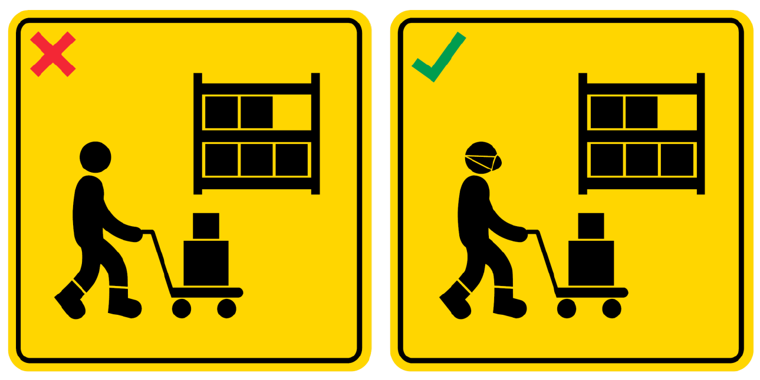
SMM Tip 7
Wear a mask
Notes:
All employees, visitors, suppliers and contractors must wear a mask at the workplace, except during activities that require masks to be removed.
Wearing a mask, coupled with other measures (e.g. safe distancing), helps to prevent or slow down the spread of COVID-19.
Do your part by wearing a mask when at work.

Slide 10
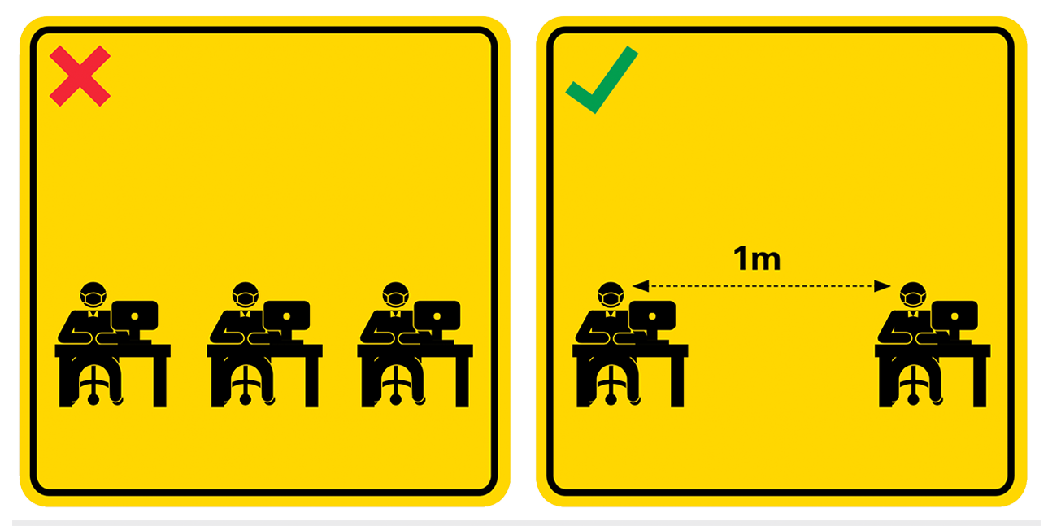
SMM Tip 8
Ensure employees are seated at least one (1) metre apart
Notes:
Employers must provide for wider physical spacing (at least 1m apart) between employees at the workplace e.g. by manually separating or by clearly marking out the workstations that can be used to achieve the 1m spacing.
Seating in boardrooms and meeting rooms should also be spaced at least 1m apart and clearly marked.
This 1m safe distancing helps to significantly reduce the density of persons at the workplace, thereby lowering the risk of disease transmission.
The same safe distancing measures should also apply to common spaces such as office entrances/ exits, lifts, pantries/ canteens, and at any place where congregation or queuing of employees or visitors/ clients may occur.
Do your part to adhere to these safe distancing measures.

Slide 11
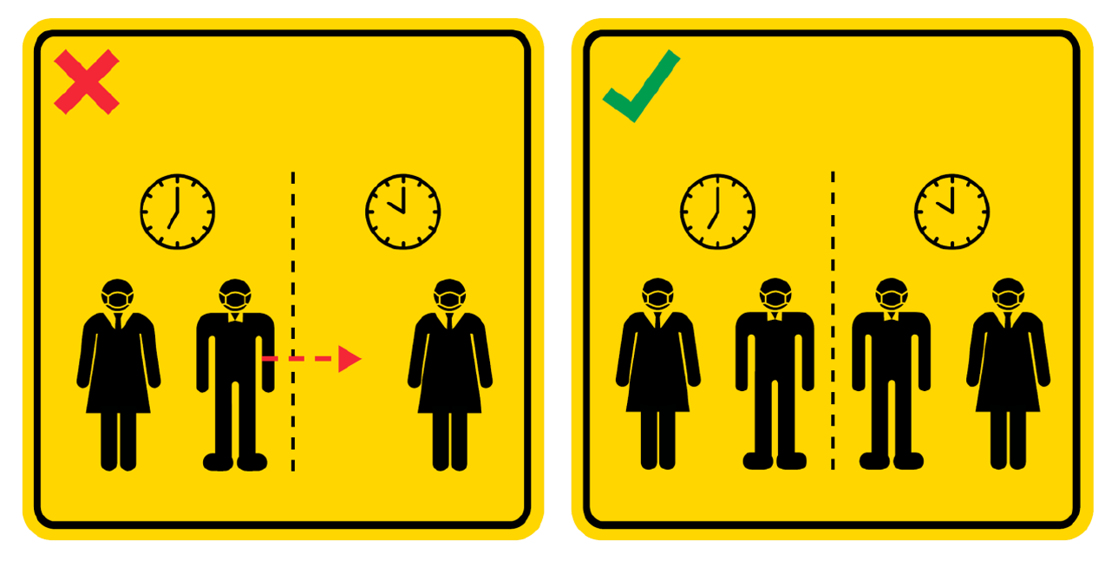
SMM Tip 9
Remain in your split team. Do not cross teams or physically interact across teams both during and outside work.
Notes:
Remain in your assigned split team and do not cross teams or physically interact across teams both during and outside working hours.
This is to prevent cross infection between split teams so that your company/ organisation can continue operations as part of its business continuity plan.

Slide 12
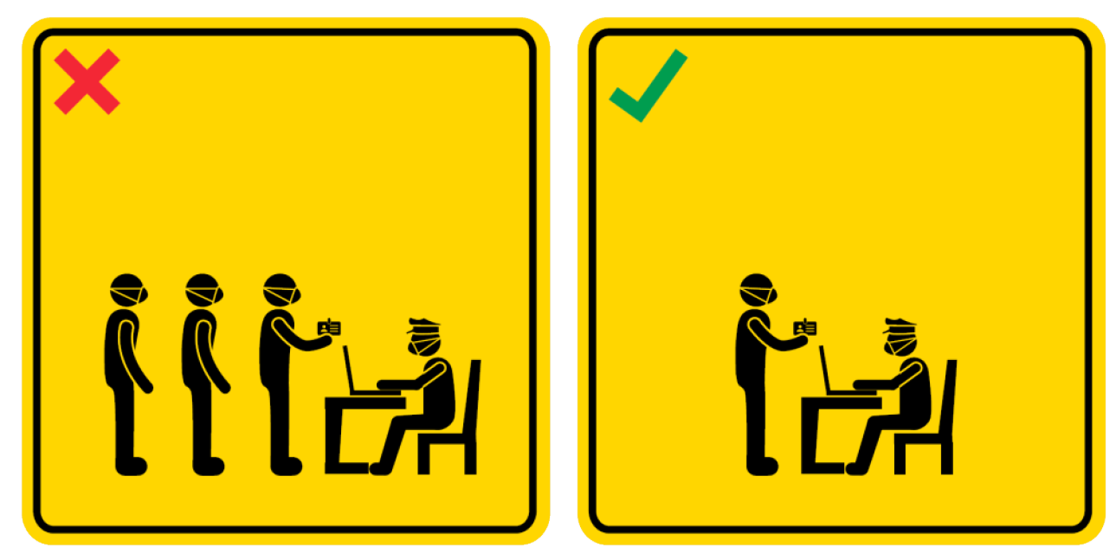
SMM Tip 10
Avoid inviting non-essential visitors to your workplace
Notes:
Do not invite non-essential visitors to your workplace. This helps to minimise the number of visitors/ persons at your workplace.

Slide 13
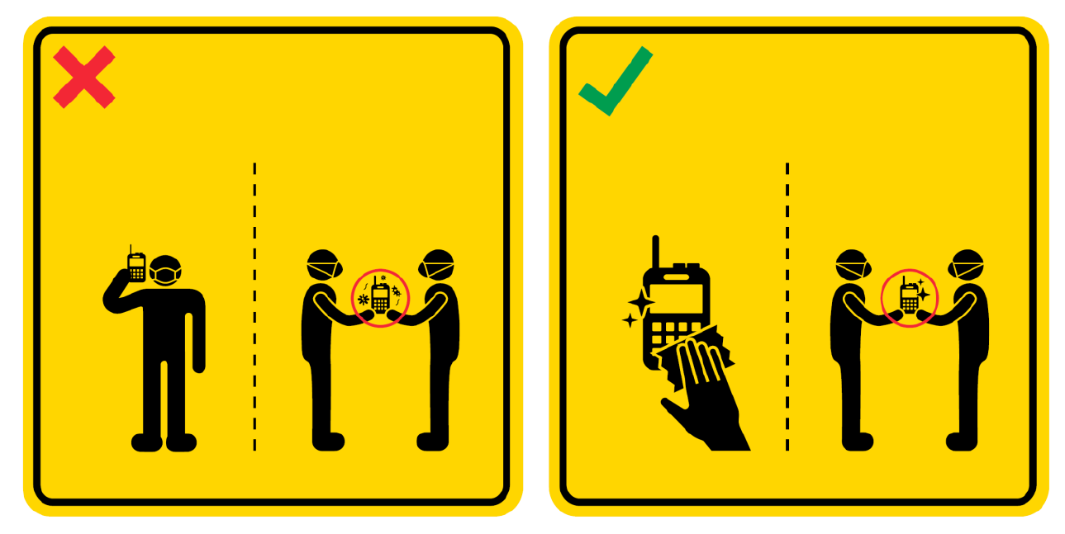
SMM Tip 11
Clean and disinfect shared items before changing hands
Notes:
Machinery and equipment shared between different employees (e.g. walkie talkies) across different shifts or alternate teams must be cleaned and disinfected before changing hands.
This is because viruses can survive on the surfaces of different materials for hours (even days), therefore any machinery or equipment surface potentially contaminated with a virus should be sanitised thoroughly before passing it on.

Slide 14
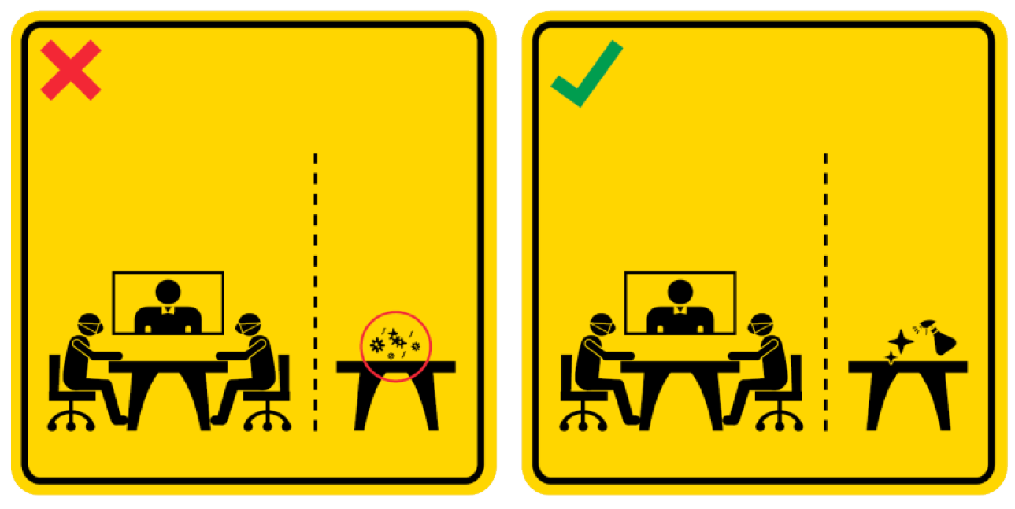
SMM Tip 12
Clean and disinfect places with high human contact
Notes:
Common areas, particularly areas with high human contact, must be frequently cleaned. Areas where physical meetings are held or meals are taken must be cleaned and disinfected thoroughly between each meeting or sitting.
In particular, surfaces which may have been exposed to respiratory droplets after a sneeze or cough (e.g. meeting or dining tables) and commonly touched surfaces (e.g. door knobs or tap handles) need to be sanitised thoroughly and frequently.
Some other examples of areas with high human contact are counters where customers are served, rooms where visitors are hosted, as well as general public access areas such as lifts, toilets and bin areas.

Slide 15
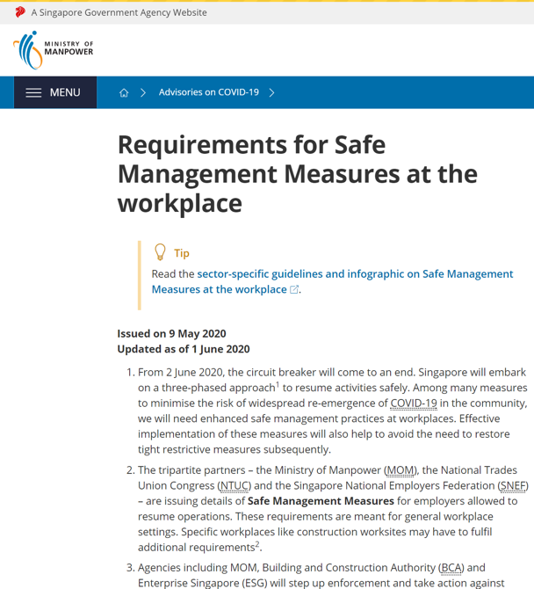
ADHERE TO SAFE MANAGEMENT MEASURES TO REDUCE RISK OF DISEASE TRANSMISSION
Read more at:
https://www.mom.gov.sg/covid-19/requirements-for-safe-management-measures

